Slide 1
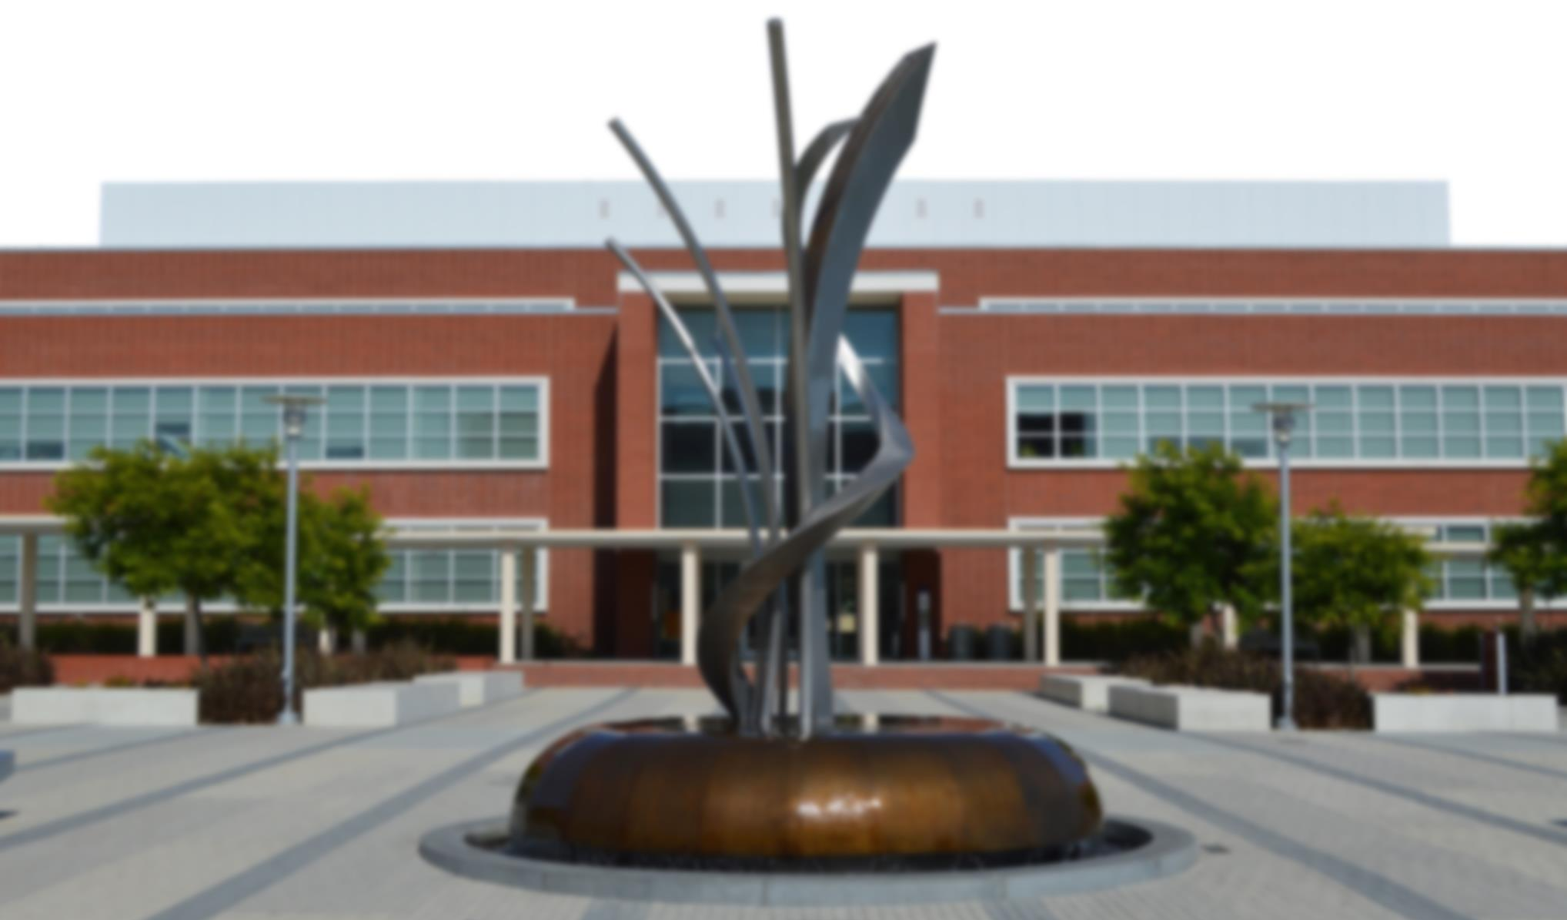
City of Richmond, California RNCC Budget Presentation
June 13, 2016

Slide 2
City Goals in Budget Initiatives
Build and maintain a minimum 10 percent unrestricted budget reserve
Create a budget structure where recurring revenues exceed recurring expenses
Repair and maintain the City’s roads by creating revenues in excess of that needed to maintain fund balance
Maintain City’s investments in parks, libraries, and other public buildings by setting aside monies for repairs as they are needed
Craft a compensation plan that is competitive but affordable

Slide 3
Issues in Achieving a Balanced Budget
City has little control over revenues
Reducing non-personnel costs is not sufficient
Reducing personnel costs:
Can lead to reductions in service
May require a meet and confer process with unions
Maintenance of City buildings, parks, and roads requires a capital infusion above-and-beyond current budgeted amounts
Revenue reductions are likely in next recession
Impact of “Richmond Kids First Initiative” could divert $4.5M of GF revenue by FY21

Slide 4
Eliminating the FY17 Budget Gap
Expense/Revenue Opportunity | Change in Net Revenue | Service Impacts
Move ancillary programs to non-General Fund sources | $1.0 million | None unless other funding not available
Reduce Personnel Costs Benefit Cost Sharing Overtime Eliminate Vacant Positions Increase revenue recovery in development departments | $5.0 million | - Impact on employees - Service impacts from lower OT and fewer employees to provide services
Non-Personnel Costs Vehicle replacement reduction Reduced contracts/prof. serv. Increase Code Enforcement fines | $3.0 million | Use of older vehicles Loss of outside professional assistance Potential service impacts in non-GF departments
Use One-Time Money Insurance Liability Worker’s Comp. Liability | $2.0 million | - Reduced one-time money for road maintenance and budget reserve
Total Cumulative Savings | $11.0 million

Slide 5
Long-Term Budget Recommendations
Opportunity | Benefit
Have employees pay portion of OPEB liabilities | Creates ongoing source of revenue to help guarantee long-term retiree healthcare
Allocate revenue above a 10% operating reserve to capital/maintenance costs | Provides targeted funding for road, park, and building maintenance
Utilize a percentage of property tax revenue from new development for road resurfacing | Provides an ongoing benefit to existing City residents from new development
Evaluate all structural budget changes (e.g., salary increases, new or expanded programs) in the City’s 5-year budget model | Ensures program sustainability and allows City to avoid budget deficits that threaten critical programs

Slide 6
Conclusions
Choices the City makes in FY17 are critical to ongoing fiscal sustainability of the City
Definitive action is required by the Council in developing the FY17 budget this spring to reset the City’s baseline budget
Cuts in spending are required to balance an $11M deficit
Impacts to employees are unavoidable (cost-sharing and/or position reductions)
Service levels may be reduced
The City does not have sufficient reserves to fund the FY17 deficit, and using any reserves in FY17 will put the City in a precarious position in FY18 and beyond
Future cost-of-living increases will depend on creating more budget room

Slide 7
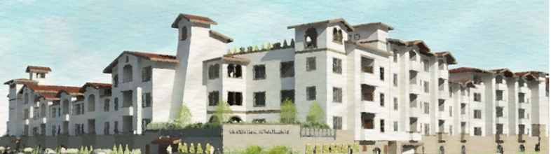
Richmond Central Ave Project 155 Affordable Apartments Central Avenue & San Mateo Street
Notes:
DRB Pending

Slide 8
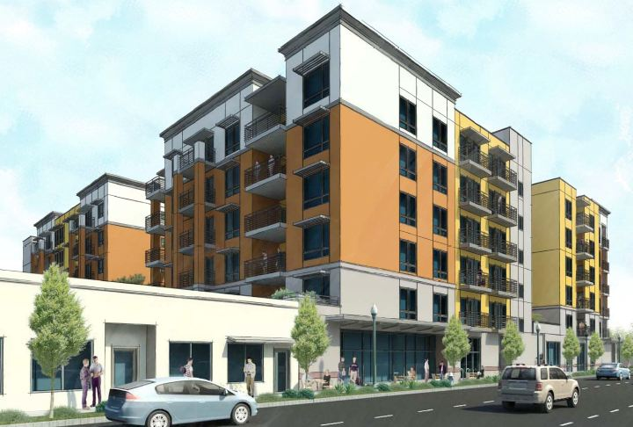
Nevin Homes Residential 289-Unit Affordable Apartments Twenty Three Nevin Avenue
Notes:
Began Construction

Slide 9
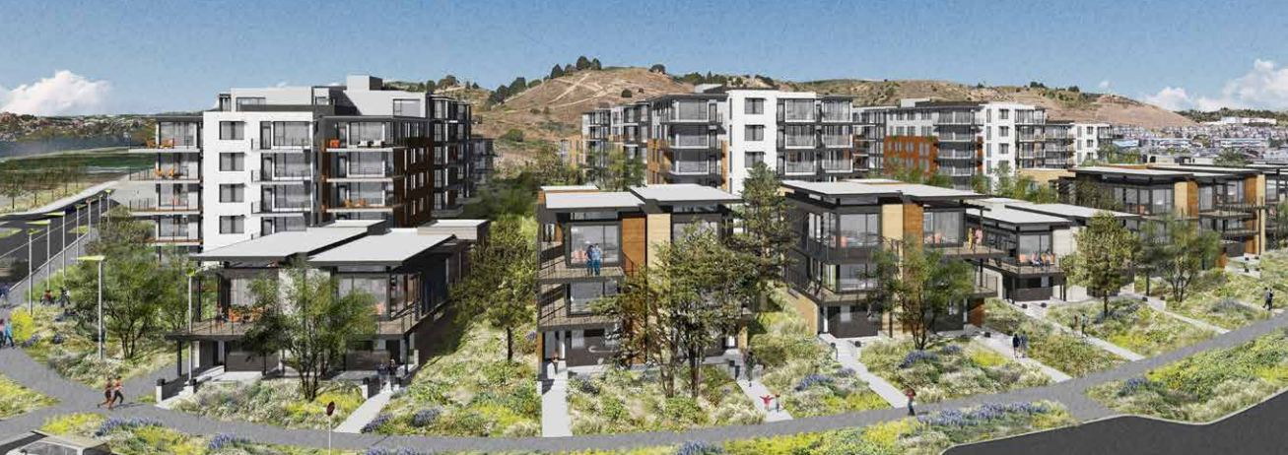
Terminal I
334-Unit Residential Community – Dornan Drive & Brickyard Cove Road
Notes:
Begin construction 2016-17

Slide 10
Mayor’s Office Projects
2nd St. Land Acquisition (Rails to Trails)
Affordable Housing Strategy Document
Beacon Programs
Citizens for Action Network
Home Front Festival Committee
Mayor’s Community Fund
North Richmond Annexation
Open Data Initiative
Pesticide Free City Symposium
Rail~Volution Conference
Resource Guides
Richmond Food Census
SunShot Competition
Urban Garden Contest

Slide 11
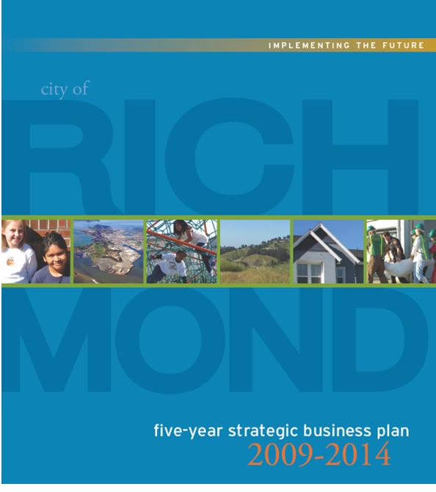
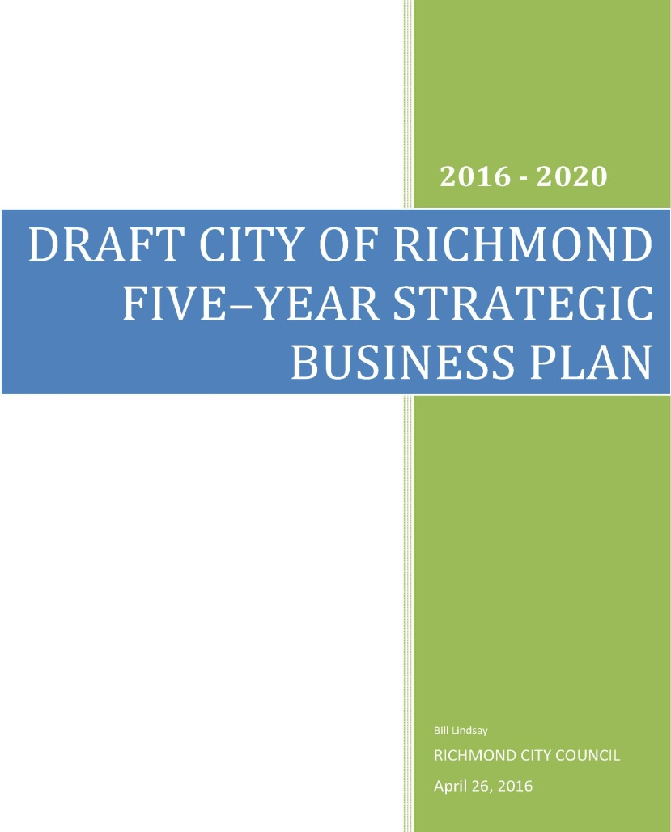
2016-17 Goals
Update the Five-Year Strategic Business Plan

Slide 12

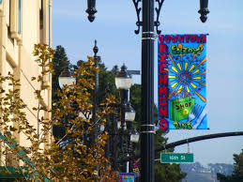
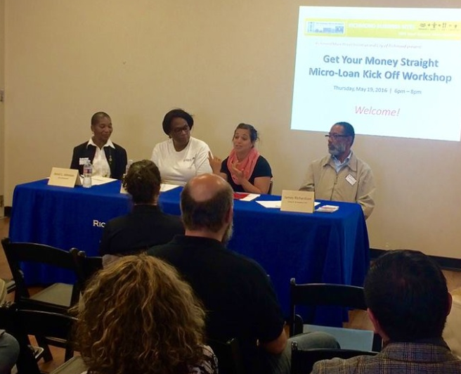
2016-17 Goals
Develop a City-wide targeted retail strategy including Hilltop and Downtown
Develop a new San Francisco Business Times Richmond issue
Increase the number of small business loans

Slide 13
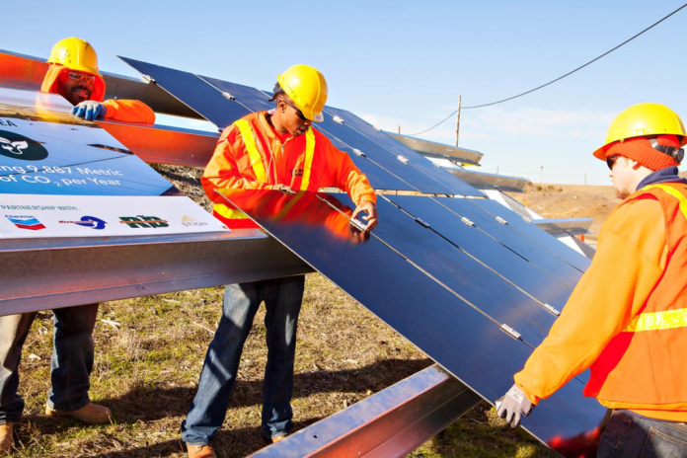


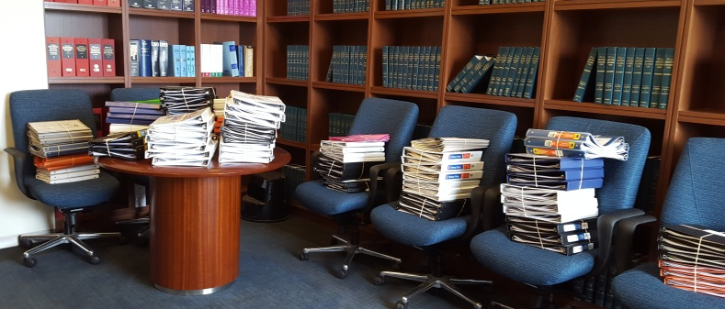
2016-17 Goals
Develop, implement and provide oversight for various
ECIA-funded projects
Solar Programs
Climate Action Plan
Competitive Grant Program
Notes:
Competitive grant program – received 98 applications totaling over $5 million in requests

Slide 14




2016-17 Goals
Implement energy efficiency and renewable programs
Notes:
Promote Sustainable Communities: Implement energy efficiency and renewable programs (Chapter 4.7)
Develop an any-income residential solar program
-Leverage existing programs and rebates to improve energy efficiency of existing buildings.
-Leverage existing funding programs and financing tools.
-Increase local solar energy generation.
-Promote and maximize utility clean energy offerings.
-Promote switching from natural gas to clean electricity.
Solar home energy program (Grid Alternatives)
Residential HERO PACE
Commercial HERO PACE
California First
Marin Clean Energy
Smart Lights (Businesses)

Slide 15
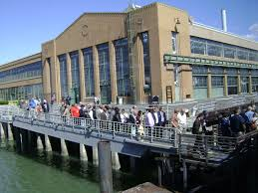
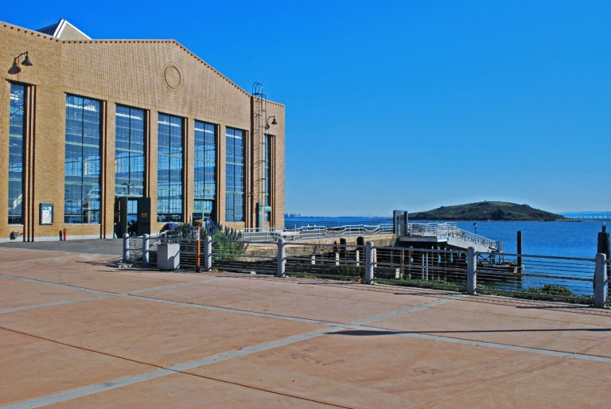
2016-17 Goals
Bring Ferry Service to Richmond in 2018

Slide 16
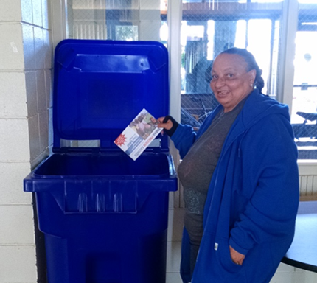
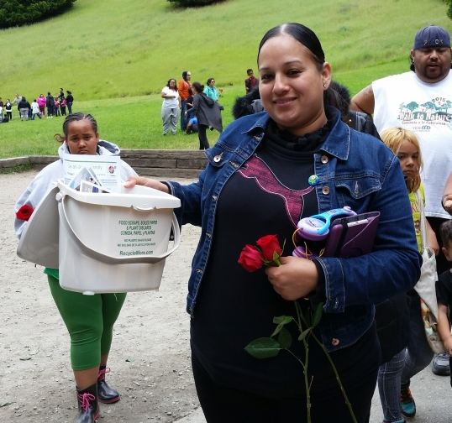
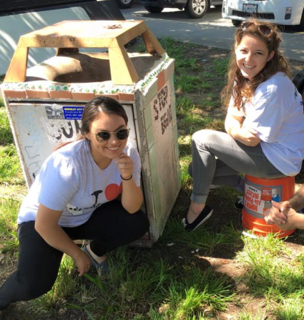
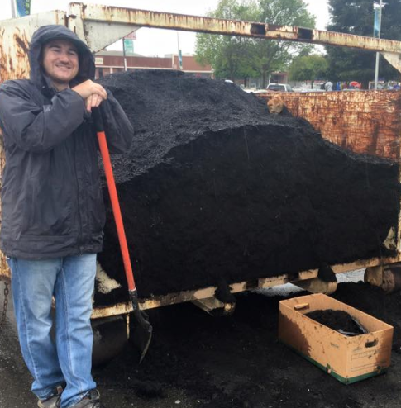
2016-17 Goals
Implement diversion programs such as recycling & food scrap programs
Notes:
Promote Sustainable Communities: Implement diversion “Recycling” programs (Chapter 4.8)
-Continue to promote, improve, and expand bulky item program collection Services
-Implementing initiative to add a recycling option to trash receptacles along city streets and in seven high-use Richmond parks.
-Collaborate with WCCUSD and RecycleMore to implement three stream recycling programs at Richmond schools.
-Target multi-family and businesses to increase enrollment in recycling and compost programs
-Negotiate franchise of industrial waste and recycling collection services with Republic Services to further incentivize recycling participation for industrial businesses.
-Integrate construction and demolition waste CalGreen requirements with Building Services Department requirements and evaluate adopting C&D ordinance
Recycling programs a recycling workshops for staff and residents (ex. Nevin Plaza Apartment Complex).
Sharps Containers
Richmond High Schools Diversion
Mattress Recycling
Compost Giveaway

Slide 17
General Fund Budget Summary
Original Projection – May 3, 2016:
Total Revenues | 148,054,112
Total Expenses | 161,677,813
Net Surplus/(Deficit) | (13,623,701)
Additions/(Reductions):
Vacancies eliminated | (315,302)
Subsidies reduced | (1,087,015)
Part-time temp reduced | (1,297,943)
Additional rental income revenue | 23,268
Department restructuring | (835,418)
Current Net Surplus/(Deficit) | (10,111,291)

Slide 18
General Fund Budget Summary
Budget Projection – May 17, 2016:
Total Revenues | 149,619,818
Total Expenses | 159,731,108
Net Surplus/(Deficit) | (10,111,291)
Additions/(Reductions):
Vacancy savings | 500,000
Targeted operating savings | 500,000
Police sworn vacancy savings | 600,000
Police sworn overtime reduction | 300,000
Police professional services reduction | 200,000
Fire sworn overtime reduction | 200,000
Utilities reduction | 200,000
Miscellaneous operating reductions | 91,367
General liability and workers comp reductions | 2,197,442
Current Net Surplus/(Deficit) | (5,322,482)

Slide 19
General Fund Budget Summary
Budget Projection – May 31, 2016:
Total Revenues | 149,619,818
Total Expenses | 154,942,300
Net Surplus/(Deficit) | (5,322,482)
Additions/(Reductions):
Eliminated subsidy to Housing Department | 233,058
Transfer in from Marina Fund | 86,778
Police part-time temp reduction | 25,681
Library positions funded by grants/ECIA | 214,388
Net Surplus/(Deficit) | (4,762,577)

Slide 20
General Fund Budget Summary
Budget Projection – June 7, 2016:
Total Revenues | 149,706,596
Total Expenses | 154,469,173
Net Surplus/(Deficit) | (4,762,577)
Recommended Reductions:
City Council | 7,000
City Manager | 50,000
City Clerk | 84,375
City Attorney | 30,000
Finance | 3,000
Human Resources | 33,000
Police | 144,880
Office of Neighborhood Safety | 40,000
Infrastructure & Maintenance Operations | 290,000
Library | 130,000
Community Services | 100,000
Information Technology | 88,155
Capital Improvement Department | 150,186
Non-Departmental | 735,680
Total Reductions | 1,886,276
Current Net Surplus/(Deficit) | (2,876,301)

Slide 21
One-Time Cash Events
One-time cash events (not revenue):
Repayment of Port loan
Repayment of RHA loan
One-time cash events (revenue):
Sale of Surplus Property
One-time cash events should not be used to balance the budget, but can be used to fund:
Capital projects
Additional street paving
Reduction in unfunded OPEB liability
Deferred Maintenance

Slide 22
THANK YOU & QUESTIONS

