Slide 1
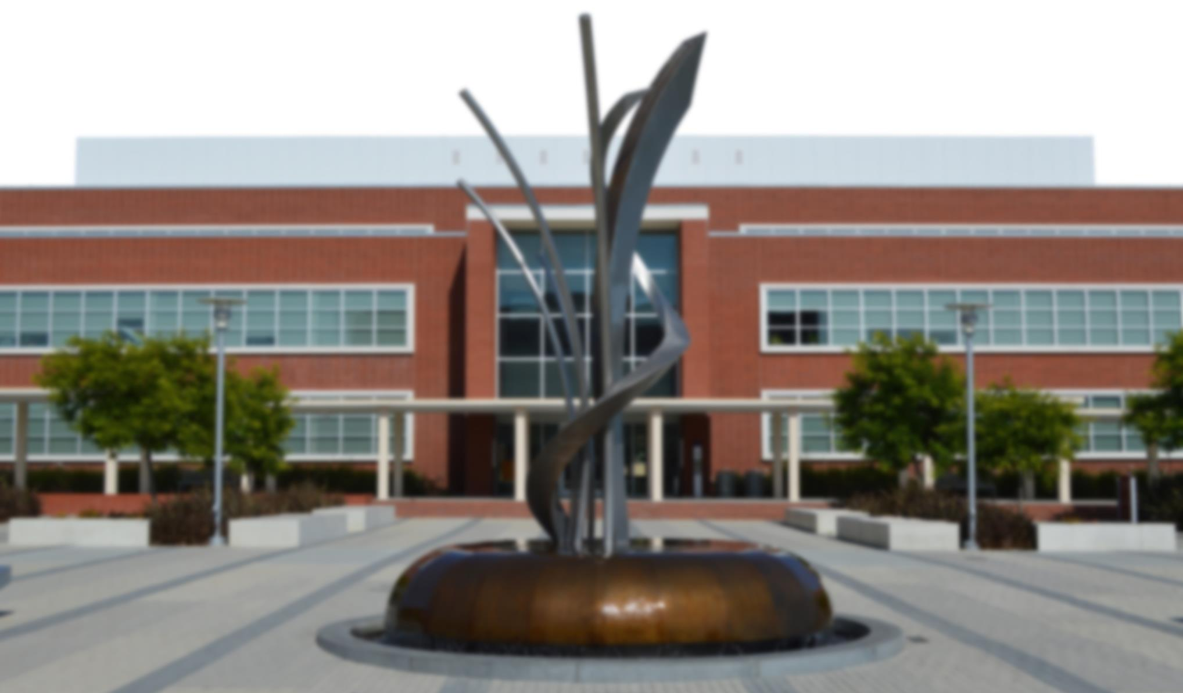
City of Richmond, California FY2017-18 Draft Budget
May 2, 2017

Slide 2
Schedule
Council Meeting Date | Activity
May 2nd | Receive an overview of the first drafts of operating and capital budgets and establish the process and schedule for City Council review and final approval.
May 16th | Receive departmental presentations (summary level) regarding revenues and expenditures.
May 23rd | Continue to receive departmental presentations (summary level) regarding revenues and expenditures (as necessary following May 16th meeting). Receive a report and recommendations from the Council-directed budget committee of the City’s bargaining units. Initiate City Council review and discussion of draft operating and capital budgets.
May 30th (if deemed necessary following May 23rd discussion) | Continue City Council review and discussion of draft operating and capital budgets.
June 6th | Continue City Council review and discussion of draft operating and capital budgets. Initiate the process to provide staff direction concerning additions and deletions from the budget.
June 20th | Conclude the process to provide staff direction concerning additions and deletions from the budget.
June 27th | Adopt the Fiscal Year 2017-18 Annual Operating Budget and Fiscal Years 2017-22 Five-Year Capital Improvement Budget.

Slide 3
Department Presentations
Departments will be allowed a maximum of five minutes to present their mission, goals, staffing, and draft budget
Presentations are as follows:
Office of the Mayor | Information Technology | Community Services
City Council | Office of Neighborhood Services | Employment & Training
Police Commission | Police Department | Port Operations
City Manager | Fire Department | Capital Improvement Department
City Clerk | Planning & Building | Housing Department
City Attorney | Water Resource Recovery | Successor Agency
Finance Department | Infrastructure Maintenance & Operations | Richmond Housing Authority
Human Resources | Library & Cultural Services

Slide 4
General Fund Revenue
 | FY2016-17 Revised Budget | FY2017-18 Draft Budget | % change
Property Taxes | 37,296,608 | 38,782,023 | 4.0%
Sales & Use Tax | 40,906,608 | 41,796,531 | 2.2%
Utility Users Tax | 44,657,538 | 45,916,543 | 2.8%
Other Taxes | 10,847,864 | 11,593,174 | 6.9%
Licenses, Permits & Fees | 5,663,753 | 8,509,290 | 50.2%
Charges for Services | 3,345,295 | 3,627,454 | 8.4%
Grants | 3,214,918 | 1,392,476 | -56.7%
Other Revenue | 2,297,245 | 2,181,061 | -5.1%
Transfers In | 4,068,506 | 5,260,657 | 29.3
Total Revenue | 152,298,334 | 159,059,209 | 4.4%

Slide 5
General Fund Expenditures
 | FY2016-17 Revised Budget | FY2017-18 Draft Budget | % change
Salaries | 69,859,418 | 70,661,968 | 1.1%
Benefits | 44,969,222 | 49,894,647 | 11.0%
Professional & Admin Services | 9,635,148 | 8,586,179 | -10.9%
Other Operating | 6,912,390 | 7,521,888 | 8.8%
Utilities | 3,278,378 | 3,277,559 | 0.0%
Cost Pool | 15,857,586 | 16,358,732 | 3.2%
Debt Service Expenditures | 1,213,080 | 1,249,533 | 3.0%
A87 Cost Plan Reimbursement | (5,895,770) | (4,433,155) | -24.8%
Transfers Out | 6,277,632 | 6,807,386 | 8.4%
Total Expenditures | 152,107,085 | 159,924,737 | 5.1%

Slide 6
Benefits Costs
Benefits | FY2016-17 Revised Budget | FY2017-18 Draft Budget | % change
California Public Employees’ Retirement System (CalPERS) | 22,855,828 | 25,369,623 | 11.0%
Other Post Employment Benefits (OPEB) | 8,378,827 | 10,506,235 | 25.4%
OPEB Employee Contributions | - | (1,622,700) | 100%
Workers Compensation | 8,467,644 | 8,430,692 | -0.4%

Slide 7
Staffing Summary
 | Adopted FY2014-15 | Adopted FY2015-16 | Adopted FY2016-17 | Proposed FY2017-18
Total FTEs | 767.2 | 738.7 | 725.2 | 719.0

