Slide 1
Regular Meeting of the Richmond Rent Board
May 16, 2018 | City Council Chambers

Slide 2
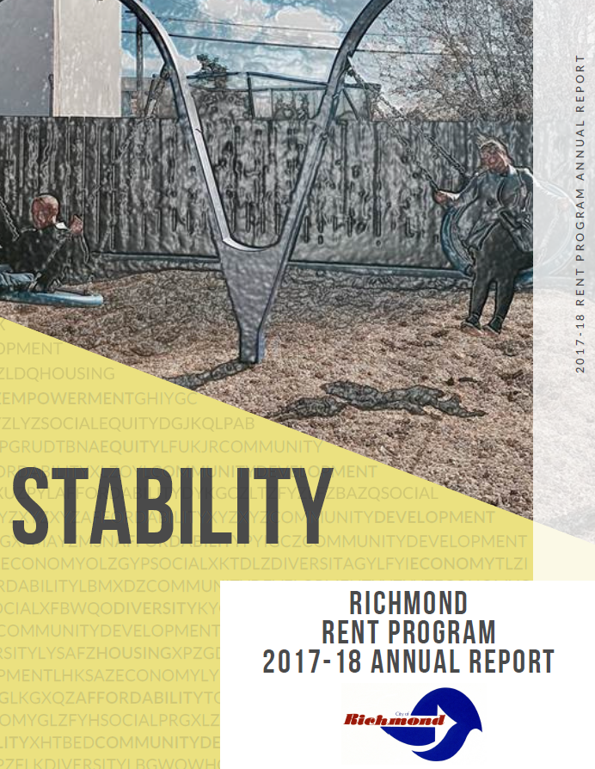
2017-18 Richmond Rent Program Annual Report
Item H-1
May 16, 2018 Rent Board Meeting
Notes:
-Remember to acknowledge Brenda – Brenda worked closely with staff to format and present the report in its current form
-This has been a year of many firsts – this presentation is regarding the Rent Program’s first annual report on the status of rental housing
-The theme of this year’s annual report is “Stability,” since, as you’ll see, it aligns well with our mission statement.

Slide 3
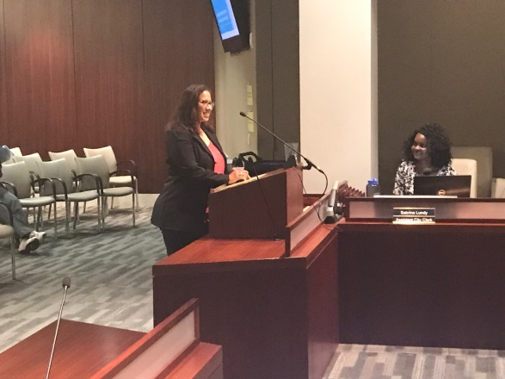
background
Section 11.100.060(e)(6) of the Fair Rent, Just Cause for Eviction, and Homeowner Protection Ordinance (“Rent Ordinance”) requires that the Rent Board report annually to the City Council on the status of rental housing covered by the Rent Ordinance.
At a minimum, the report must include:
A summary of the notices served and the basis upon which they were served.
The amount of the rent increases and the addresses for which they were served.
Staff members are seeking approval of the Annual Report from the Rent Board prior to its presentation to the City Council.

Slide 4
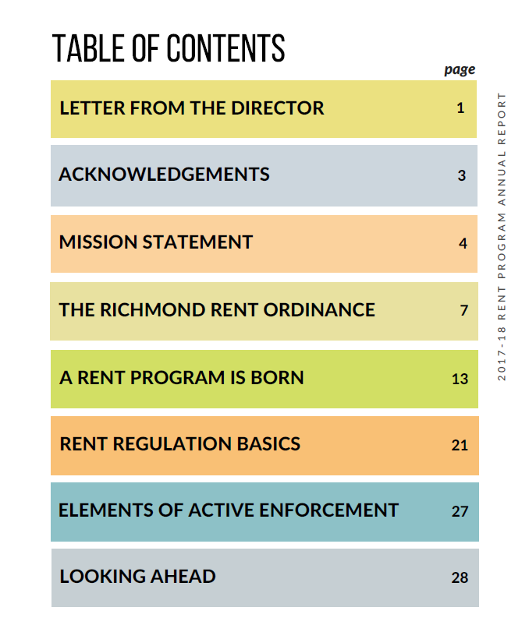
contents of the 2017-18 annual report
The Rent Program’s first Annual Report includes the following chapters:
A letter from the Executive Director
Acknowledgments of staff members and volunteers
Rent Program mission statement
Overview of the Rent Ordinance
Development of the Rent Program
Rent Regulation Basics
Elements of Active Enforcement
Our goals for Fiscal Year 2018-19
Notes:
-This presentation will not address each of these items in detail; however, we encourage all to read the report and provide us with your feedback

Slide 5

acknowledgments
The Rent Program would like to acknowledge the following City staff members and volunteers, who provided critical leadership, policy development, and administrative support for the launch and early development of the Rent Program:
RENT PROGRAM STAFF:
Andrea Zuniga
Brenda Ogutu
Charles Oshinuga
Cynthia Shaw
Magaly Chavez
Mariah Fairley
Michael Roush (Contract)
Moises Serano
Nicolas Traylor
Paige Roosa
Paul Cohen
Philip Verma
Ramona Howell
Vickie Medina
CITY STAFF:
Alex Walker-Griffen
Bill Lindsay
Coreyana Whatley
David Padilla
Gabino Arredondo
Miguel Flores
Mike Uberti
Randall Narron
Saidy Brizuela
Shané Johnson
Shasa Curl
Sherry Drobner
Steve Furtado
Sue Hartman
Sue Kadlec
Trina Jackson
VOLUNTEERS:
Daniel Tu
Jorge Morales Martinez
Lynn Tu
Brian Lewis
Lynne Therriault
Rent Program staff
Notes:
-An important part of the annual report, and this annual report specifically, is to acknowledge everyone who has helped the Rent Program get to this point.
-The development and launch of the Rent Program was incubated in the City Manager’s Office; without their leadership and guidance of the City Manager Bill Lindsay, Administrative Chief Shasa Curl, and Management Analysts Gabino Arredondo and Mike Uberti, the Rent Program would have been extremely challenged in its early days. We received a great deal of admin support from Shane Johnson and Sue Kadlec in the Manager’s Office as well.
-The IT Departmetn has been a tremendous help – we would like to thank IT Director Sue Hartman, Systems Manager Steve Furtado, and Senior Programmer Randall Narron, specifically, for their technical assistance with our database development and mass mailings
-I would also like to acknowledge some of the amazing interns we’ve worked with - -Coreyana Whatley, David Padilla, Miguel Flores, Saidy Brizuela, many of whom we were introduced to by Ms. Trina Jackson in the City Council Office. We appreciate the help of her team immensely.
-Many thanks are owed to Sherry Drober in LEAP on the first floor for allowing us use of the LEAP computer labs in the early days.
-And last, but certainly not least, we wanted to acknowledge the numerous volunteers who devoted time and energy to the Program’s startup; namely Daniel Tu, Jorge Morales Martinez, Lynn Tu, Brian Lewis, and Lynn Therriault.

Slide 6
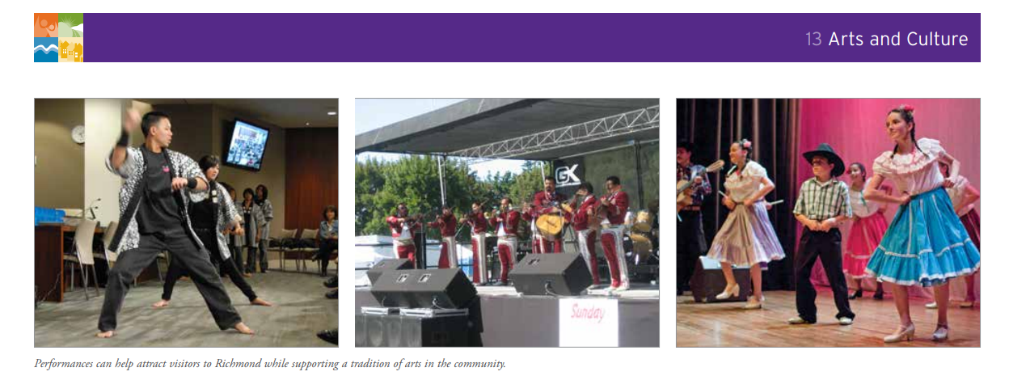
Rent program mission statement
The mission of the Rent Program is to strengthen the community by providing
housing stability for Richmond residents. The Rent Program strives to ensure housing stability for Richmond residents by limiting rent increases and protecting tenants in good standing from unwarranted, arbitrary, discriminatory, or retaliatory evictions while providing Landlords with a fair return.
The primary objectives of the Rent Program are:
To provide housing stability for Tenants;
To encourage and maintain the social, cultural, and economic diversity the City of Richmond proudly represents; and
To provide Landlords with a fair return.
Richmond General Plan 2030

Slide 7
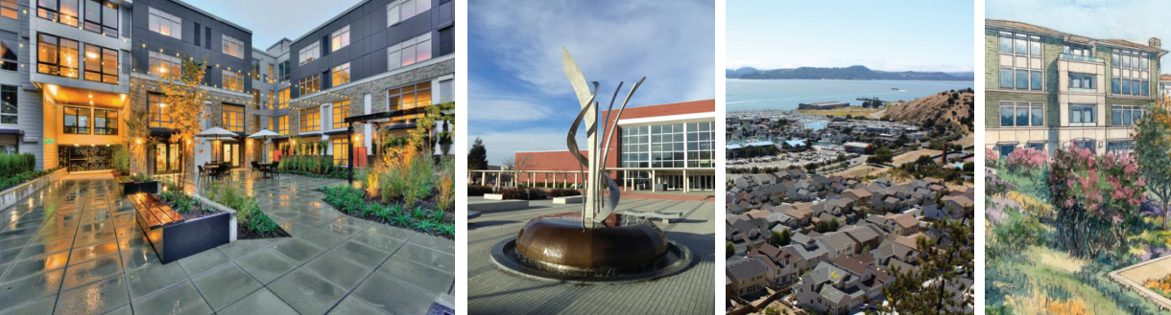
Purpose of the rent ordinance
PROMOTE neighborhood and community stability, healthy housing, and affordability for renters in the City of Richmond by
CONTROLLING excessive rent increases and arbitrary evictions to the greatest extent allowable under California law, while providing Landlords a fair return.
Richmond General Plan 2030 5TH Cycle Housing Element Update

Slide 8

Main components of the rent ordinance
Multifamily Properties built before 1995 are rent-controlled
Just Cause for Eviction requirements apply to most Rental Units and Tenants
Landlords must file Rent Increase and Termination of Tenancy Notices with the Rent Program
Landlords must enroll all Rental Units and
pay the Rental Housing Fee
The Rent Board is the Program’s
appointed governing body
Richmond Rent Board

Slide 9
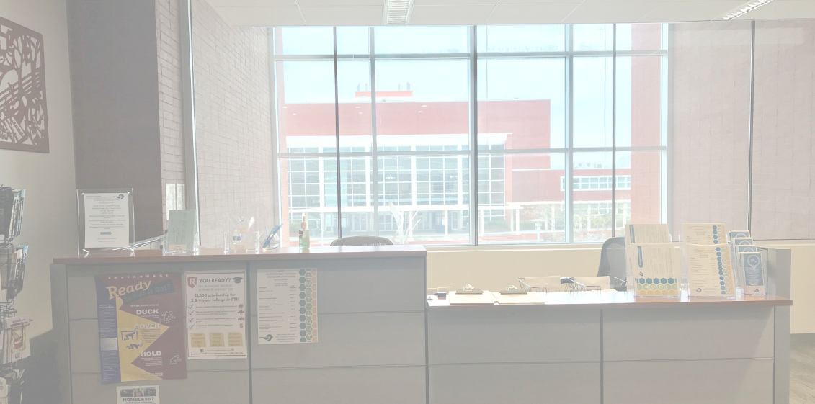
Main components of the rent program department
Holistic Counseling on the Rent Ordinance and State law
Community engagement and outreach
Informal and formal mediation services
Referrals to Community Services Agencies
Support with the completion of Rent Program forms and the Rent Adjustment Petition process
The Rent Program office is located on the second floor of 440 Civic Center Plaza at City Hall.

Slide 10
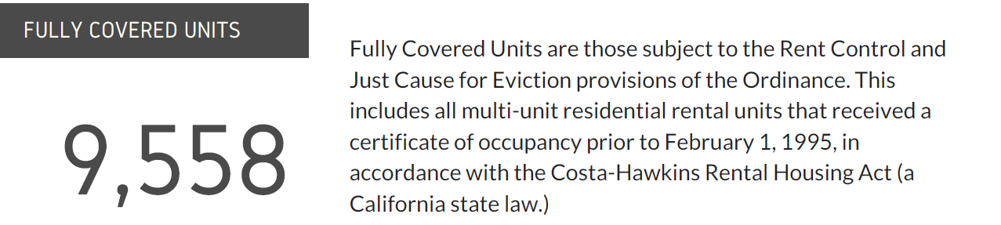
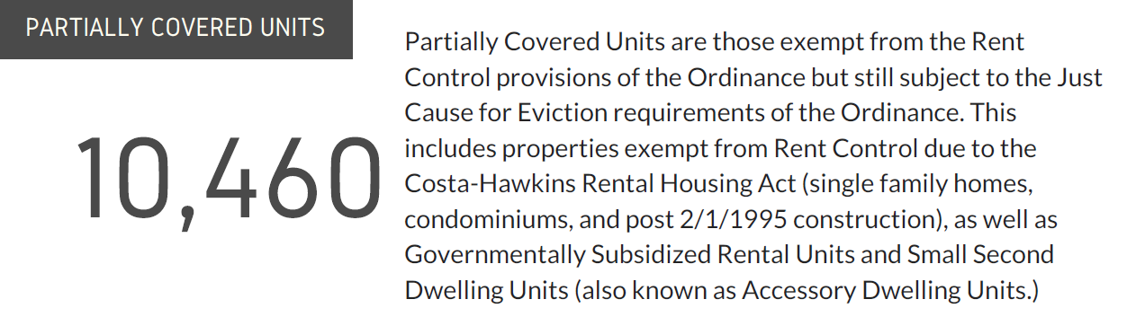
Rental units regulated by the rent program department

Slide 11
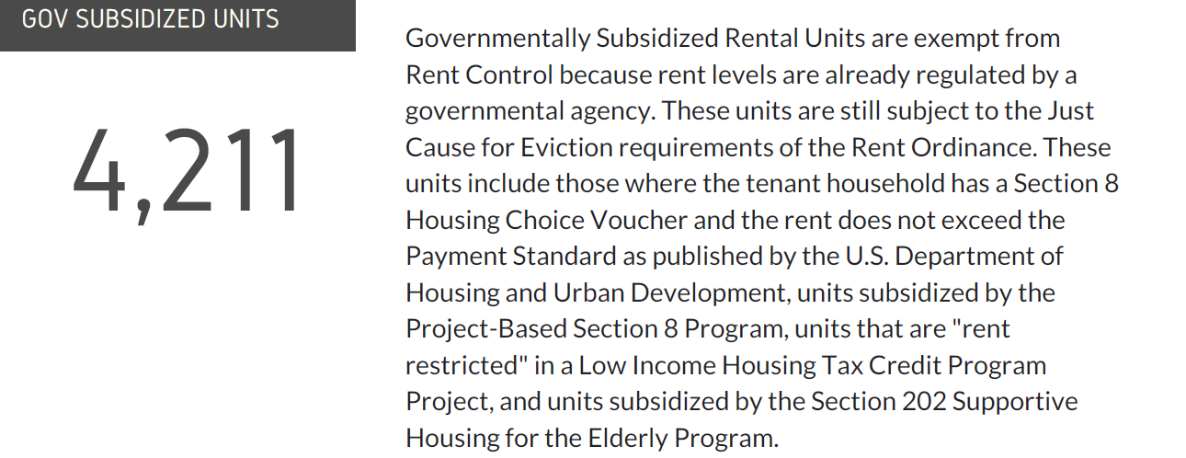
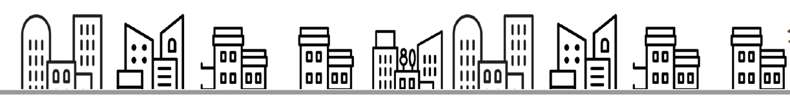
Rental units regulated by the rent program department (continued)

Slide 12
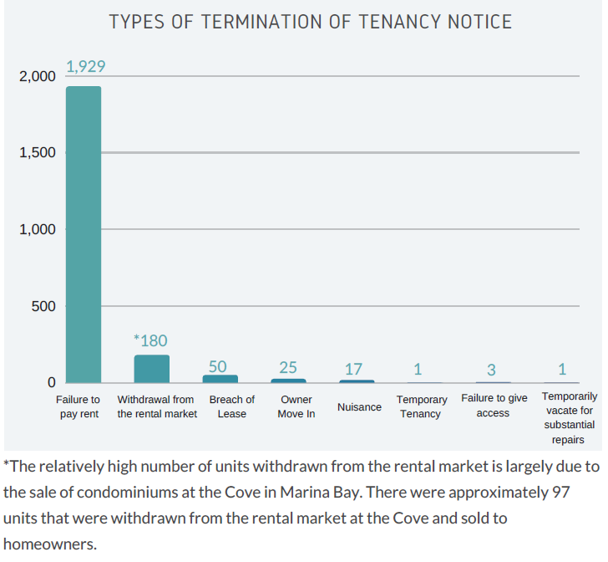
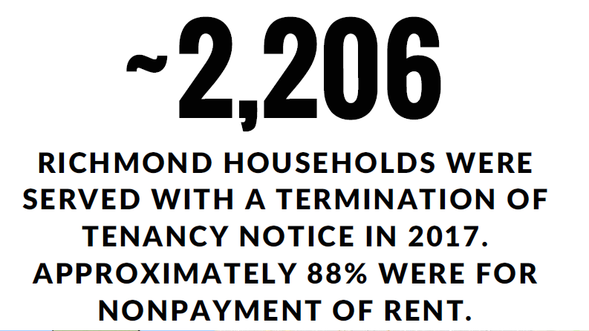
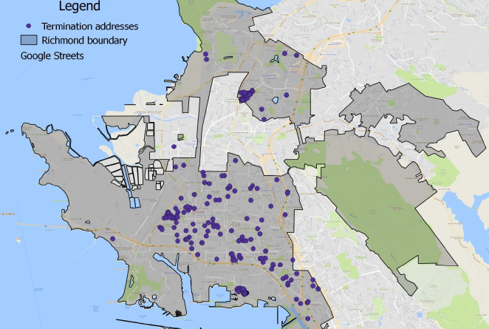
Termination of tenancy: by the numbers
Location of Rental Units Served a Termination of Tenancy Notice in 2017
Notes:
Date range: January 31, 2017 – December 20, 2017
-The greatest numbers of termination notices are concentrated in areas where there are large housing developments – more in the central city as opposed to marina bay and point richmond.

Slide 13
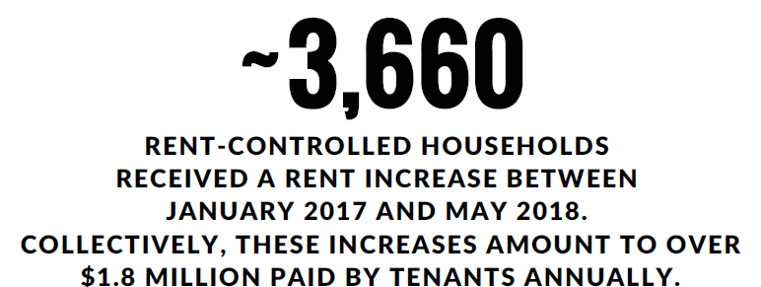
Rent increases: by the numbers
2016 Annual General Adjustment (AGA): 3.0%
Between December 27, 2016, and September 25, 2017, approximately 1,092 households were served a rent increase notice in accordance with the 2016 AGA.
The average rent increase was $37.
Location of Rental Units Served a Rent Increase Between January 2017 and May 2018
2017 Annual General Adjustment (AGA): 3.4%
Between July 3, 2017, and May 6, 2018, approximately 2,568 rent-controlled households were served a rent increase notice in accordance with the 2017 AGA (could be combined with the 2016 AGA for qualifying tenancies.)
The average rent increase was $43.

Slide 14
Elements of active enforcement
Tenancy Registration and Tracking of the Maximum Allowable Rent
Comprehensive Counseling
Extensive Outreach and Community Education
Notes:
Another area of focus in this year’s annual report is on the elements of active enforcement.
Three of these elements are comprehensive or what we like to call “holistic” counseling, extensive outreach and community education, and tenancy registration and the tracking of the Maximum Allowable Rent.
Comprehensive counseling is a key service provided by the Rent Program, and we provide this by allowing for nuanced discussions or individual situations. Housing issues are often complex and may intertwine many issues in a single case. To that end, we work to help tenants and landlords untangle what is often a variety of related issues, be in a rent increase, habitability problems, or conflicts with their landlord.

Slide 15
Looking Ahead: Fiscal year 2018-19 goals
Establish a robust rent registration and rent tracking system.
Increase collection of the Rental Housing Fee through aggressive compliance efforts.
Establish a fully operational Hearings Unit with online forms in multiple languages.
Successfully train the Rent Program Services Analysts and other senior staff on how to conduct formal mediations.
Publish the “Guide to Rent Control in Richmond” in multiple languages.
Expand the use of innovative outreach tools.
Work collaboratively with other City departments to improve housing inspection options and strengthen affordable housing policy.
Improve the Rent Program website and develop online registration of new tenancies.

Slide 16
Recommended action
RECEIVE AND APPROVE the 2017-18 Rent Program Annual Report and DIRECT staff to present the report to the City Council in June 2018.

Slide 17
Policy Considerations for a Partial Pass-Through of the Rental Housing Fee
Item H-3 | May 16, 2018, Regular Meeting of the Richmond Rent Board
Nicolas Traylor, Executive Director

Slide 18
Statement of the Issue
Section 11.100.060 (l)(1) of the Fair Rent, Just Cause for Eviction, and Homeowner Protection Ordinance (“Rent Ordinance”) provides that “All Landlords shall pay a business license fee if required by the Richmond Municipal Code plus a Residential Rental Housing Fee.”
The Rent Program budget is funded by the Rental Housing Fee.
At the April 18, 2018 Regular Meeting, the Rent Board directed staff to draft a policy report regarding a possible pass-through of a portion of the Rental Housing Fee to Tenants.
The Executive Director has prepared a policy report for the Board’s consideration.

Slide 19
The Pass-Through Only Applies to Controlled Units
Most rent stabilization programs cover their operating costs by charging an annual per-unit fee to landlords covered by the program.
The Fee proposed for the City of Richmond for the 2018 – 2019 Fiscal Year is $207 for fully covered units which equates to $17.25 a month over 12 months.
If a pass-through policy is adopted, it would only apply to fully covered units, since Landlords of partially covered units could presumably increase the rent to cover the cost of the Fee.

Slide 20
Fiscal Impact
Program expenditures would increase
The tasks associated with implementing a partial pass-through of the Residential Housing Fee (hereinafter, “Fee”) would likely increase overall program expenditures. The estimated cost to administer a pass-through of the Fee is expected to be at least 0.25 full time employee (FTE) in a counseling position. Based on the salary of a Rent Program Services Analyst, 0.25 FTE would amount to a $32,000 increase in salary and benefit costs.
Basis for anticipated increase in expenditures
This $32,000 cost estimate is based on the costs associated with reviewing and processing pass-through notices, addressing eligibility disputes, handling petitions based on unauthorized fees/charges, and assisting tenants who may have received a notice of termination of tenancy resulting from non-payment of the pass-through Fee.
Either Fee increases by ~$4/unit or key Program activities reduced
Such an increase would need to be offset by either an increase in the Fee of ~$4/unit or a reduction in other key agency activities, namely compliance, outreach, and rent registration.
Reducing key activities negatively impacts compliance
Reducing resources for outreach and rent registration would negatively impact overall compliance with both the Rent Ordinance itself as well as collection of the Fee.

Slide 21
Discussion of Fee Pass-Through Policy Considerations

Slide 22
Arguments Against a Pass-Through

Slide 23
Pass-Through Increases Staff Costs: May Lead to Fee Increase(s)
It is likely a pass-through would increase staff costs, potentially leading to an increase in the Rental Housing Fee (and the amount that is passed on to Tenants).
Requires shifting current budgeted resources away from integral activities such as compliance/enforcement.
Preliminary estimates suggest it will take between 0.25 FTE to 0.5 FTE to administer the pass-through. This would amount to an additional ~$4 to $8 in annual Fees per unit. Tenants would therefore also pay an additional amount if a portion of the Fee (e.g. 50%) were passed on to them.

Slide 24
Pass-Through Would Add Complexity to Counseling and May Lead to Unnecessary Disputes
A pass-through policy adds an additional layer of complexity to counseling which would lead to an increase in a counselor’s workload.
An increase in workload would include, but would not be limited to the following: determining whether or not the pass-through of the Fee applies to a particular tenancy, counseling Landlords who mistakenly attempt to evict for non-payment of the Tenant’s portion of the Fee, and counseling Tenants who receive notices of termination of tenancies for failing to pay their portion of the Fee.
Some Landlords may also (unlawfully) deduct pass-through Fees not paid by the Tenants from the security deposit.
Results in an increase in petitions to recover unlawfully held security deposits, or mistakenly include the pass-through Fee in the calculation of the Maximum Allowable Rent, resulting in increased counseling cases to resolve those miscalculations.

Slide 25
Administering a Complex Pass-Through Program Detracts From Compliance
At this time any policy that diminishes resources targeted for compliance could negatively impact both Landlords and Tenants.
Since the Rent Program has only collected 60% of the potential Fees to date, the top priority for the agency at this time is increasing compliance with the Fee. Implementing a pass-through policy at this time would diminish resources needed for compliance.
Once the Rent Program has reached compliance rates comparable to established Rent Programs (90%-95% compliance rate) and fewer resources are needed for compliance, a pass-through may be a policy for the Rent Board to reconsider.
Shifting resources away from compliance, outreach and rent registration, diminishes the Rent Program’s ability to collect the Fees necessary to fund the Program, which could potentially increase the Fee in future years.

Slide 26
Landlords Not Receiving a Fair Return Can Offset Cost of Fee Through An MNOI Rent Adjustment Petition
Landlords with unusually high costs (including the cost of the Rental Housing Fee), can apply for an Individual Rent Adjustment for Maintenance of Net Operating Income as a means of recovering a portion the Rental Housing Fee. If the fee of $207 per unit per year contributes to an inability to maintain the same inflation-adjusted Net Operating Income (NOI) as the owner had in 2015, they can receive an increase in the Maximum Allowable Rent level sufficient to cover that cost as well as any other increased costs that result in a decrease in NOI (assuming the Landlord is in compliance with all Program requirements.)
In the case of landlords who charged a rent significantly below market in the Base Year, the Rent Board may adopt regulations that enable these landlords to apply for an Individual Rent Adjustment that will adjust their Base Rent taking into consideration 2015 market rents for the affected units.

Slide 27
Landlords may be able to deduct the Rental Housing Fee on their taxes
The Fee may be tax-deductible for Landlords. On the other hand, Tenants cannot deduct the pass-through of the Fee on their taxes.

Slide 28
With vacancy decontrol in effect, Landlords can recover Fees through vacancy rent increases
Although there is a possibility that the Costa-Hawkins Rental Act will be repealed in November of this year, Landlords currently have the ability to reset rents to market following a voluntary vacancy or complete turnover of original occupants. This allows the Fee paid by the Landlord to be offset by a vacancy rent increase(s).
If the Costa Hawkins Rental Act is repealed and the Rent Board decides to adopt “full rent control” or vacancy control, a pass-through of the Rental Housing Fee would arguably be more appropriate since Landlords would not be able to reset rents between tenancies.

Slide 29
The Pass-Through and Eviction Related Concerns: Attempt to Evict for Non-Payment of the Pass-Through
Tenants may be served a 3-day notice to pay rent or quit for not paying the Fee pass-through. While the Fee is not considered Rent (it is a surcharge) and is not part of the Maximum Allowable Rent level, some Landlords may not know this and may attempt to evict a Tenant for nonpayment of the Fee.
Both Landlords and Tenants would likely incur financial burdens associated with litigating such nonpayment cases. While some Tenants may receive legal assistance or representation, other Tenants may fail to access legal representation, and may be unable to navigate the complexities of the eviction process. For instance, some tenants may fail to timely respond to an unlawful detainer or respond to the unlawful detainer but miss their court date(s), either of which would result in a default judgement and eviction.
Some Tenants, especially undocumented tenants, may vacate in fear of having to expose themselves by going to court.

Slide 30
Increased outreach needed to mitigate unlawful pass-through-related evictions would add to Program costs
To address this situation, the Rent Program would need to engage in robust outreach and education for both Landlords and Tenants to help mitigate such unlawful attempts to evict due to non-payment of the pass-through Fee.
This additional outreach would add to the costs of administering the pass-through, which, as mentioned, would either increase the budget and therefore the Rental Housing Fee, or detract from other key activities, such as compliance.

Slide 31
A pass-through policy may lead to miscalculations of the Maximum Allowable Rent which would increase staff time and resources necessary to resolve such disputes
Implementing the pass-through of Fees may lead to confusion about whether or not the Fee is part of the Maximum Allowable Rent level. The Maximum Allowable Rent level is calculated by multiplying the base or initial rent by the Annual General Adjustment. The miscalculation of the Maximum Allowable Rent would occur if a Landlord included the pass-through Fee amount in the calculation of the Maximum Allowable Rent. For example, if the pass-through Fee were $8 per month and a Tenant’s Maximum Allowable Rent were $1000, landlords might apply the Annual General Adjustment percentage (e.g. 3%) to $1,008 instead of to $1,000.
This minor miscalculation could lead to an increased need for Program staff to assist Tenants and Landlords with correcting the calculation and resolving rent overcharges that resulted from the miscalculation. This could increase the need for counseling and mediation resources, and would likely lead to increased petitions and hearings. The impact would likely result in an increase in staff costs, which would need to be compensated for by an increase in the Fee or reduction in other key services.

Slide 32
As a “start-up,” the Richmond Rent Program should not be devoting its limited organizational bandwidth to implementing a complex administrative task that is difficult to enforce
In Berkeley, where a limited pass-through policy for pre-1996 tenancies has been in place for many years and where robust outreach and education on their pass-through is done, Berkeley’s housing counselors still devote a notable portion of their time dealing with the aftermath of, and correcting for, MAR miscalculations. The Berkeley Rent Stabilization Program has been around for over 40 years and has a staff of over 20 FTE (and a budget of over $5,000,000 annually). The Richmond Rent Program has half the budget and staff compared to Berkeley and is a start-up with compliance deficiencies one would expect a new rent control program to have. Additionally, the Richmond Rent Program has many organizational programs still under development (e.g. rent registration, compliance projects and the hearings program).
Adding an additional administrative program that does not significantly increase levels of compliance but rather, increases staffing costs/burdens, is not advisable at this time and works against our primary mission.

Slide 33
An unenforceable pass-through policy may lead to increased conflict between Landlords and Tenants
As a surcharge in addition to the rent, the Landlord is not entitled to evict for non-payment, so the Fee could be subject to resistance from some Tenants.
One could easily imagine that this lack of enforceability could lead to a rising the level of conflict between Landlords and Tenants, with the Rent Program in the middle of having to mediate or assist in resolving a problem that it helped create.

Slide 34
Arguments to Support a Limited Pass-Through

Slide 35
A pass-through of $8.63 is presumably affordable to many Tenant households
All Tenants benefit from the Rent Program and its services, and presumably many would be able to afford to pay an additional $8.63 a month. The charge will increase Tenant awareness of the program and give Tenants a stake in keeping program costs down. While the Rent Board could establish a policy exempting low-income Tenants from paying the pass-through, this could create a disincentive to renting to low-income Tenants. It is also important to note that the pass-through would likely not apply to Section 8 tenancies in accordance with HUD regulations.
Additionally, although any increase in rent for a low-income Tenant could lead to financial strain, it is currently unknown whether an $8-$9 per month surcharge would actually lead to the kind of housing instability that could cause displacement or financial strain.

Slide 36
Another argument for allowing a limited pass-through is promoting fairness. The primary beneficiaries of rent controls and eviction protections are Tenants. Without rent controls and eviction protections, Tenants in Richmond were subject to upward swings in the rental housing market, which resulted in many experiencing rent shock and rent increases that far outweighed an $8.63 increase in monthly expenses. An $8.63 increase in monthly expenses for Tenants is a small price to pay for the numerous important services provided by the Rent Program.
It is worth the cost of administering a pass-through because fairness in funding the Program strengthens and protects the Rent Ordinance

Slide 37
Recommendation
While staff supports the concept of sharing the costs of the Rent Program between Landlords and Tenants, at this time administering a pass-through policy may not be in the interest of the Rent Program.
Setting aside the other compelling arguments against the pass-through, the strongest argument against a pass-through at this particular time is that it would increase Program costs due to its complexity, thereby detracting from key Program activities, namely compliance and outreach, which, during the startup period, is the most important priority for the agency.

Slide 38
Recommendation Continued
This November, California voters may decide to repeal the Costa Hawkins Rental Act, which would allow the Richmond Rent Board to implement “full rent control” or vacancy control.
If and when vacancy decontrol is prohibited and Landlords become unable to reset the rent to market between tenancies, a pass-through of the Rental Housing Fee should be brought back to the Board for serious reconsideration.
Even if Costa Hawkins remains in place, the Rent Board could always reconsider a pass-through policy, at a time when doing so would not detract from our fundamental need to achieve higher compliance with the Rental Housing Fee.
Once the Richmond Rent Program has achieved levels of compliance comparable to established rent programs, a pass-through policy would not detract from our primary start-up goal of achieving compliance with the Rental Housing Fee.

Slide 39
Policy Recommendations If and When the Board Decides to Adopt A Pass-Through of the Fee
Option 1: Allow a 50% pass-through of the Fee ($8.63/month or $9 if the Board elects to round the Fee to the nearest dollar) that applies only to tenancies that started on or before July 21, 2015 (where no vacancy rent increase has been taken since the implementation of rent control).
The Board can institute a waiver of the pass-through for low-income Tenants.
Once there has been at least one vacancy rent increase post-July 21, 2015, the pass-through would no longer apply to that unit going forward (as it is likely that most vacancies would result in rent increases far exceeding the $17.25 monthly cost of the Fee).

Slide 40
Policy Recommendations If and When the Board Decides to Adopt a Pass-Through of the Fee
Option 2: Allow a pass-through of approximately $4 per month or 25% of the Fee. The Board could decide whether or not the pass-through would only be applicable to tenancies that started on or before July 21, 2015. Under this proposal, 25% of the Fee would be passed on to the all rent controlled Tenants regardless of their income status.
This would amount to approximately $4.31/month. To keep the calculation simple, the Board may elect to round down to $4.00 per month. Because there would be no need to verify income, administering the pass-through would be less complicated to keep staff costs down.

Slide 41
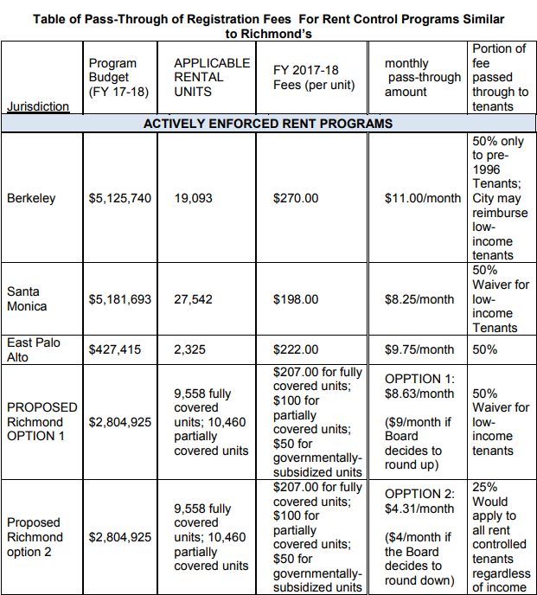

Slide 42
Recommended Action
RECEIVE a memo from the Executive Director regarding the adoption of a policy permitting a partial pass through of the Rental Housing Fee to be paid by Tenants over a 12-month period and PROVIDE direction to staff.

