Slide 1
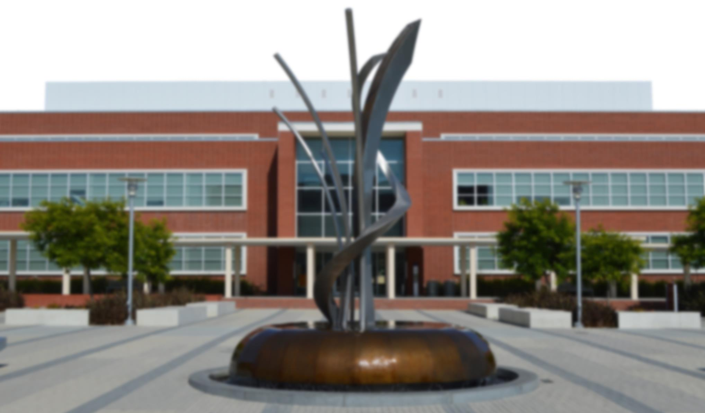
City of Richmond, California FY2019-20 Proposed Budget
Richmond City Council
June 4, 2019

Slide 2
Overview
Background
Next Steps
FY 2019-20 Budget Analysis
Fiscal Improvements
Recap

Slide 3
Background
May 7, 2019
FY 2019-20 Revenues: $172.8 million, Expenditures:$180.4 million
General Fund shortfall: $7.6 million
May 21, 2019
Departmental Budget Presentations
May 28, 2019
City staff / Department heads reduced shortfall to $3.3 million
Russ Branson, PFM Group: ~ 75% - 80% of GF expenses: personnel
June 4, 2019
Objective: minimize personnel reduction, preservation of direct services
The originally proposed management restructuring ($1.9 M) was withdrawn for this budget process
Budget deficit now: $2,000,000
Need to continue working to eliminate deficit, eliminate personnel reductions and preserve direct services
Notes:
~80% from Russ’s presentation (based on 5-Year Financial Forecast)
Actual % is ~75%a

Slide 4
Next Steps
June 4, 2019
Start developing the budget checklist this evening, with no management restructuring
June 5-12, 2019
Continue working with staff and unions to come up with a balanced budget proposal while preventing layoffs
June 18, 2019
The City Council will receive responses to checklist items
Update on progress to balance the budget & eliminate layoffs
Finalize budget checklist
June 25, 2019
Balanced Budget Adoption
Continue working with staff and unions to develop long term financial stability measures
Management efficiencies and possible restructuring should be examined
Notes:
Added “and”
Changed the date from May to June

Slide 5
Budget Gap Analysis
Budget Analysis Gap as of May 23, 2019 | $ (7,593,162)
Reductions/Savings:
Capital Improvement Department (Over-time, Personnel Reclassifications) | $ 37,773
City Manager's Office (Allocation of staff costs to ECIA and Grants, Trainings, Office Supplies) | $ 106,999
Community Services (Recreation Program Expansion) | $ 97,557
Finance (Asset Inventory Contract) | $ 50,000
Human Resources (Software Upgrades) | $ 10,000
Information Technology (Ricoh Professional Services in Copy Center, Desktop Phone Replacement Equipment) | $ 125,000
Infrastructure Maintenance & Operations (Overtime) | $ 48,000
Library (Costs Moved to Grant) | $ 5,437
Police (Interview room upgrades, Canine Purchase, Replacement Computers) | $ 207,761
Citywide (Reduced vehicle replacement, including Police and Fire) | $ 278,000
Community Services (Increase in rental income) | $ 47,000
Non-Departmental (Civic Center debt savings) | $ 618,431
Non-Departmental (Revenue increases to property taxes and sales tax) | $ 1,714,500
Other adjustments (Salary and benefits projection updates) | $ 311,564
Police - Added positions (1-Lieutenant Sworn, 3-Admin Aides Non-Sworn) | $ (548,375)
Non-Departmental (Transfer to General Capital for Corp Yard Roof Replacement) | $ (500,000)
Notes:
Markisha to send and we will fix

Slide 6
Budget Gap Analysis
Information Technology (Add back copy center professional services) | $ (75,000)
Other adjustments (3rd of July funding fully restored, Council stipends budgeted at full rate) | $ (73,961)
City-wide (Reduce insurance reserve allocations) | $ 2,100,000
Non-Departmental (Add appropriation to pay toward OPEB unfunded liability) | $ (250,000)
Non-Departmental (Add appropriation to pay toward funds with negative cash balances) | $ (250,000)
Various Department Reductions (DIMO-Overtime and Office Supplies, IT-Equipment Rental, Police-Part Time Temp Staff, HR-Recruitment Services Contract, Library-Part Time Staff Budget Revision, Books and Subscriptions Budget Moved to Other Funds) | $ 276,969
City Manager (Reallocate staff time to non-general fund; staff time partially covered by grant) | $ 71,818
Police (Staff time covered by grant) | $ 21,000
Infrastructure Maintenance & Operations (Reduce professional services $10k; increase abatement fees $40k) | $ 50,000
Library (Transfer in from Planning & Building to cover staff time spent on census data) | $ 50,000
Community Services (Transfer in from Planning & Building to cover staff time spent on census data) | $ 50,000
Non-Departmental (Transfer in for Port contribution - bond savings $700k; eliminate security contract $300k) | $ 1,000,000
Various Departments - Estimated savings from reduction of 13 positions | $ 1,904,853
Revised Budget Gap | $ (107,836)
Notes:
Markisha to send and we will fix

Slide 7
Budget Gap Analysis Cont’d.
Why is there a budget gap?
Costs growing faster than revenues
Structural issue, declining staffing levels
Staffing costs 75% of General fund
Accumulating negative balances
RHA and impact on cash reserves
CalPERS, OPEB Cost
Measure K – Kids First Initiative
Notes:
Changing title
Why background?

Slide 8
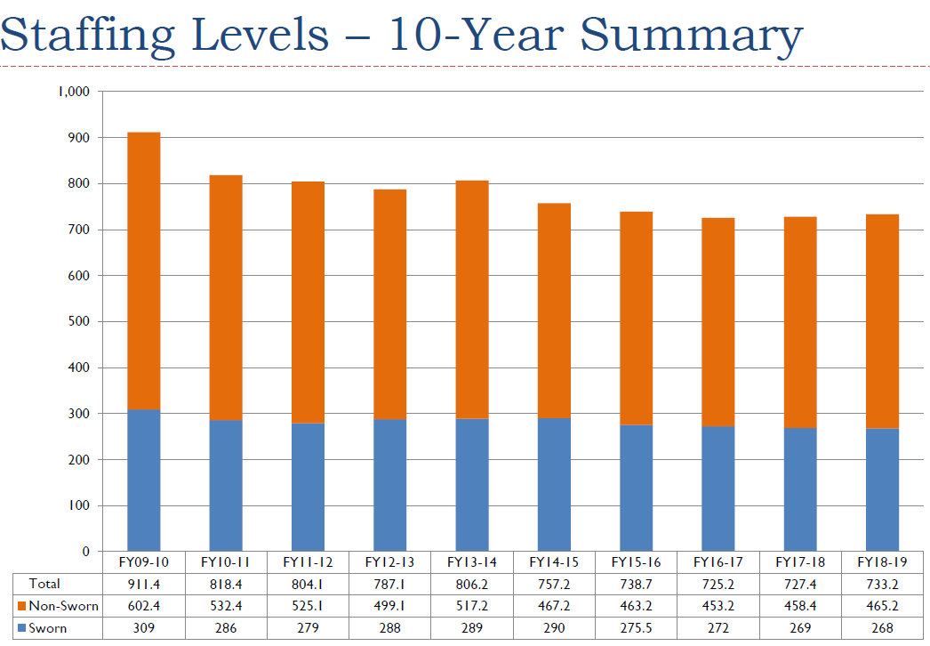
Budget Gap Analysis Cont’d.

Slide 9
General Fund Uses

Slide 10
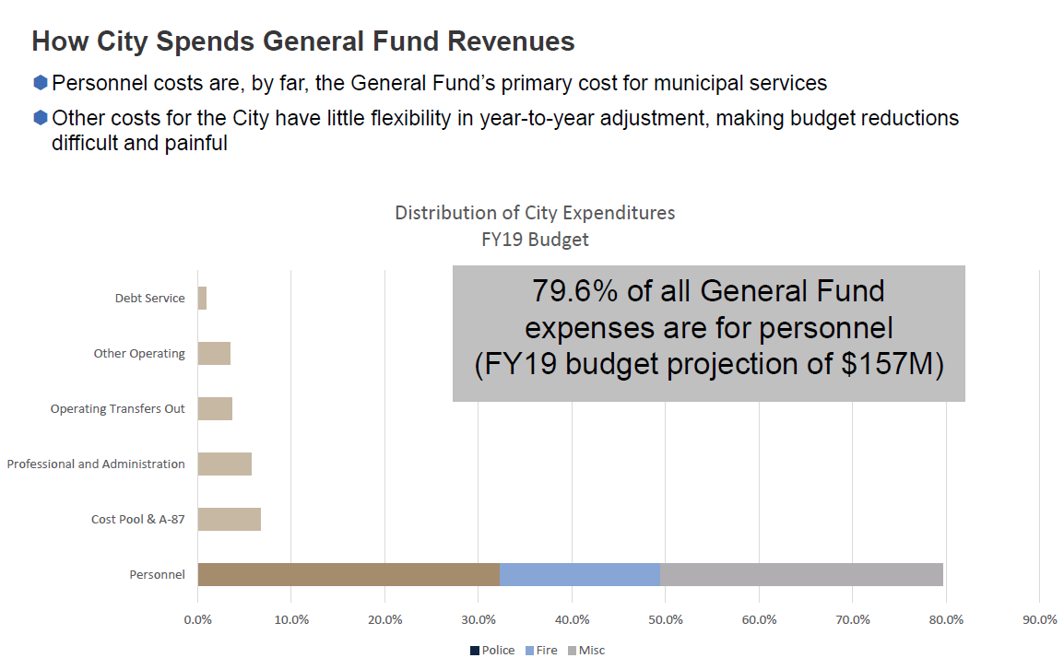
Budget Gap Analysis Cont’d.

Slide 11
Budget Gap Analysis Cont’d.
Fund with Negative Cash Balances | May impact General Fund
Fund | FY 17 | FY 18 | Action Plan
Transportation Operation (R-Transit) - 1003 | ($1,749,243) | ($2,902,517) | Current fiscal year funding expected by year end
Engineering Cost Recovery – 1051 | (2,208,899) | (2,298,974) | Increase in GF subsidy
Code Enforcement Cost Recovery – 1053 | (2,439,356) | (2,381,066) | General Fund Reserves
2007 Refunding & Civic Center – 3005 | (1,208,843) | (1,003,477) | On 5-Year Repayment Plan
Stormwater – 4006 | (1,416,114) | (904,974) | Future revenues
Housing Department | (3,143,929) | (3,367,762) | Disallowed costs will be drawn from General Fund
Total | ($12,166,384) | ($12,858,770)

Slide 12
Budget Gap Analysis Cont’d.
RHA Debt : $14.2 M

Slide 13
Budget Gap Analysis Cont’d.
Outstanding amount from Fiscal Year 2008-2009 thru Fiscal Year 2018-2019 (as of April 2019) |  |  |  |  |  |  |  |  |  | $ 8,570,285.94
RHA Loans and Notes Receivables:
Advanced by former RDA to RHA now assumed by Housing Successor - to assist RHA with its lease payment for 2003 Multifamily Housing Revenue Bonds |  |  |  |  |  |  |  |  |  | $ 174,067.00
RHA Housing Corp. - RHA Component Unit - Notes and Loans Receivable for Triangle Court and Friendship Manor: |  |  |  |  |  |  |  | Loan Amount | Accrued Interest as of 12/31/18 | Total Amount Due
Fund Source: Gen. Fund Loan from Gen Fund to RHA for RAD pre-develop. cost (Dec. 2014) |  |  |  |  |  |  |  | $ 700,000 | $ 28,019.18 | $ 728,019.18
Fund Source: Low/Mod Housing Fund Loan from Housing Successor to RHA for RAD project (Dec. 2015) |  |  |  |  |  |  |  | $ 1,100,000 | $ 32,901.60 | $1,132,901.60
Fund Source: Housing In-Lieu Fund Loan from Housing Successor (in-lieu funds) to RHA for RAD project (last draw Feb. 2018) |  |  |  |  |  |  |  | $ 3,600,000 | $ 42,652.18 | $3,642,652.18
 |  |  |  |  |  |  |  | $ 5,400,000 | $ 103,572.96 | $ 5,503,572.96
Total Amount Due from RHA and RHA Housing Corporation: |  |  |  |  |  |  |  |  | $ 14,247,925.90
RHA Debt : $14.2 M

Slide 14
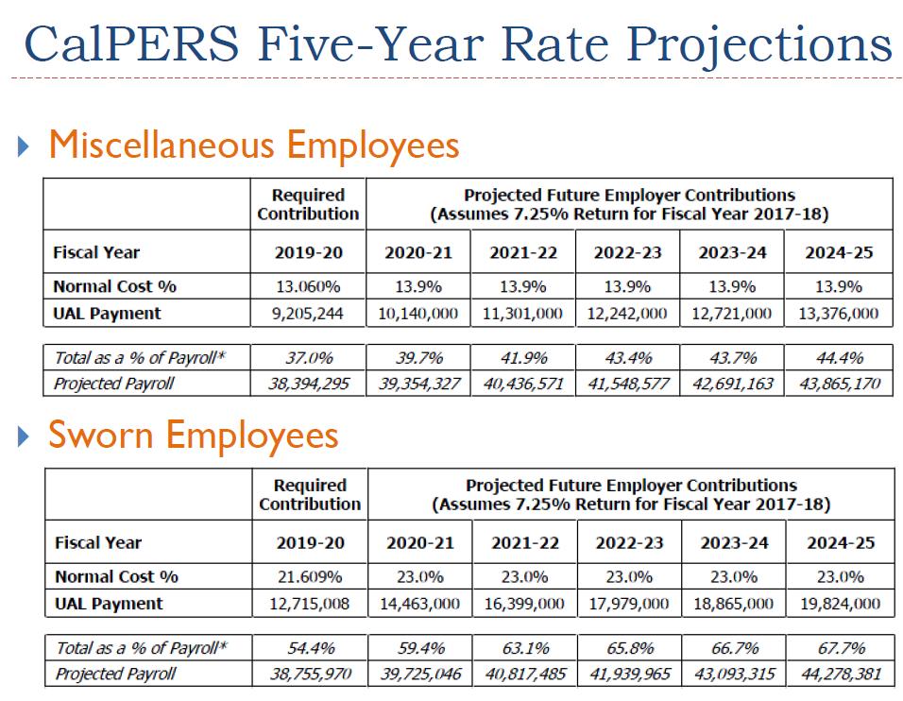
Budget Gap Analysis Cont’d.

Slide 15
Budget Gap Analysis Cont’d.
What is Measure K – Kids First Initiative?
Ballot measure passed on June 5, 2018 amending Measure E to correct outdated language and to propose changes
Establishes special fund to expand children’s services in the City
Requires a portion of unrestricted General Fund revenue to be set aside to fund youth programs and services
 | Funding Requirement | Estimated Amount
FY2018-19 | $250,000 | $250,000
FY2019-20 | $700,000 | $700,000
FY2021-22 | 1% | $1,527,191
FY2022-23 | 2% | $3,054,381
FY2023-24 | 3% | $4,581,572

Slide 16
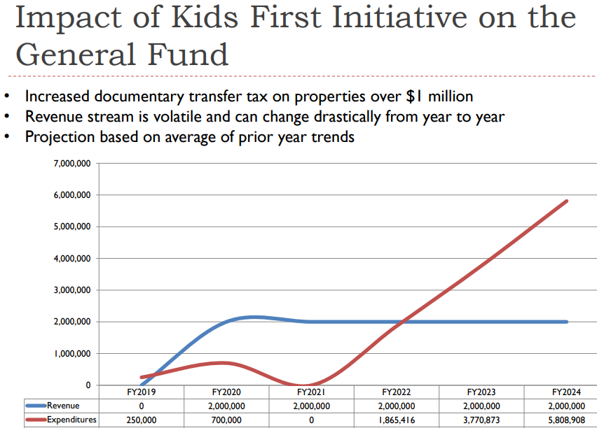
Budget Gap Analysis Cont’d.
Estimated: $2M, Actual YTD: $742K
Notes:
Need number (in red) – will work with Finance

Slide 17
Fiscal improvements – Financial discipline
S&P Bond Rating: Upgraded three notches from A- to AA- and the lease revenue bond rating from BBB+ to A+.
Savings: Civic Center ~ $600,000 + Port ~$700,000 = $1.3M
“The outlook also reflects our expectation that reserve levels will remain strong…during the next two years, and that the city will manage its debt and ongoing expenditures sufficiently to avoid any future structural imbalances.
Should the local economy continue to strengthen, reflecting higher income and wealth metrics, if the city's pension costs represent a smaller portion of the city's budget, and if the city keeps reserves at very strong levels in the current year and projected for the next few years, we could raise the rating…
Should Richmond's financial performance deteriorate to the point of resulting in structural imbalance either because of an unexpected decline in revenues or because the city is unable to manage its debt and pension-related costs, we could lower the rating.”

Slide 18
Recap: Next Steps
June 4, 2019
No action being asked on proposed restructuring
Start developing the budget checklist this evening, without restructuring
June 5-12, 2019
Continue working with staff and unions to come up with a balanced budget proposal while preventing layoffs
June 18, 2019
The City Council will receive responses to checklist items
Update on progress to balance the budget & eliminate layoffs
Finalize budget checklist
June 25, 2019
Balanced Budget Adoption
Continue working with staff and unions to develop long term financial stability measures
Management efficiencies and possible restructuring should be examined after budget adoption

