Slide 1


Mayor’s Office
FY2019-20 Draft Budget Presentation
May 21, 2019

Slide 2
Mission
To use the Office of the Mayor to promote Richmond, increase economic activity, insure housing for all, improve health, education and safety, enhance the quality of life for Richmond residents and provide public policy leadership.
The Charter designates the mayor as “the chief elected officer and ceremonial head of the City, responsible for providing civic leadership and taking issues to the people, and marshalling public interest in and support for municipal activity. The Mayor shall be concerned with the general development of the community and the general level of City services and activity programs and may develop and inform City residents of policies and programs which he or she believes are necessary for the welfare of the City.” (Charter of the City of Richmond, Article III-A Sec. 2.)

Slide 3
FY2018-19 Accomplishments
Community
  Coordinated and participated in numerous community events.
  Hosted and organized over 20 public events.
  Distributed hundreds of public statements and advisories through news and social media.
  Fielded and responded to hundreds of constituent questions, comments and complaints.

Slide 4
FY2018-19 Accomplishments
Leadership
  Drafted and sponsored over a dozen city policy agenda items to improve regulations, advance health, housing and economic development goals, and weigh-in on important issues.
  Made over 85 appointments to Boards, Commissions and Committees.
  Sponsored over 20 proclamations.
  Represented Richmond at US Conference of Mayors, League of California Cities, Contra Costa Mayors Conference, BCDC, LAFCO, WCCTAC, CCTA and ABAG.

Slide 5
FY2018-19 Accomplishments
Major Projects
  Completed hiring and transition to new City Manager.
  Established Downtown Richmond Visitor Center.
  Supported marketing/outreach for Richmond ferry service with great success.
  Secured funding for GRIP Warming Center, and launched initiative to establish managed homeless encampment.
  Protected plans to open multi-use bike/ped path on Richmond-San Rafael Bridge.

Slide 6
FY2019-20 Goals
Advance public policies to improve quality of life.
  Improve health and mobility by improving sidewalk conditions and pedestrian safety
  Advance climate change and resiliency policies
  Reduce trash/dumping and blight
  Housing and homelessness
Engage with business and development community to strengthen economic growth.
Support public land-use entitlement process for successful development at Pt. Molate.
Launch the new Richmond Visitor Center at the Transit Village.
Represent Richmond at a regional, state and national level to influence polices favorable to Richmond and increase funding for Richmond projects and programs.

Slide 7
Staff
Position | FY2018-19 Mid-Year | FY2019-20 Proposed
Mayor | 1.0 | 1.0
Admin Trainee | 1.0
Assistant Admin Analyst | 2.0 | 2.0
Management Analyst I/II | 1.0 | 1.0
Total Full-Time Equivalent (FTEs) | 5.0 | 4.0

Slide 8
General Fund Budget
FY2019-20 DRAFT BUDGET
 |  | FY2018-19 Mid-Year | FY2019-20 Proposed
Revenue
 | Total Revenue
Expenditures | Salaries & Wages | 269,313 | 276,327
 | Benefits | 226,650 | 215,826
 | Professional & Admin | 12,400 | 15,900
 | Other Operating | 2,900 | 2,400
 | Utilities | 1,824 | 1,250
 | Cost Pool | 28,610 | 21,793
 | A87 Cost Plan Reimbs | (146,839) | (146,839)
 | Total Expenditures | 396,658 | 386,657
Net Impact |  | (396,658) | (386,657)

Slide 9
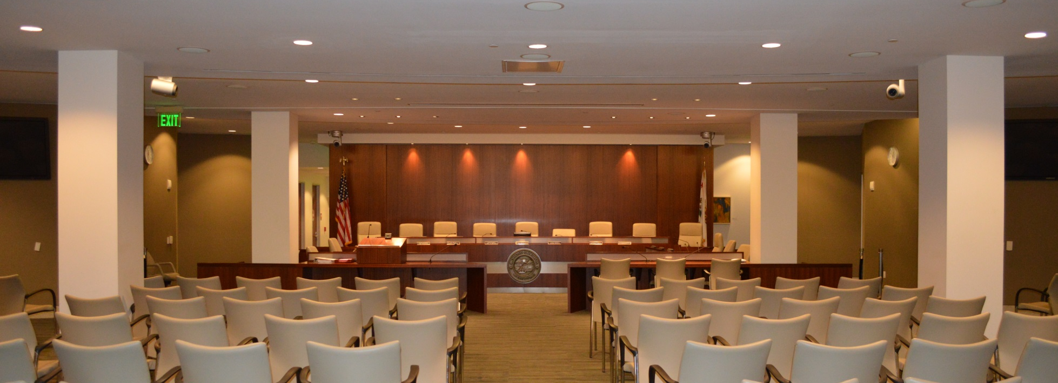
City Council
City Council
FY2019-20 Draft Budget Presentation
May 21, 2019

Slide 10
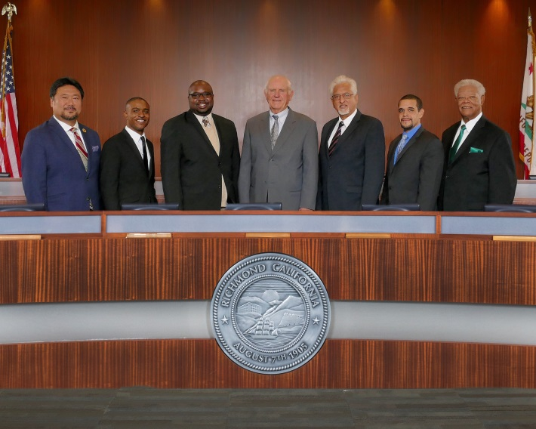
Mission
The City Council establishes comprehensive goals and objectives for the City; provides leadership in establishing policies for the conduct of municipal affairs; formulates priorities for allocation of City resources; represents the City at local, regional, state, and national events; and holds regularly-scheduled meetings, hearings, and study sessions to receive community input while conducting business in a public forum.

Slide 11
FY2018-19 Accomplishments
Participated in a City Council Retreat and identified seven priority areas of governance
Adopted 58 Resolutions and Adopted 18 Ordinances
Held 33 City Council and Special Meetings
Hired a new city manager and housing authority director
Approved Environmental Community Investment Agreement (ECIA) grant awards (Category 3) in the total amount of $56,190 to six Richmond-serving non-profit organizations.
Notes:
7/24/2018 CC Mtg – Item H-11
1) House of Loving Hands Inc. - $6, 190; 2) Men and Women of Valor - $10k; 3) Richmond Main Street Initiative - $10k; 4) RPAL - $10k, 5) Social Progress, Inc. - $10k and 6) Youth Code Now - $10k

Slide 12
FY2019-20 Goals
Governance, Finance and Leadership
Strategize on methods to mitigate deficits, increase revenue and maintain a balanced budget.
Support the City Manager and Department Heads in maximizing services and resources to Richmond residents.
Full Service and Safe Communities
Reduce crime through effective programming and policy implementation.
Environment, Health Equity, and Sustainable Communities
Support the initiatives of the Government Alliance on Race and Equity to advance equity.
Approve initiatives and policies that are environmentally friendly, support smart growth and livable communities.
Continue to explore methods to decrease homelessness and increase affordable housing.
Economic Development and Education
Hold a joint meeting of the Richmond City Council and WCCUSD
Support efforts to increase the ridership of the Richmond Ferry, smart development and promote local hires
Support Richmond Promise

Slide 13
Staff
Position | FY2018-19 Mid-Year | FY2019-20 Proposed
SR ADMIN ANALYST | 1.0 | 1.0
Total Full-Time Equivalent (FTEs) | 1.0 | 1.0

Slide 14
General Fund Budget
FY2019-20 DRAFT BUDGET
 |  | FY2018-19 Mid-Year | FY2019-20 Proposed
Revenue
 | Total Revenue
Expenditures | Salaries & Wages | 275,459 | 290,779
 | Benefits | 180,382 | 180,811
 | Professional & Admin | 24,681 | 41,050
 | Other Operating | 14,780 | 15,300
 | Utilities | 1,100 | 1,100
 | Equipment & Contract Services
 | Cost Pool | 57,215 | 59,950
 | Asset Capital Outlay | 1,820 | 1,820
 | A87 Cost Plan Reimbs | (201,743) | (201,743)
 | Total Expenditures | 353,694 | 389,067
Net Impact |  | (353,694) | (389,067)

Slide 15

Community Police Review Commission
FY2019-20 Draft Budget Presentation
May 21, 2019

Slide 16
Mission
The purpose of the Community Police Review Commission (formally known as the Citizen’s Police Review Commission) is to advise the City Council, City Manager, and Chief of Police on all matters pertaining to the administration of the Richmond Police Department

Slide 17
FY2019-20 Goals
To provide a timely and professional response to public inquiries over the CPRC office telephone line, and to facilitate the business of the CPRC by having sufficient staff support to accomplish tasks promptly and efficiently.
To continue our efforts at community outreach in order that the public will know of this resource - accomplishing this goal requires materials for education (handcards) and items to bring people in - kids and adults - so, like giveaways.
To continue to have CPRC participation in NACOLE, the national association of civilian oversight of law enforcement. NACOLE provides opportunities for sharing information and learning from the experience of other police commissions.
To run a businesslike, professional monthly meeting, with all support services readily available.
To conduct a retreat in order to give the CPRC an opportunity to have extended conversations about matters within our purview, input from experts and others, self-examination and an opportunity to identify and strategize toward a more effective CPRC.
To increase the visibility of CPRC commissioners and to clearly identify CPRC commissioners as being distinct from RPD employees during community events, training events and ride-alongs.

Slide 18
Staff
 | FY2018-19 Mid-Year | FY2019-20 Proposed
Assistant Administrative Analyst | 0.1 | 0.1
Total Full-Time Equivalent (FTEs) | 0.1 | 0.1

Slide 19
General Fund Budget
FY2019-20 DRAFT BUDGET
 |  | FY2018-19 Mid-Year | FY2019-20 Proposed
Revenue
 | Total Revenue
Expenditures | Salaries & Wages | 69,159 | 72,527
 | Benefits | 7,068 | 5,475
 | Professional & Admin | 10,061 | 10,550
 | Other Operating | 1,117 | 1,100
 | Total Expenditures | 87,405 | 89,652
Net Impact |  | (87,405) | (89,652)

Slide 20
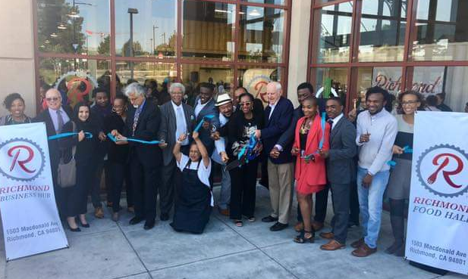
City Manager’s Office
FY2019-20 Draft Budget Presentation
May 21, 2019
Notes:
Photo: April 30, 2019 ribbon cutting at the Grand Opening of the Richmond Food Hall and Business Hub located at 1503 Macdonald Ave in the BART Garage Retail Space.

Slide 21
Mission
The City Manager’s Office implements City Council policy through day-to-day oversight of operating departments, and (often in collaboration with other departments) through the initiation, development, and implementation of programs and policies that provide for the efficient, effective and equitable delivery of services to all those who live, work and play in the City of Richmond.

Slide 22
Mission
The City Manager’s Office performs specific operational responsibilities in the following areas:
  City Council Directed Special Projects
  Community & Economic Development
  Department of Children and Youth Services
  Environmental & Community Investment Agreement (ECIA) Program Development and Oversight
  Environmental Initiatives
  Health in All Policies
  Policy & Program Development
  Property & Asset Management
  Resident and Business Issues Resolution
  Transportation & Transit Connectivity

Slide 23

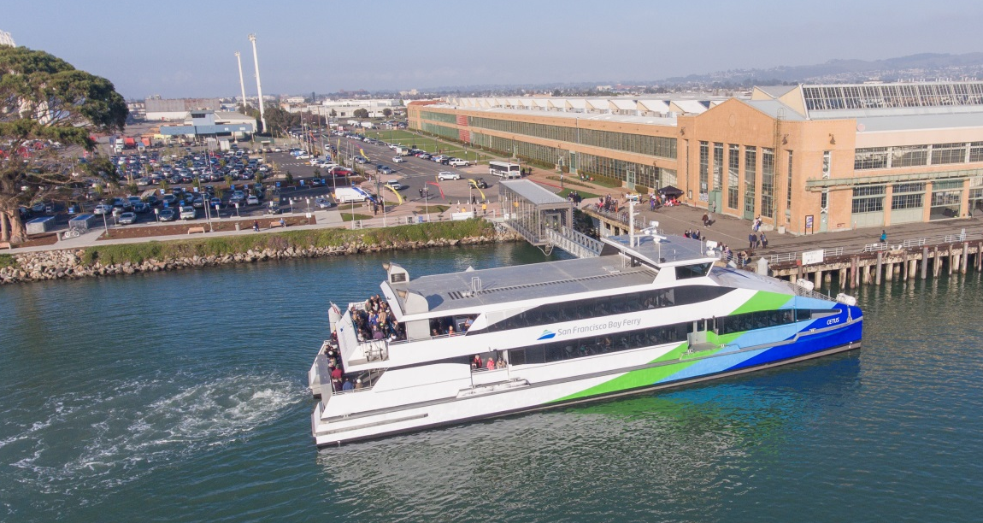
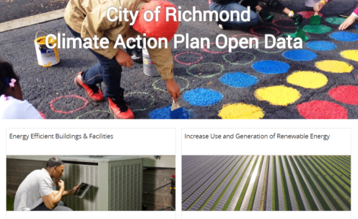
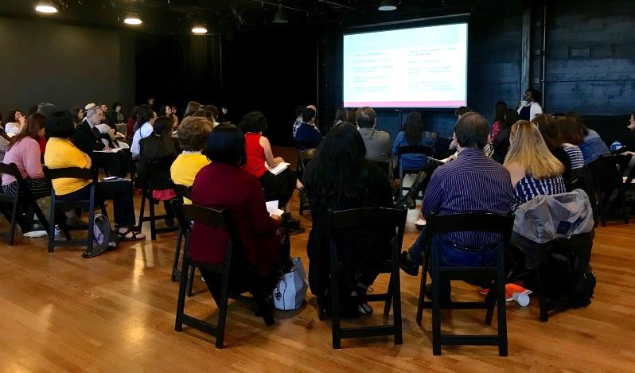
FY2018-19 Accomplishments
Taste of Richmond 2019
Richmond Ferry Launch - January 10, 2019
Department of Children and Youth Services Meet and Greet on April 10, 2019
Launched Climate Action Plan September 25, 2018
Notes:
City Manager’s Office
Planned and organized Retreat and Strategic Planning Meeting with the new Richmond City Council - February 8, 2019
Richmond City Council adopted the Strategic Plan Priorities on March 26, 2019
Community and Economic Development Accomplishments
Launch of the new Richmond Ferry - January 10, 2019
Approval of HCV (Section 8) transfer
Lead the transition of Section 8 and Public Housing (4F)
Environmental Initiatives Accomplishments
City staff launched a dashboard on September 25, 2018, to report on the implementation of the Climate Action Plan, expanding the original Open Data platform maintained by the Richmond Police Department. Staff are continuing to expand and improve the dashboard.
Monthly Compost Giveaway Program and Free Mattress Drop-off for Richmond residents
Health Initiatives Accomplishments
Created Draft Community Engagement Toolkit
Commence development of HiAP Report
Children and Youth Services
Launched the Department of Children and Youth Services, and hosted the Community Overview and Meet and Greet at the East Bay Center for the Performing Arts - April 10, 2019
Oversight Board to be appointed by the Richmond City Council by June 30, 2019
Business Retention, Recruitment, and Support
Richmond Business Hub Grand Opening in the BART Garage Retail Space on April 30, 2019
San Ft Business Times Richmond Supplemental published on October 12, 2019.
Transportation
Adopted for implementation the Richmond Integrated & Equitable Multimodal Mobility Plan (aka First Mile / Last Mile plan) - February 26, 2019
Released Request for Proposals (RFP) to solicit proposals to provide a bike share system - August 27, 2018
Property and Asset Management
Closed out $10,000 BAAQMD grant for Family Justice Center Electronic Bicycle Lockers
Successfully managed City-owned contaminated sites including 9-Deed Restricted properties in Marina Bay, 3 in Richmond Parkway, and environmental assessment and clean up of the City Corporation Yard, and day to day management of the 413-acre Pt Molate
Bonus (In the event there are programmatic questions from Richmond City Council regarding the work being implemented in the City Manager’s Office Staff)
CMO Accomplishments
Half-day training on Implicit Bias and Racial Equity for GARE team, City Council, Senior staff, and other City staff- June 7, 2019
Community and Economic Development Accomplishments
Request for Qualifications and Proposals (RFQ/P) for Metro Walk Phase 2 awarded to SAAǀEVI
Executed Disposition Development Agreement (DDA) with SAA|EVI for 12th and Macdonald
Environmental Initiatives Accomplishments
Renewable Energy and Energy Efficiency
Energize Richmond: Energy Efficiency Rebates for Commercial Businesses & Multi-family Properties
The Energize Richmond developed is a City program aiming to decrease energy costs and reduce greenhouse gas emissions in the Richmond community. In 2018, approximately 72 Richmond businesses received and energy audit and completed energy upgrades. 700 multi-family units at 5 properties participated in Energize Richmond receiving energy efficiency upgrades partially funded by MCE and the City of Richmond (leveraging ECIA funding).
The City of Richmond in partnership with the non-profit, GRID Alternatives, provided free solar systems to 75 income-qualifying homes in Richmond and North Richmond in 2018. GRID recently expanded its programmatic focus to include EVs in 2018 and has already established credentials as a recognized leader in connecting EV rebate programs with low-income residents. On May 29th at 6:30 PM in the City Council Chambers, there will be a Clean Cars for All Electric Vehicle Showcase for Richmond residents interested in Electric Vehicles.
Zero Waste Programs
Installation of Public and Park Recycling Bins
The Environmental and Health Initiatives Division partnering with local artists, students, and community park rebuilds to install recycling bins and tile mosaic art on trash receptacles located along public right-of-ways. On July 30 2018 the City of Richmond partnered with Y-Plan and successfully hosted a mosaic workshop for Y-Plan students visiting from Japan.
CalRecycle Illegal Dumping Grant
The Environmental and Health Initiatives Division partnered with the Department of Infrastructure and Maintenance to install cameras and fences in strategic locations to both deter illegal dumping and catch people who dump illegally in the area funded through a CalRecycle grant. The CalRecycle grant has also been used to expand the bulky item pick-up program to include Richmond multi-family dwellings between 3 and 19 units.
CalRecycle Food Waste Rescue and Prevention Grant
The Environmental and Health Initiatives Division partnered with the non-profit Greater Richmond Interfaith Program (GRIP) to increase Food Waste Rescue and Prevention in Richmond.
Continue to implement, enforce, and conduct outreach for Richmond’s newly amended Food Ware Ordinance
Health Initiatives Accomplishments
Implement and attend Y-Plan meetings, projects, and presentations
Organized and hosted Medicare workshop for seniors - June 29, 2019
Business Retention, Recruitment, and Support
Issued RFP for Downtown Retail Store Operator
Approved a $100,000 small business loan to Greener Printer; saving 21 full time jobs and creating 2.5 new jobs.
Worked with the Economic Development Commission to design and implement the Third annual signature marketing and promotions event, Taste of Richmond. The Second Annual event in 2018 attracted over 625 paying patrons attended, and 21 participating food vendors. This years goal is to sell 750 tickets.
Transportation
Implemented effective parking policies to manage on and off-street parking on city-owned lots and residential neighborhoods.
Increased ridership opportunities for R-Transit patrons
Developed incentives to encourage transit-oriented development near existing transit stations and corridors, and to reduce automobile usage.
Expanded carpool and vanpool programs
Property and Asset Management
Obtained Pt Molate property license revenues of $120,000. Annually exceeding budget projection of $80,000. Self-funded site Safety and Security improvements;
Worked with State Coastal Conservancy to continue work on subtidal blight clearance and habitat restoration;
Served City as a Panelist at Living Shorelines Conference representing Pilot work at Red Rocks Warehouse;
Obtained TCE revenue in amount of $43,800 from PGE for six months temporary use of unimproved city property;
Professional designation achievement of a SR/WA designation in the renowned International Right of Way Association.

Slide 24
FY2019-20 Goals
City Manager’s Office
Continue to align the organization and the FY 2019/20 budget with stated City Council strategic priorities
Implement Reorganization and provide Richmond City Council with a balanced budget for adoption
Community and Economic Development
Implement Richmond Housing Authority (RHA) Asset Repositioning Strategy (4E)
Issue Request for Proposal (RFP) for Nevin Plaza and Request for Qualifications (RFQ) Nystrom Village (4E)
Environmental Initiatives
Continue to implement Climate Action Plan (3A, 3B, 3C)
Successfully implement State Mandated Recycling Laws- AB 341, AB 1826, SB 1383 (3A)
Health Initiatives
Launch Community Engagement Toolkit (3D)
Complete HiAP Report (3D)
Notes:
Additional Goals
Community and Economic Development Accomplishments (4A)
Completion of 12th and Macdonald design application (4A)
Receive assignment approval for Metro Walk Phase 2 and complete assignment to developer selected by the Richmond City Council
Environmental and Health Initiatives (3A, 3B, 3C)
Renewable Energy and Energy Efficiency (3B/C)
Continue Sign-ups for Energize Richmond: Energy Efficiency Rebates for Commercial Businesses & Multi-family Properties
Continue to partner with GRID Alternatives and build upon the current partnership to assist low-income residents in achieving EV ready homes. Goal of 60 home solar installations.
Zero Waste Programs (3A)
Continue Installation of Public and Park Recycling Bins. Goal of 20 smart recycling and trash bin installations.
Continue to partner with local artists, students, and community park rebuilds to install recycling bins and tile mosaic are on trash receptacles along public right-of-ways. Goal to complete 15 mosaic bins.
Continue to implement illegal dumping grant by installing cameras in strategic illegal dumping locations, implement the Multi-family Bulky Item Clean-up Program, and install fencing in strategy locations to deter illegal dumping, host additional neighborhood meeting.
Continue to Implement CalRecycle Food Waste Rescue and Prevention Grant and partner with local community based organization to increase Food Waste Rescue and Prevention in Richmond.
Continue to monitor RecycleMore JEPA update, compliance with State mandated recycling laws, and compliance with Post-Collection Agreement
Health Initiatives (3D)
Continue to partner and implement Y-plan programs and projects.
Launch Health Dashboard
Organize Health Enrollment events for services

Slide 25
FY2019-20 Goals
Children and Youth Services
Develop Community Needs Assessment and 3-Year Strategic Investment Plan; present to the City Council for review and approval by December 30, 2020 (3E)
Business Retention, Recruitment, and Support
Recommend operator for Downtown Retail Store Operator for Richmond City Council consideration
Recommend developer for 920 Macdonald Ave (4A)
Transportation
Secure additional funding through WCCTAC and other agencies for the development of transportation priorities (4B)
Commence Bikeshare and Citywide shuttle services
Property and Asset Management
Manage City brownfield parcels (3K)
Ready under utilized parcels for remediation and transfer (3K and 4A)
Notes:
Additional Goals
Business Retention, Recruitment, and Support
Approving 3 new loans to small businesses.
Transportation (4B)
Implement the 1st Mile/Last Mile Transportation Strategic Plan. This plan is a key planning document which will serve as a blueprint for how the City programs ECIA transportation funds, pursues grants and knits housing and businesses into the community.
Encourage and promote innovative solutions to transportation challenges, including incentive plans proposed in the ECIA Agreement
Maximize the use of efficiency of the existing transportation system throughout Richmond neighborhoods and commercial to improve pedestrian safety and accessibility and to encourage transit options and pedestrian accessibility.
Work with partnering transit agencies to enhance the ease of movement of people and goods throughout the City.
Educate the community regarding transportation issues and opportunities
Promote improved mobility of people through local organizational partnerships.
Property and Asset Management (3K, 4A)
Assist City Dept., Divisions and public with Real Property Needs.

Slide 26
Staff
Position | FY2018-19 Mid-Year | FY2019-20 Proposed
City Manager Office
Administrative Chief | 1.0 | 1.0
Assistant Administrative Analyst | .9
Associate Administrative Analyst |  | .9
City Manager | 1.0 | 1.0
Community & Economic Dev. Director | 1.0 | 1.0
Development Project Manager II | 1.0 | 1.0
Economic Development Administrator | 1.0 | 1.0
Environmental Services Manager | 1.0 | 1.0
Executive Assistant to the City Manager | 1.0 | 1.0
Management Analyst I | 2.0 | 3.0
Management Analyst II | 1.0 | 1.0
Transportation Division
Management Analyst II | 1.0 | 1.0
Paratransit Assistant | 1.0 | 1.0
Paratransit Driver | 3.0 | 3.0
Paratransit Driver Lead Worker | 1.0 | 1.0
Project Manager I | 1.0 | 1.0
Project Manager II | 1.0 | 1.0
Total Full-Time Equivalent (FTEs) | 18.9 | 19.9

Slide 27
General Fund Budget
FY2019-20 DRAFT BUDGET
 |  | FY2018-19 Mid-Year | FY2019-20 Proposed
Revenue | Licenses, Permits, Fees | 30,000 | 26,500
 | Charges for Services | 5,000 | 4,000
 | Other Revenue | 77,000 | 73,500
 | Operating Transfers In | 86,778 | 86,778
 | Total Revenue | 198,778 | 190,778
Expenditures | Salaries & Wages | 1,465,925 | 1,521,392
 | Benefits | 758,671 | 853,435
 | Professional & Admin | 330,926 | 336,582
 | Other Operating | 51,396 | 39,200
 | Utilities | 3,000 | 3,000
 | Equipment & Contract Svcs. | 0 | 10,100
 | Cost Pool | 118,451 | 119,340
 | A87 Cost Plan Reimbursement | (312,698) | (348,113)
 | Total Expenditures | 2,415,671 | 2,534,936
Net Impact |  | (2,216,893) | (2,344,158)

Slide 28
Department of Children & Youth Budget
FY2019-20 DRAFT BUDGET
 |  | FY2018-19 Mid-Year | FY2019-20 Proposed
Revenue | Operating Transfer In | 250,000 | 700,000
 | Total Revenue | 250,000 | 700,000
Expenditures | Salaries & Wages |  | 236,944
 | Benefits |  | 87,428
 | Professional & Admin | 250,000 | 191,100
 | Other Operating |  | 16,000
 | Utilities |  | 1,200
 | Equipment & Contract Services |  | 1,000
 | Total Expenditures | 250,000 | 533,672
Net Impact |  | 0 | 166,328

Slide 29
R-Transit Programs
FY2019-20 DRAFT BUDGET
Non-General Fund |  | FY2018-19 Mid-Year | FY2019-20 Proposed
Revenue | Licenses, Permits, Fees
 | Other Revenue | 40,000 | 20,000
 | Grants | 840,000 | 840,000
 | Total Revenue | 880,000 | 860,000
Expenditures | Salaries & Wages | 277,741 | 241,618
 | Benefits | 283,333 | 302,052
 | Professional & Admin | 421,183 | 422,000
 | Other Operating | 9,325 | 8,100
 | Utilities/Equip Services | 2,280 | 2,500
 | Cost Pool | 306,671 | 282,349
 | Total Expenditures | 1,300,533 | 1,259,386
Net Impact |  | (420,533) | (399,386)

Slide 30
Non-General Fund Budget
FY2019-20 DRAFT BUDGET
Non-General Fund |  | FY2018-19 Mid-Year | FY2019-20 Proposed
Revenue | Licenses, Permits, Fees | 221,714 | 92,000
 | Grants | 1,321,974 | 987,716
 | Operating Transfer In
 | Total Revenue | 1,543,688 | 1,079,716
Expenditures | Professional & Admin | 1,568,592 | 1,204,889
 | Other Operating | 12,933 | 29,957
 | Utilities | 2,000 | 2,000
 | Asset/Capital Outlay | 7,870 | 84,084
 | Total Expenditures | 1,591,395 | 1,320,930
Net Impact |  | (47,707) | (241,214)
Budget includes: North Richmond Mitigation, Veolia Mitigation, Grants & CIP
ECIA & R-Transit budgets are not included in FY 18-19 mid-year or FY 19-20 budgets
No General Fund support is needed

Slide 31



City Clerk’s Office
FY2019-20 Draft Budget Presentation
May 21, 2019

Slide 32
Mission
The mission of the City Clerk’s Office is to serve as a responsible link between the public and local government to ensure legislative processes are open to the public, to record, maintain, and provide timely access to City documents and legislative actions of the City Council and other City agencies to promote transparency, and community participation and awareness.

Slide 33
FY2018-19 Accomplishments
Promote Effective Government
Processed 286 Passport applications.
Administered successful June and November 2018 elections, and improved the election process. This included making information available electronically and streamlining candidates’ information manuals.
Hired a City Clerk Technician to focus primarily on improving the Passport Program and the historical records management.
Completed a uniformed Board and Commission Processing Manual. The manual is currently on line at: https://www.ci.richmond.ca.us/DocumentCenter/View/48361/COR-Board-and-Commissioners-Handbook---Revised-Feb-2019---WITH-ATTACHMENTS

Slide 34
FY2019-20 Goals
Governance, Finance and Leadership
Promote transparency by providing accurate information and maximize access to legislative history in a timely manner
Improve Passport processing by increasing hours of operation and increase passport acceptance agents
Reevaluate the effectiveness of the Council Chambers Use Policy to ensure the facility is used as intended and revenue is collected when appropriate
Update all permanent books of minutes, resolutions, and ordinances
Ensure all contracts are available on line
Begin preparation for the November 2020 General Election – modify processes from lessons learned in the 2018 November General election

Slide 35
Staff
Position | FY2018-19 Mid-Year | FY2019-20 Proposed
ASSISTANT CITY CLERK | 2.0 | 2.0
CITY CLERK | 1.0 | 1.0
CITY CLERK TECH | 1.0 | 1.0
Total Full-Time Equivalent (FTEs) | 4.0 | 4.0

Slide 36
General Fund Budget
FY2019-20 DRAFT BUDGET
 |  | FY2018-19 Mid-Year | FY2019-20 Proposed
Revenue | Licenses, Permits, Fees | 1,000 | 1,500
 | Charges for Services | 8,000 | 8,000
 | Other Revenue | 200 | 200
 | Rental Income | 5,000 | 3,000
 | Total Revenue | 14,200 | 12,700
Expenditures | Salaries & Wages | 374,683 | 386,352
 | Benefits | 262,068 | 272,658
 | Professional & Admin | 363,748 | 103,600
 | Other Operating | 21,800 | 21,800
 | Utilities | 1,500 | 1,500
 | Cost Pool | 29,237 | 31,315
 | Asset Capital Outlay | 7,250 | -
 | A87 Cost Plan Reimbs | (146,661) | (163,285)
 | Total Expenditures | 913,625 | 653,940
Net Impact |  | (899,425) | (641,240)

Slide 37

City Attorney’s Office
FY 2019-20 Draft Budget Presentation
May 21, 2019

Slide 38
Mission
Provide full range of legal services to City Council, Successor Agency to RCRA, Housing Authority Board, Port of Richmond (Surplus Property Authority), Municipal Sewer District, all Boards, Commissions, Committees, and to City Manager, Department Heads and City Staff
Represent the City, Successor Agency and Housing Authority, plus City officials and staff in litigation in state and federal court, both as a defendant and as a plaintiff, including police defense, general tort liability, land use litigation, employment litigation including wrongful termination, discrimination, retaliation, harassment and all other civil matters
Assist directly in significant development projects, including Terminal One, Point Molate, proposed sale and development of City-owned parcels(e.g. Transit Village, 12th & Macdonald), affordable housing projects, and Miraflores

Slide 39
FY 2018-19 Accomplishments
Active litigation management: Significant cost controls (negotiate discounted rates, scrutinize bills line-by-line, routinely request write-offs); Handle small matters in-house, when feasible; updated RFQ for approved attorney list
Excellent litigation results: Active management of many significant matters (e.g. Pt. Molate, Northshore, Richmond Hills, plus major injury and death cases, police civil rights cases)
Enhanced transparency: Public Records policy is to provide all permissible documents as soon as possible
Efficient operation: Status quo budget; no frills, virtually no travel

Slide 40
FY 2019-20 Goals
Continue efforts to reduce litigation costs, lower attorneys’ hourly rates, scrutinize invoices
Continue outreach to maintain and enhance diversity of outside counsel (maintain significant gains with women and other under-represented groups and achieve additional gains with other groups)
Continue cost-savings/cost-recovery efforts with departments including receivership
Continue efforts regarding transparency, including ongoing improvement to City Public Records Act Program
Assist City staff to achieve the entitlement process benchmarks for Point Molate
Continue to provide advice on proposed policies including preparation of an ordinance prohibiting storage and handling of coal

Slide 41
Staff
Position | FY2018-19 Mid-Year | FY2019-20 Proposed
Assistant City Attorney | 3.0 | 0.0
City Attorney | 1.0 | 1.0
Executive Secretary II | 1.0 | 1.0
Office Specialist | 1.0 | 1.0
Senior Assistant Attorney | 3.0 | 6.0
Supervising Office Assistant | 0.7 | 0.7
Total Full-Time Equivalent (FTEs) | 9.7 | 9.7

Slide 42
General Fund Budget
FY2019-20 DRAFT BUDGET
 |  | FY2018-19 Mid-Year | FY2019-20 Proposed
Expenditures | Salaries & Wages | 975,412 | 1,171,625
 | Benefits | 458,911 | 610,552
 | Professional & Admin | 73,400 | 74,550
 | Other Operating | 17,175 | 19,625
 | Equipment & Contract Services | 325 | 325
 | Cost Pool | 113,002 | 110,425
 | A87 Cost Plan Reimbursement | (284,117) | (322,664)
 | Total Expenditures | 1,354,108 | 1,664,438
Net Impact |  | (1,354,108) | (1,664,438)

Slide 43

Finance Department
FY2019-20 Draft Budget Presentation
May 21, 2019

Slide 44
FY2018-19 Accomplishments
Governance, Finance and Leadership
Adopted a balance budget (4th consecutive year)
Built a financial forecasting model in-house
Received budget awards from the California Society of Municipal Finance Officers (CSMFO) and the Government Finance Officers Association (GFOA) for the FY2018-19 Annual Operating and FY2018-23 Capital Improvement Plan budget documents

Slide 45
FY2019-20 Goals
Governance, Finance and Leadership
Adopt a balanced budget
Complete three bond financings: Civic Center, Pt. Potrero and Wastewater
Budget an amount towards the OPEB unfunded liability
Review opportunities to increase revenues
Update financial policies
Submit budget documents to the CSMFO and GFOA

Slide 46
Staff
Position | FY2018-19 Mid-Year | FY2019-20 Proposed
Accountant I/II | 6 | 6
Accounting Assistant I/II | 8 | 8
Accounting Manager | 2.4 | 3
Administrative Services Analyst | 1 | 1
Budget & Finance Services Agency Director | 1 | 1
Budget Administrator | 1 | 1
Budget Analyst I/II | 3 | 3
Business Licenses Specialist | 1 | 2
Buyer II | 1 | 1
Executive Secretary | 1 | 1
Payroll Coordinator | 2 | 2
Payroll Supervisor | 1 | 1
Revenue Manager | 1 | 0
Senior Accountant | 1.5 | 2
Senior Budget Analyst | 1 | 1
Senior Buyer | 1 | 1
Total Full-Time Equivalent (FTEs) | 32.9 | 34.0

Slide 47
General Fund Budget
FY2019-20 DRAFT BUDGET
 |  | FY2018-19 Mid-Year | FY2019-20 Proposed
Revenue
 | Total Revenue
Expenditures | Salaries & Wages | 2,651,870 | 2,904,218
 | Benefits | 1,866,837 | 2,047,730
 | Professional & Admin | 956,203 | 809,969
 | Other Operating | 68,607 | 69,110
 | Utilities | 2,166 | 1,400
 | Equipment & Contract Services | 2,625 | 125
 | Cost Pool | 277,589 | 241,897
 | Asset/Capital Outlay | 2,122
 | A87 Cost Plan Reimbs | (1,297,995) | (1,559,376)
 | Total Expenditures | 4,530,024 | 4,515,073
Net Impact |  | (4,530,024) | (4,515,073)

Slide 48

Human Resources Management
Human Resources Management
FY2019-20 Draft Budget Presentation
May 21, 2019

Slide 49
Mission
The Human Resources Management Department supports our customers in accomplishing their missions by attracting, training, and retaining a highly-skilled and diversified workforce that is fairly compensated and rewarded for its effort in an equitable, safe and responsible work environment. This is accomplished within existing resources, in an environment of change, with integrity, and in a manner that is consistent with City policies, Code of Ethics, merit system principles, collective bargaining agreements, and federal and state laws.

Slide 50
FY2018-19 Accomplishments
Conducted executive and exempt recruitments in-house which resulted in significant savings for the City of Richmond.
Updated the departmental intranet site to include all HR and Risk Management forms.
Ensured City of Richmond was compliant with AB1825 (Sexual Harassment Training ) requirement.
Expanded the Public Safety Alternative Dispute Resolution Program for the Workers’ Compensation program.

Slide 51
FY2019-20 Goals
Complete the Leadership Academy that Human Resources Management Department will provide to Supervisors and above. This Leadership Academy will consist of eight (8) modules that will be provided throughout the year. (1F)
Institute an online onboarding process in our efforts to go paperless. (1G)
Reduce the number of vacant Police Officer, Lateral, Trainee positions in the City of Richmond and increase the number of women and other underrepresented groups in the Police Department. (1H)
Reduce the number of vacant Communications Dispatcher I positions in the City of Richmond. (1I)
In an effort to increase the number of women and other underrepresented groups in the Fire Department, the Human Resources Management Department testing process will include the use of the California Firefighter Joint Apprenticeship Committee’s (Cal-JAC) Firefighter Candidate Testing Center to reach a more diverse pool of qualified candidates. (1J)

Slide 52
Staff
Position | FY2018-19 Mid-Year | FY2019-20 Proposed
Human Resources Management Director | 1.0 | 1.0
Human Resources Personnel Officer | 2.0 | 2.0
Human Resources Technician II | 2.0 | 2.0
Labor Relations / Training Manager | 1.0 | 1.0
Personnel Analyst I | 2.0 | 2.0
Personnel Analyst II | 1.0 | 1.0
Principal Personnel Analyst | 3.0 | 3.0
Project Manager I | 1.0 | 1.0
Risk Manager | 1.0 | 1.0
Senior Personnel Analyst | 1.0 | 1.0
Total Fulltime Equivalents (FTEs) | 15.0 | 15.0

Slide 53
General Fund Budget
FY2019-20 DRAFT BUDGET
 |  | FY2018-19 Mid-Year | FY2019-20 Proposed
Revenue
 | Total Revenue
Expenditures | Salaries & Wages | 1,038,520 | 1,109,031
 | Benefits | 529,009 | 604,864
 | Professional & Admin | 138,600 | 125,600
 | Other Operating | 18,625 | 17,625
 | Utilities | 1,000 | -
 | Cost Pool | 370,978 | 387,252
 | A87 Cost Plan Reimb. | (271,920) | (300,772)
 | Total Expenditures | 1,824,812 | 1,943,600
Net Impact |  | (1,824,812) | (1,943,600)

Slide 54
Non-General Fund Budget
FY2019-20 DRAFT BUDGET
 |  | FY2018-19 Mid-Year | FY2019-20 Proposed
Revenue | Use of Money & Prop | 100,000 | 100,000
 | Charges for Services | 21,368,269 | 21,872,219
 | Operating Transfers In |  | -
 | Total Revenue | 21,468,269 | 21,972,219
Expenditures | Salaries & Wages | 1,137,342 | 1,178,760
 | Benefits | 606,385 | 613,365
 | Professional & Admin | 1,029,602 | 907,700
 | Other Operating | 31,000 | 31,000
 | Prov for Insurance Loss | 16,933,712 | 18,439,858
 | Cost Pool | 511,100 | 508,992
 | Asset/Capital Outlay | 817,319 | 10,000
 | Grant Expenditures | - | -
 | Total Expenditures | 21,066,461 | 21,689,675
Net Impact |  | 401,808 | 282,544

Slide 55

Information Technology
Insert picture
OPEN DATA KEY PERFORMANCE indicators
FY2019-20 Draft Budget Presentation
May 21, 2019

Slide 56

Mission
Information Technology manages and maintains technology infrastructure that is secure, reliable, adaptable, scalable, and driven by best practices and technological requirements.
Manage network and communications for 47 sites.
Manage Business systems and GIS for City departments.
Manage hardware and software for 700 desktops, 150 laptops, and 450 mobile devices for City departments.
Provide and maintain Open Data platform, internally and externally.
Manage communications to the public through KCRT, print services, website, and social media.
Collaborate with City and community partners to provide Free Internet in support of underserved communities and youth education.

Slide 57
FY2018-19 Accomplishments
Governance, Finance and Leadership
Replaced critical network servers and critical aging security cameras in City Hall and Council Chambers.
Completed Network Infrastructure audit of City wide network and communications equipment.
Improved bandwidth for the Fire Stations.
Implemented Open Data Systems for government transparency.
Developed departmental GIS applications for capital improvement and major development projects.
Expanded Wi-Fi in City facilities.
Enhanced Richmond Rent Program systems.

Slide 58
FY2019-20 Goals
Governance, Finance and Leadership
Continue maintenance and replacement for critical systems.
Develop departmental GIS web mapping applications.
Upgrade ERP Systems to satisfy additional reporting functionality and meet regulatory requirements.
Enhance and upgrade sound equipment and high definition video.
Expand Open Data Systems for government transparency.
Expand Community Wi-Fi funded by the ECIA grant.

Slide 59
Staff
Position | FY2018-19 Mid-Year | FY2019-20 Proposed
BUSINESS SYSTEMS MANAGER | 1.0 | 1.0
CABLE TV ADMINISTRATOR | 1.0 | 1.0
CABLE TV PROGRAMMING COORDINATOR | 1.0 | 1.0
CABLE TV ENGINEER SUPPORT ASSISTANT | 1.0 | 1.0
CABLE TV PRODUCTION SUPPORT ASSISTANT | 1.0 | 1.0
DUPLICATING MAIL ASSISTANT II | 1.0 | 1.0
GIS ADMINISTRATOR | 1.0 | 1.0
I T TECH ASSISTANT | 1.0 | 1.0
IT DIRECTOR | 1.0 | 1.0
NETWORKING & SYSTEMS ENGINEER | 1.0 | 1.0
NETWORK & SYSTEMS SPEC II | 1.0 | 1.0
NETWORK & SYSTEMS MANAGER | 1.0 | 1.0
SENIOR PROGRAMMER ANALYST | 1.0 | 1.0
SENIOR CABLE TV PRODUCTION ASSISTANT | 1.0 | 1.0
TELEPHONE RADIO SPECIALIST | 1.0 | 1.0
 | 15.0 | 15.0

Slide 60
General Fund Budget
FY2019-20 DRAFT BUDGET
 |  | FY2018-19 Mid-Year | FY2019-20 Proposed
Revenue
 | Total Revenue
Expenditures | Salaries & Wages | 820,132 | 1,070,791
 | Benefits | 510,087 | 689,819
 | Professional & Admin | 518,758 | 509,876
 | Other Operating | 68,066 | 68,121
 | Utilities | 322,486 | 381,226
 | Equipment & Contract Services | 608,000 | 733,733
 | Cost Pool | 143,009 | 108,886
 | Asset/Capital Outlay | 30,000 | 30,000
 | A87 Cost Plan Reimbs | (665,821) | (770,341)
 | Total Expenditures | 2,354,717 | 2,822,111
Net Impact |  | (2,354,717) | (2,822,111)

Slide 61
Non-General Fund Budget
FY2019-20 DRAFT BUDGET
 |  | FY2018-19 Mid-Year | FY2019-20 Proposed
Revenue | Licenses, Permits, Fees | 1,325,000 | 1,250,000
 | Grants | 109,752
 | Transfers In | 100,000 | 100,000
 | Total Revenue | 1,534,752 | 1,350,000
Expenditures | Salaries & Wages | 573,824 | 442,371
 | Benefits | 391,967 | 305,288
 | Professional & Admin | 339,759 | 246,800
 | Other Operating | 39,400 | 39,400
 | Utilities | 59,800 | 5,727
 | Cost Pool | 202,803 | 191,571
 | Asset/Capital Outlay | 708,943 | 533,317
 | Total Expenditures | 2,316,496 | 1,764,474
Net Impact |  | (781,744) | (414,474)

Slide 62
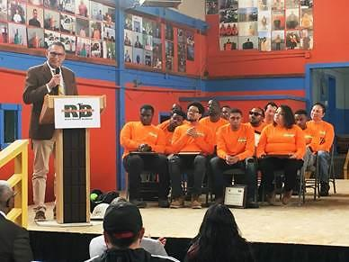
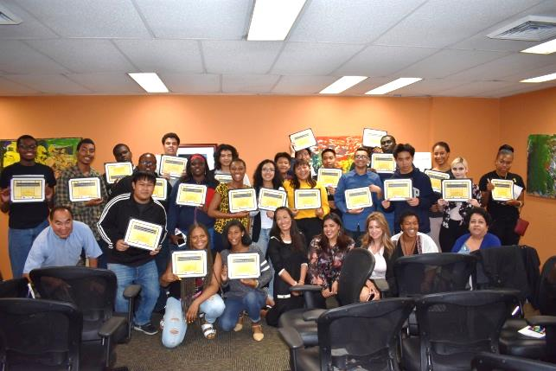


Employment and Training
FY2019-20 Draft Budget Presentation
May 21, 2019

Slide 63
Mission
The Employment & Training Department is committed to the development and growth of our community that enhances the quality of life in Richmond. This will be accomplished through establishing effective private/public partnerships and implementing strategies and programs that develop a skilled, talented, educated, and competitive workforce.

Slide 64
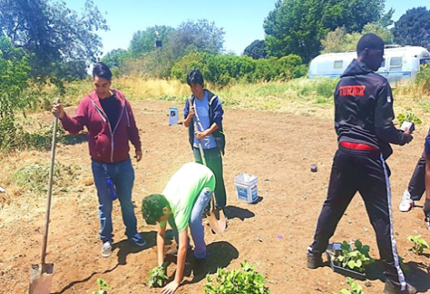
FY2018-19 Accomplishments
RichmondWORKS:
1500 job seekers participated in the Career Center services: assistance with resumes, interviewing, job/career counseling and job search/job placement
Of the 1500, 116 job seekers were enrolled into ACES (Accelerating Careers through Essential Skills) or occupational skills training
720 job placements in total with an average wage of $16.60/hr.
YouthWORKS:
210 at risk youth were provided job prep, career exploration, education or training of which 175 were placed on summer employment with government, non-profits and local businesses; 20% of the 175 had disabilities

Slide 65
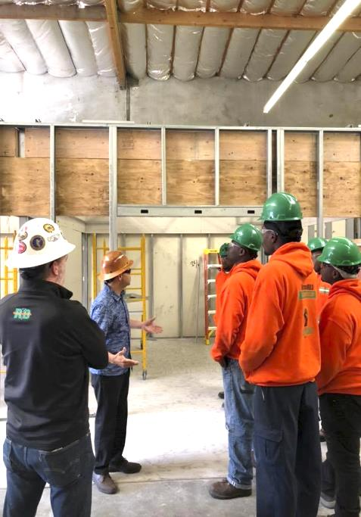
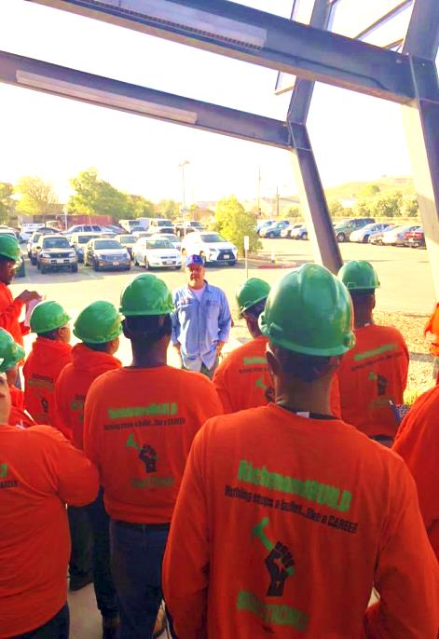
FY2018-19 Accomplishments
RichmondBUILD:
Completed three cohorts training with over 60 graduates
Was very successful in placing Richmond residents with various apprenticeship programs including Electricians, Carpenters-Local 152, Laborers Local 324, Plumbers & Steamfitters Local 342, Iron Workers Local 377, Heat and Frost-Local 16

Slide 66
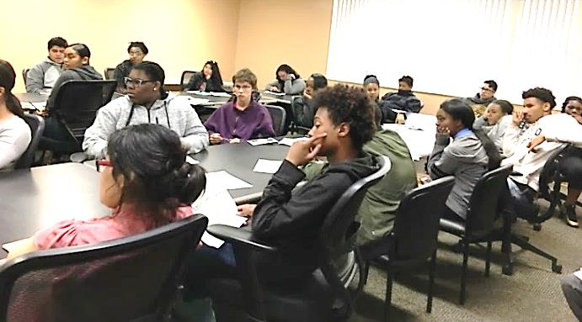
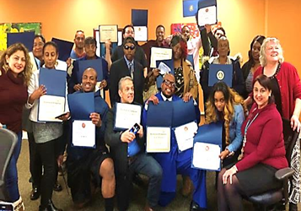
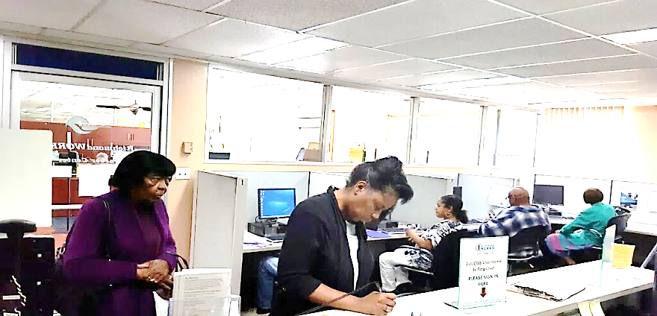
FY2019-20 Goals
RichmondWORKS and YouthWORKS:
Increase our community partnerships in order to leverage services for both our Adult and Youth programs
Expand and market our Accelerating Careers thru Essential Skills (ACES) model to the business community to help businesses retain employees
Continue to focus and design innovative programs to reach and serve community residents who face barriers to employment

Slide 67
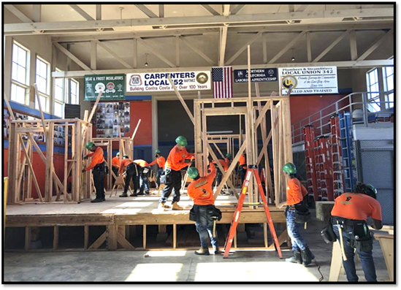
FY2019-20 Goals
  RichmondBUILD:
Operate three training cohorts and serve 75 Richmond residents
Secure funding from Senate Bill 1 and the Environmental Protection Agency
We will continue to work with various apprenticeship coordinators to increase opportunities for our graduates

Slide 68
Staff
Position | FY2018-19 Mid-Year | FY2019-20 Proposed
Administrative Aide | 1.0 | 1.0
Administrative Services Analyst | 2.0 | 2.0
Director, Employment & Training | 1.0 | 1.0
Employment Program Manager | 3.0 | 3.0
Employment Program Specialist I | 2.0 | 2.0
Employment Program Specialist II | 6.0 | 6.0
Finance Manager | 1.0 | 1.0
Office Assistant II | 1.0 | 1.0
Project Coordinator | 1.0 | 1.0
Senior Employment Program Specialist | 1.0 | 1.0
Total Full-Time Equivalent (FTEs) | 19.0 | 19.0

Slide 69
Non-General Fund Budget
FY2019-20 DRAFT BUDGET
 |  | FY2018-19 Mid-Year | FY2019-20 Proposed
Revenue | Grants | 5,983,883 | 4,574,068
 | Operating Transfer In | 1,038,102 | 1,425,197
 | ECIA | 950,000 | 500,000
 | Other Revenue | 997,994 | 776,363
 | Total Revenue | 8,114,979 | 7,275,628
Expenditures | Salaries & Wages | 1,614,215 | 1,635,649
 | Benefits | 1,088,562 | 1,165,156
 | Grant Expenditures | 2,927,278 | 3,002,626
 | Utilities | 14,300 | 17,800
 | Equipment & Contract Services | 140,000 | 165,000
 | Cost Pool | 517,002 | 540,097
 | Employment & Training Allocation | 256,283
 | Total Expenditures | 7,830,477 | 7,267,258
Net Impact |  | 284,502 | 8,370

Slide 70
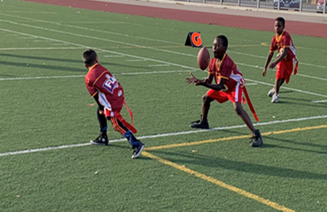
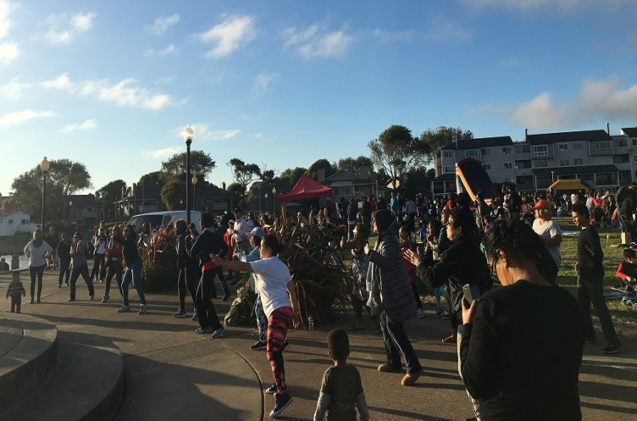
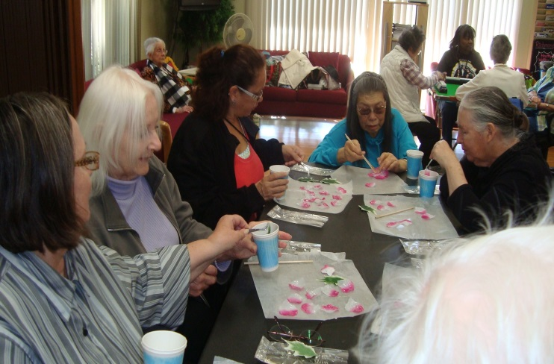
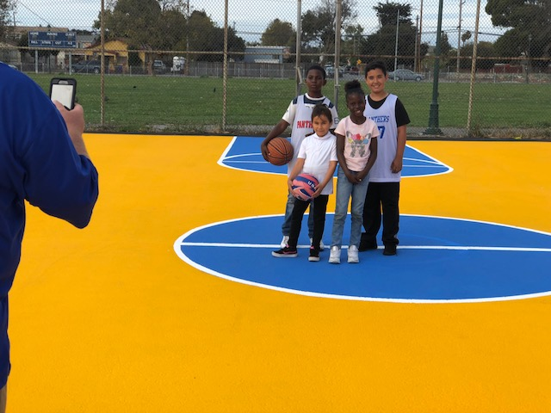
Community Services
FY2019-20 Draft Budget Presentation
May 21, 2019

Slide 71
Mission
The Community Services Department is dedicated to enriching the
quality of life in Richmond through its recreation programs, facilities, and cultural events.
Notes:
I am suggesting removing the language in red and including the words in green

Slide 72
FY2018-19 Accomplishments
Increased attendance at Camp Achieve Summer Program by 40% and demonstrated 10% literacy gains for camp attendees.
Partnered with WCCUSD and two Charter Schools to provide tennis, basketball and soccer programs to 400 students.
Received a grant in the amount of $120,000 from United States Soccer Foundation to build two acrylic mini pitch surfaces with soccer goals at Wendell Park.
Rentals at the Richmond Auditorium increased from 91 in FY2017-18 to 93 in FY2018-19 (this does not include the rentals occurring in the remainder of this fiscal year).
Disbursed ECIA mini grants to 10 organizations in FY2018-19. Each organization received $5,000.
Partnered with First Five of Contra Costa County and other Richmond-based organizations to engage Richmond residents to survey over 20 parks and to apply for Proposition 68 grant funds.
Collaborated with OES and the Red Cross to provide shelter management training for Community Services staff.
Notes:
Can you identify at least 2 goals from your areas?

Slide 73
FY2019-20 Goals
Goal #1 Governance, Finance and Leadership
1. Enforce adherence to policy and fee guidelines according to the ECI Index.
2. Maintain clean and attractive facilities to increase rentals that will generate revenues.
Goal #2 Environment, Health Equity and Sustainable Communities
1. Develop programs that enhance active health and wellness lifestyles for all participants.
2. Maintain attendance records of participants through computerized tracking system.
Goal #3 Economic Development and Education
1. Continue collaboration with the WCCUSD to provide the Achieve Summer Camp Program offering quality educational and recreational programs to prevent summer learning loss.
2. Maintain and expand outside collaborative partnerships with human service organizations.
Notes:
This is the page we need to think through as a group. This has to align with the Council’s goals that came out of their retreat.

Slide 74
Staff
Position | FY2018-19 Mid-Year | FY2019-20 Proposed
Accountant II | 1.0 | 1.0
Administrative Aide | 2.0 | 2.0
Associate Administrative Analyst | 1.0 | 1.0
Auditorium Aide | 3.2 | 3.2
Community Services Director | 1.0 | 1.0
Community Services Administration Manager | 1.0 | 1.0
Development Project Manager II | .8 | 0
Executive Secretary II | 1.0 | 1.0
Finance Manager II | 1.0 | 1.0
Office Specialist | 2.0 | 2.0
Recreation Program Coordinator | 9.0 | 9.0
Recreation Program Specialist | 1.6 | 1.6
Recreation Supervisor | 3.0 | 3
Senior Lifeguard | 1.6 | 1.6
Total Full-Time Equivalent (FTEs) | 29.2 | 28.4
New Request for: .8 Recreation Program Specialist

Slide 75
General Fund Budget
FY2019-20 DRAFT BUDGET
 |  | FY2018-19 Mid-Year | FY2019-20 Proposed
Revenue | Licenses, Permits, Fees | 730,669 | 622,551
 | Other Revenue | 3,000 | 25,000
 | Rental Income | 531,810 | 555,429
 | Grants | 29,270 | 26,250
 | Total Revenue | 1,294,749 | 1,229,230
Expenditures | Salaries & Wages | 2,933,021 | 3,005,416
 | Benefits | 1,929,530 | 2,010,695
 | Professional & Admin | 451,476 | 426,291
 | Other Operating | 114,212 | 88,332
 | Utilities | 16,212 | 13,705
 | Equipment & Contract Services | 4,000 | 11,000
 | Cost Pool | 746,846 | 576,102
 | Asset Capital Outlay | 34,966 | 8,402
 | Total Expenditures | 6,230,263 | 6,139,943
Net Impact |  | (4,935,514) | (4,910,713)

Slide 76
Non-General Fund Budget
FY2019-20 DRAFT BUDGET
 |  | FY2018-19 Mid-Year | FY2019-20 Proposed
Revenue | Licenses, Permits, Fees | 268,315
 | Grants | 431,377 | 352,518
 | Total Revenue | 699,692 | 352,518
Expenditures | Professional & Admin | 53,664 | 2,128
 | Other Operating | 11,713
 | Asset/Capital Outlay | 947,494 | 938,091
 | Grant Expenditures | 72,500 | 50,000
 | Total Expenditures | 1,085,371 | 990,219
Net Impact |  | (385,679) | (637,701)

Slide 77

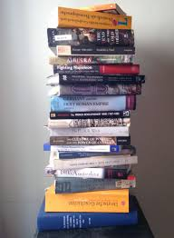
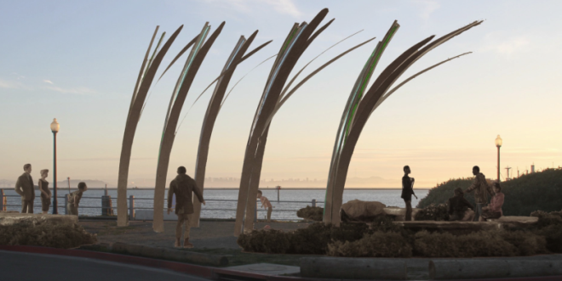
Library & Cultural Services
Insert picture
FY2019-20 Draft Budget Presentation
May 21, 2019

Slide 78
Mission
The Library and Cultural Services Department provides diverse materials and services to meet the community’s personal, cultural, educational, and professional needs onsite and at locations throughout the community. Library and Cultural Services Department is committed to supporting a lifelong enjoyment of reading, learning and the arts.
LIBRARY SERVICES:
Empower community members through free access to books, media, computers and high speed Internet and wifi @ the Library and with 24/7 online access to eBooks, audiobooks, Discover & Go museum passes, language learning and video job training courses.
Toddler to Teens and Beyond: Storytime, homework help, summer reading, college readiness, author talks and music, art, and health programs for adults all through the community
LITERACY FOR EVEY ADULT PROGRAM (LEAP)
LEAP’s mission is to raise the level of literacy among Richmond residents by providing programs to teach basic reading, writing and math skills, digital literacy skills, English language skills and career and college readiness including the GED and High School Diploma programs.
PUBLIC ART:
Implement the City CIP Percent for Public Art and the Percent for Public Art in Private Development programs
Support local art non-profits, and community based arts and culture programs

Slide 79
FY2018-19 Accomplishments
Workforce Development
Y-Plan Project: LEAP learners used research and evaluation tools to solve identified problem
Launched PACE 4 the Workplace Initiative: LEAP partnered with local employers to ensure residents attain necessary skills and education to make a living wage.
NEW @ Library: Knowledge City a offers hundreds of online video courses in Business, IT, Safety and More. Available 24/7—free with a library card.
    Educating the Next Generation Workforce
Monthly STEAM (Science, Technology, Engineering, Art and Math) programs at Main Library
Expanded Reading Buddies program to year around
NEW: ABC Mouse 24/7 Online early learning academy
Pilot Student Success Initiative to provide student library cards at a local school
Beyond Books- Free in 2018
Eye exams and glasses for kids 3-18 @ the Library
Bike repair clinics
Weekly at LEAP: Fresh Approach produce truck (attendance earns free produce), and a Yoga Class
Online Access to New York Times
    Connecting the Community through Art
Weekly and Monthly Art Projects @ the Library
10 Neighborhood Public Art Mini-Grants: Visual, multi-media, and performing arts projects
Chalk Art Event for National Audubon Society’s 100th birthday held in Civic Center Plaza
WOW (Words on Wheels) Bookvan
Established regular service to five senior sites and added programs into the project

Slide 80
FY2019-20 Goals
LIBRARY AND CULTURAL SERVICES DEPARTMENT:
With community input review current programs, services, policies and procedures for potential barriers to service. Align programs/services to city/citizen priorities. Work with city and community partners to secure necessary funding and resources.
Library Services:
Expand the Student Success Initiative with school, City, and community partners.
Expand WOW book van services to provide cost effective library access to underserved and vulnerable populations:
Upgrade and improve library facilities prioritizing safety, accessibility, and increased capacity for programs and services
LEAP:
Continue to identify strategies/partnerships to increase student enrollment and completion
Continue the PACE 4 the Workplace initiative project.
Establish a Family Literacy Program for low literacy residents
Public Art:
Complete three City public art projects at Pt. Sheridan, Bradley A. Moody Underpass and Family Justice Center
Continue implementation of the Percent for Art in Private Development ordinance
Administer the Neighborhood Public Art mini-grant program

Slide 81
Staff
Position | FY2018-19 Mid-Year | FY2019-20 Proposed
Administrative Librarian | 2 | 2
Administrative Services Analyst | 1 | 1
Arts And Culture Manager | 1 | 1
Assistant Administrative Analyst | 1 | 1
Executive Secretary II | 1 | 1
Family Literacy Specialist | 1 | 1
Learning Center Manager II | 1 | 1
Library Information Systems Support Technician | 1 | 1
Librarian I | 2 | 2
Librarian II | 6 | 6
Library Aide/I | 0.7 | 0.7
Library Assistant I | 1 | 1
Library Assistant II | 5 | 5
Library Associate | 2 | 2
Library & Cultural Services Director | 1 | 1
Literacy Program Manager | 1 | 1
Office Assistant II/Pt | 0.6 | 0.6
Senior Library Assistant | 2 | 2
Volunteer Tutor/Learner Coordinator | 3 | 3
Total Full-Time Equivalent (FTEs) | 33.4 | 33.4

Slide 82
General Fund Budget
FY2019-20 DRAFT BUDGET
 |  | FY2018-19 Mid-Year | FY2019-20 Proposed
Revenue | Rental Income | 23,800 | 23,800
 | Total Revenue | 23,800 | 23,800
Expenditures | Salaries & Wages | 2,518,863 | 2,517,742
 | Benefits | 1,755,098 | 1,879,951
 | Professional & Admin | 706,754 | 702,395
 | Other Operating | 385,744 | 367,549
 | Utilities | 8,000 | 8,000
 | Cost Pool | 501,760 | 496,458
 | Total Expenditures | 5,876,219 | 5,972,095
Net Impact |  | (5,852,419) | (5,948,295)

Slide 83
Non-General Fund Budget
FY2019-20 DRAFT BUDGET
 |  | FY2018-19 Mid-Year | FY2019-20 Proposed
Revenue | Licenses, Permits and Fees | 381,093
 | Fines & Forfeitures | 19,000 | 19,000
 | Use of Money and Property | 3,787
 | Other Revenue | 8,475 | 10,675
 | Grants | 274,798 | 234,312
 | Operating Trasfer In | 16,275
 | Total Revenue | 703,428 | 263,987
Expenditures | Salaries & Wages | 600 | -
 | Professional & Admin | 807,840 | 704,378
 | Other Operating | 35,994 | 28,561
 | Utilities | 17,400 | 17,400
 | Cost Pool |  | 34,000
 | Asset/Capital Outlay | 397,315 | 333,584
 | Grant Expenditures | 11,000 | 13,696
 | Total Expenditures | 1,270,149 | 1,131,620
Net Impact |  | (566,721) | (867,632)

Slide 84
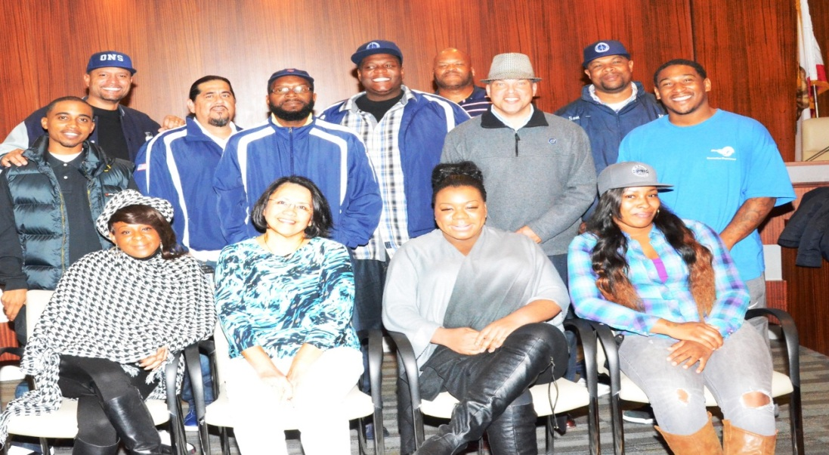
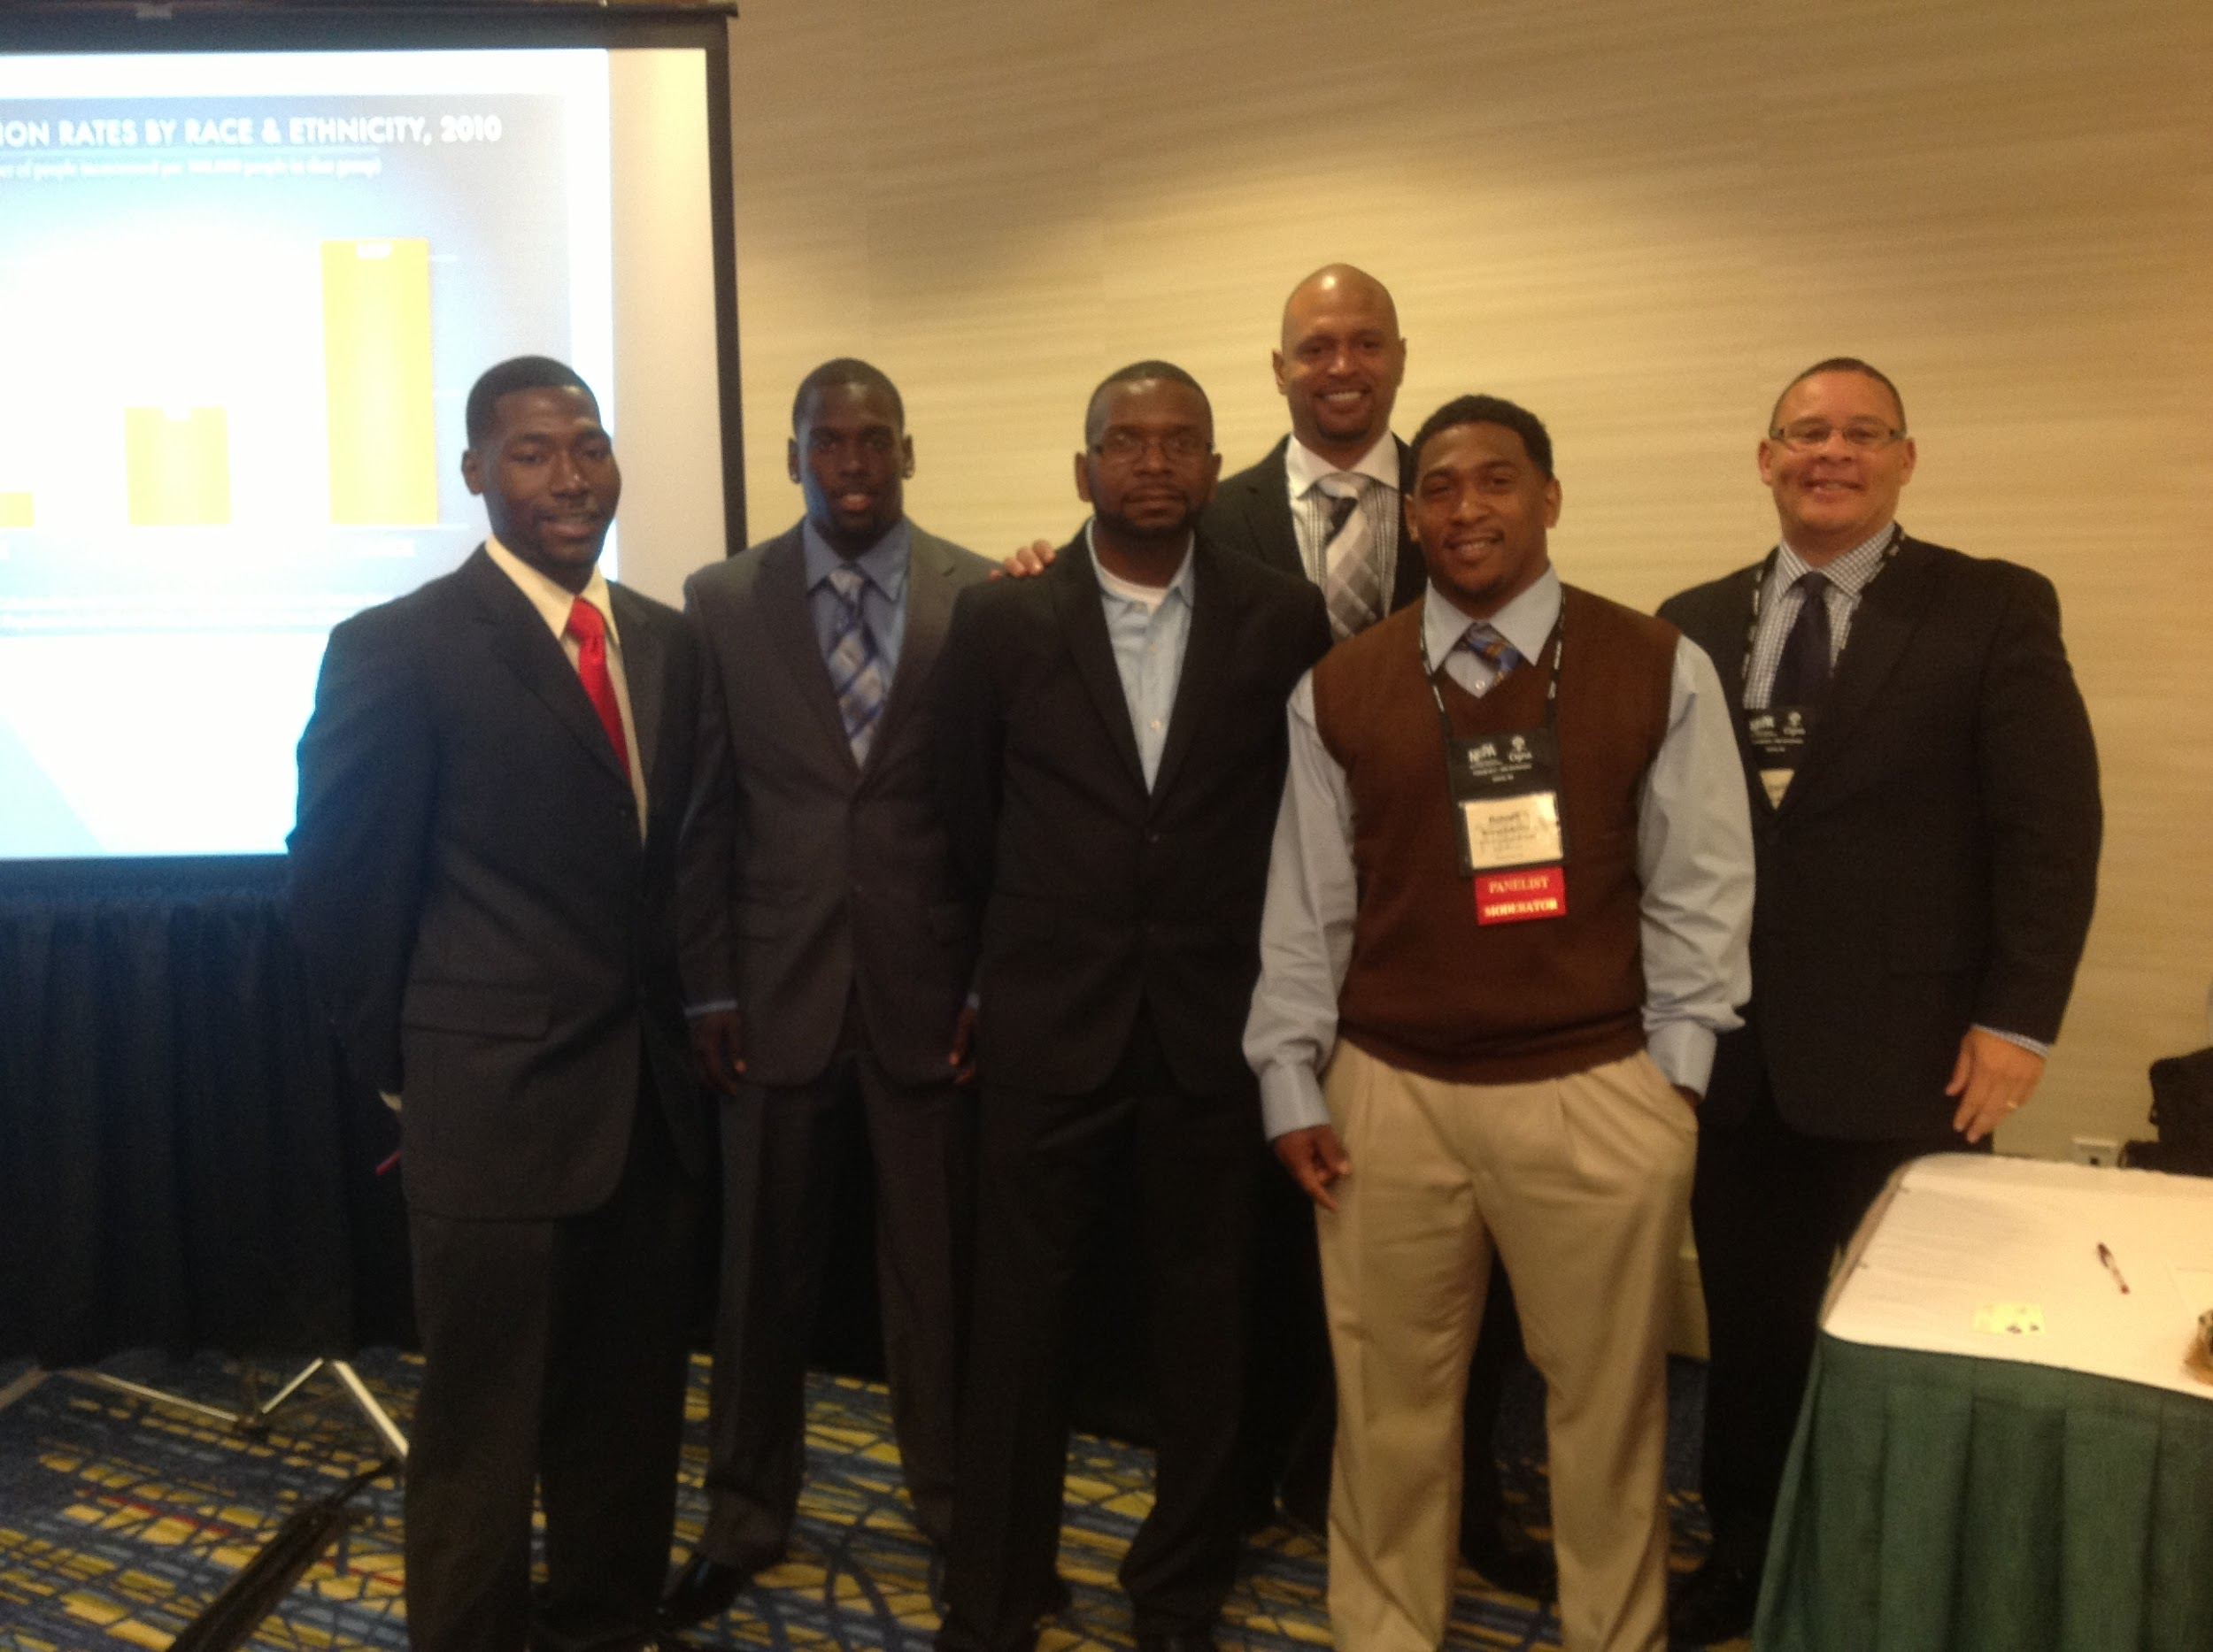
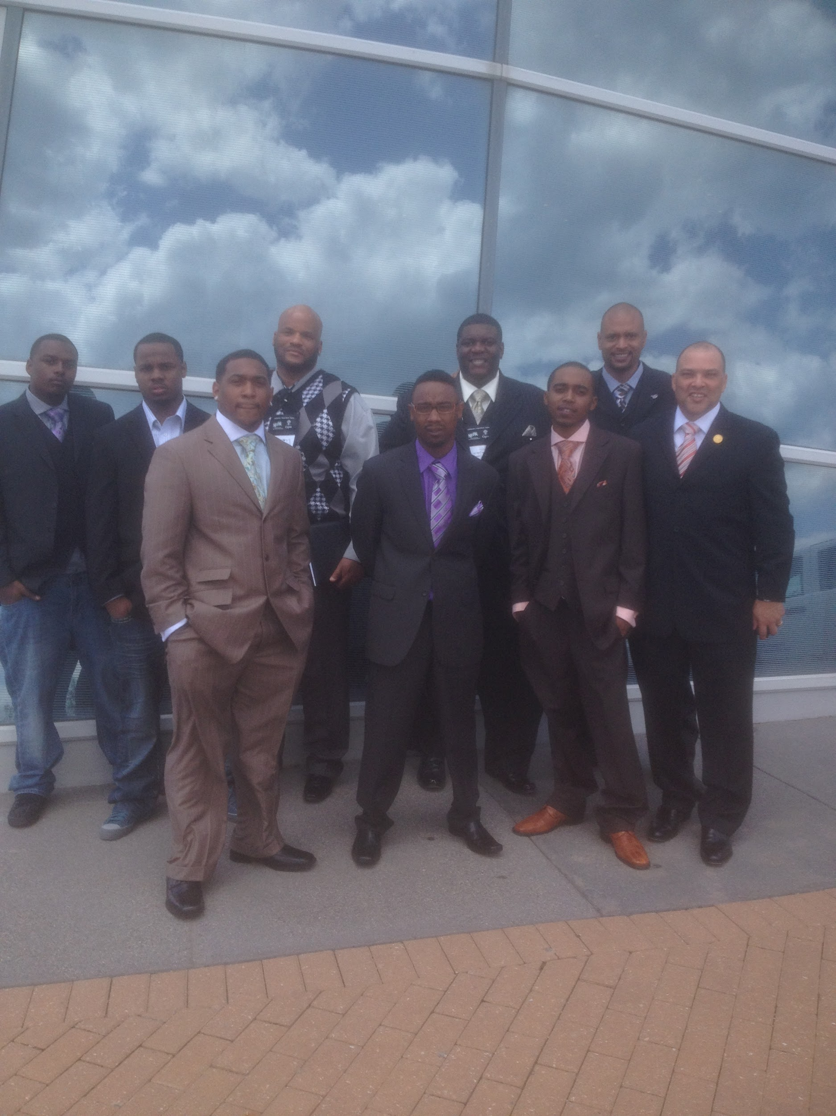
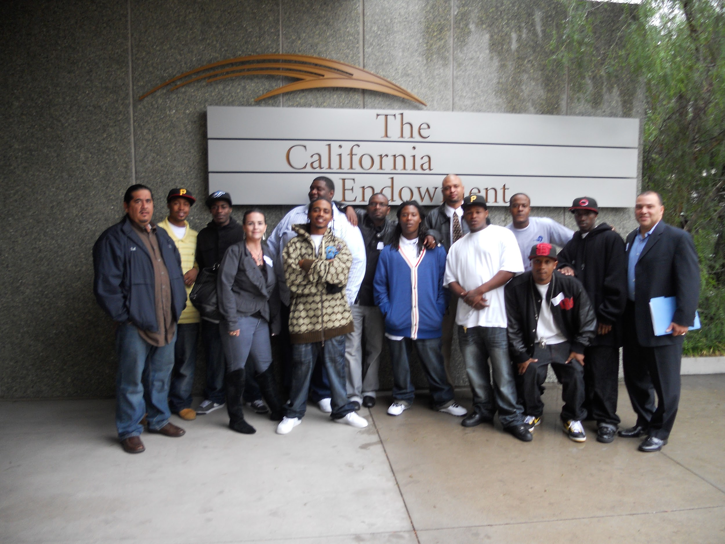
Office of Neighborhood Safety
FY2019-20 Draft Budget Presentation
May 21, 2019

Slide 85
Mission
Interrupt and reduce cyclical and retaliatory firearm assaults
Improve health status of boys and men of color involved in cyclical and retaliatory firearm assaults
Increase community safety in Richmond neighborhoods most impacted by cyclical and retaliatory gun violence
Partner with public, community-based and philanthropic stakeholders to ensure community driven and responsive services for boys and men of color impacted by gun violence
Notes:
Interrupt and Reduce cyclical and retaliatory Firearm Assaults
Improve Health Status of Boys and Men of Color involved in cyclical and retaliatory Firearm Assaults
Increase Community Safety in Richmond Neighborhoods most impacted by cyclical and retaliatory gun violence
Ensure community driven and responsive services for Boys and Men of Color impacted by gun violence by partnering with public and community stakeholders

Slide 86
FY2018-2019 Accomplishments
4638
  1:1 Intervention engagements by staff
5887
  Hours of Street Outreach Coverage
308
  Social Service Navigational Support
209
  Community Conflict Mediations
57
  Gun Violence Intervention
  Secured $600,000 in grant funding through local, state and federal resources
Notes:
Secured $600,000 in grant funding
CAVIP 2018-20 6/30/20 $500,000
East Bay Community Foundation $20,000
East Bay Community Foundation $25,000
Operation Peacemaker Fellowship $25,000
KP North Comm. Benefit Program $30,000
Total $600,000

Slide 87
FY2019-2020 Goals
Reduce cyclical and retaliatory firearm assaults
Increase Street Outreach Capacity
Provide “Upstream” Outreach and Engagement Strategy focused on Youth Ages 11-17 “at-risk” of involvement in street violence
Secure financial resources through local, state and federal grants
Notes:
Reduce cyclical and retaliatory firearm assaults: Through one on one interactions with those likely to be involved in gun violence.
Focusing on: Youth Ages 11-17 “at-risk” of involvement in street violence
Increase Street Outreach Capacity – Hire community liaisons (as Peacekeepers) to assist ONS with the mitigation of violence.
Secure financial resources through local, state and federal grants: Awaiting response from the Board of State and Community Corrections (BSCC) on award of the Youth Reinvestment Grant – 1 Million Grant award that will fund the following Agencies: Youth Services Bureau, Richmond Police Activities League and The Safe Return Project

Slide 88
Staff
Position | FY2018-19 Mid-Year | FY2019-20 Proposed
Neighborhood Change Agents | 3.0 | 3.0
ONS Program Manager |  | 1.0
Project Coordinator | 1.0 | 1.0
Recreation Program Coordinator | 2.0 | 1.0
Total Full-Time Equivalent (FTEs) | 6.0 | 6.0

Slide 89
General Fund Budget
FY2019-20 DRAFT BUDGET
 |  | FY2018-19 Mid-Year | FY2019-20 Proposed
Revenue | Other Revenue | 5,000 | 5,000
 | Grants | 585,609 | 403,087
 | Total Revenue | 590,609 | 408,087
Expenditures | Salaries & Wages | 574,835 | 679,267
 | Benefits | 390,326 | 408,279
 | Professional & Admin | 486,985 | 317,560
 | Other Operating | 31,729 | 39,352
 | Utilities | 16,000 | 16,000
 | Cost Pool | 68,320 | 47,055
 | Asset Capital Outlay | 9,651 | 9,600
 | Grant Expenditures | 188,579 | 53,087
 | Total Expenditures | 1,766,425 | 1,570,200
Net Impact |  | (1,175,816) | (1,162,113)

Slide 90
Non-General Fund Budget
FY2019-20 DRAFT BUDGET
 |  | FY2018-19 Mid-Year | FY2019-20 Proposed
Revenue
 | Total Revenue
Expenditures | Professional & Admin | 58,000 | 58,000
 | Total Expenditures
Net Impact |  | (58,000) | (58,000)

Slide 91

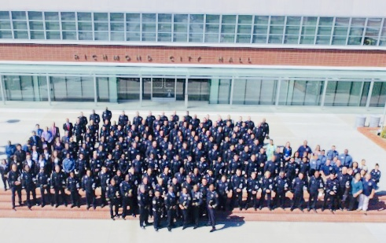
Police Department
FY2019-20 Police Budget Presentation
May 21, 2019

Slide 92
Mission
The mission of the Richmond Police Department is to prevent crime and to maintain order by providing Constitutional and professional police services that incorporate strategies grounded in community engagement and collaborative partnerships that address causes of crime and disorder, that help solve neighborhood problems, and that improve quality of life in Richmond.
In compliance with professional standards established by the Oath of Office, Professional Code of Ethics and administrative directives; perform in a manner that promotes public trust, confidence and sense of safety and security.

Slide 93
FY2018-19 Accomplishments
2018 Accomplishments
    CRIME REDUCTION – crime down, community engagement up …
    All crime -6% | Violent -12% | Property -5%
        Promising down trend in homicide rate spanning 4 decades-
            2018 = 18
            2017 = 15
            2016 = 24
        Decade averages: 2010’s = 16
        2000’s = 34
        1990’s = 38 *1991 = 61
        1980’s = 24
    *Highest annual tally in recorded history.

Slide 94
FY2018-19 Accomplishments
2018 Accomplishments
    Mark43 CAD/RMS Transition Complete
      Public safety-specific software that enables computer aided dispatch and records management systems to function in concert – it represents a modern, new kind of web-based public safety platform that allows first responders to collect, manage, analyze, and share information
    Community Safety Academy – Fourth Cohort
      Premise: Community safety is everyone responsibility
      Aim: Engage community members to learn crime prevention, connect with neighbors, “behind the scenes” look at policing

Slide 95
FY2019-20 Goals
Address Crime & Disorder – Zero Homicides
  Notable change or update in 2018
      Changing nature of homicides – 1 of 18 acts by firearm | 14 of 15 in 2017 | 22 of 25 in 2016 | 4 cases linked to homelessness
      Shootings on the decline –
        ShotSpotter activations decreased 14% compared to 2017
        Firearms assaults on people decreased 19%
  All hands priority, everyone can play a role
  Partner with others
  Address root causes
  Relentless follow up, follow through

Slide 96
FY2019-20 Goals
Strategic Plan 2019-2021 Development
  Our Vision: Our vision is to provide professional police services by partnering with our community to ensure Richmond is a safe place to live, work, and visit.
  Our Core Values are fundamental beliefs we hold which form the foundation on which we perform work and conduct ourselves. They require constant abidance in an ever-changing world. They are practices we should be using every day in everything that we do.
      SERVICE
      LEADERSHIP
      CHARACTER
      DEVELOPMENT
      RESPECT

Slide 97
FY2019-20 Goals
Community Engagement Growth – Police Transparency
  Community Safety Academy
  Pound the Beat
  “Community Briefing” video segments
  Park Ranger Program
  Engage Young People
    Police Explorer Program
    RPAL
    RYSE
    SRO

Slide 98
Staff
Position | FY2018-19 Mid-Year | FY2019-20 Proposed
Asst Police Chief | 1.0 | 1.0
Police Captain | 5.0 | 4.0
Police Chief | 1.0 | 1.0
Police Lieutenant | 8.0 | 9.0
Police Officer | 127.0 | 128.0
Police Officer Trainee | 8.0 | 8.0
Police Sergeant | 28.0 | 28.0
TOTAL SWORN | 178.0 | 179.0
Accountant II | 1.0 | 1.0
Administrative Aide | 2.0 | 5.0
Administrative Trainee | 2.0 | 1.0
Assistant Police Property Technician | 2.0 | 2.0
Administrative Service Analyst | 1.0 | 1.0
CCTV Wireless & Systems Specialist | 1.0 | 1.0
Code Enforcement Officer II | 1.0 | 1.0
Communications Call Taker | 1.0 | 1.0

Slide 99
Staff (Continued)
Position | FY2018-19 Mid-Year | FY2019-20 Proposed
Communications Dispatcher I | 4.0 | 4.0
Communications Dispatcher II | 12.0 | 12.0
Communications Manager | 1.0 | 1.0
Communications Shift Supervisor | 4.0 | 4.0
Crime Analysis Technician | 3.0 | 1.0
Crime Analyst | 1.0 | 1.0
Crime Prevention Manager | 1.0 | 1.0
Crime Prevention Specialist |  | 1.0
Crime Scene Technician | 3.0 | 5.0
Jailer | 5.0 | 6.0
Network and Systems Specialist I | 1.0 | 1.0
Network and Systems Specialist II | 1.0 | 1.0
Office Assistant II | 1.0 | 1.0
Parking Enforcement Representative | 5.0 | 5.0
Police Assistant | 1.0 | 0.0
Police Property Technician | 1.0 | 1.0
Police Records Specialist | 9.0 | 9.0

Slide 100
Staff (Continued)
Position | FY2018-19 Mid-Year | FY2019-20 Proposed
Police Records Supervisor | 1.0 | 1.0
Project Manager II | 1.0 | 1.0
Public Information Officer | 1.0 | 1.0
Public Safety Technology Supervisor | 1.0 | 1.0
Senior Accountant | 1.0 | 1.0
Systems Administrator | 1.0 | 1.0
TOTAL NON SWORN | 70.0 | 73.0
Total (FTEs) | 248.0 | 252.0
*Additional Request:
-Police Officer 2
-Communication Dispatcher I 2

Slide 101
General Fund Budget
FY2019-20 DRAFT BUDGET
 |  | FY2018-19 Mid-Year | FY2019-20 Proposed
Revenue | Licenses, Permits, Fees | 603,749 | 569,498
 | Fines & Forfeitures | 611,800 | 580,957
 | Charges for Services | 1,497,046 | 1,017,561
 | Other Revenue | 108,000 | 107,296
 | Grants | 129,623 | 150,000
 | Total Revenue | 2,950,218 | 2,425,311
Expenditures | Salaries & Wages | 32,198,178 | 32,401,242
 | Benefits | 22,124,534 | 25,638,289
 | Professional & Admin | 3,460,569 | 4,096,068
 | Other Operating | 2,402,964 | 2,472,062
 | Utilities | 294,120 | 340,299
 | Equipment & Contract Services | 365,940 | 480,255
 | Cost Pool | 3,719,473 | 4,382,674
 | Asset Capital Outlay | 322,018 | 318,261
 | Debt Service | 236,160 | 236,160
 | Operating Transfer Out | 3,910,462 | 3,677,082
 | Total Expenditures | 69,034,418 | 74,042,394
Net Impact |  | (66,084,200) | (71,617,082)

Slide 102
NON-General Fund Budget
FY2019-20 DRAFT BUDGET
 |  | FY2018-19 Mid-Year | FY2019-20 Proposed
Revenue | Licenses, Permits & Fees | 57,886
 | Charges for Services | 851,278 | 838,403
 | Other Revenue | 230,346 | 230,346
 | Grants | 269,435 | 161,024
 | Operating Transfer In | 4,839,190 | 4,727,723
 | Total Revenue | 6,248,135 | 5,957,496
Expenditures | Salaries & Wages | 2,672,463 | 2,665,378
 | Benefits | 1,414,605 | 1,517,154
 | Professional & Admin | 679,870 | 621,176
 | Other Operating | 8,981 | 5,000
 | Utilities | 50,000 | 50,000
 | Equipment & Contract Services | 108,846 | 140,246
 | Cost Pool | 947,740 | 901,540
 | Asset Capital Outlay | 424,399 | 420,997
 | Operating Transfer Out | 200,000
 | Total Expenditures | 6,506,904 | 6,321,491
Net Impact |  | (258,769) | (363,995)

Slide 103
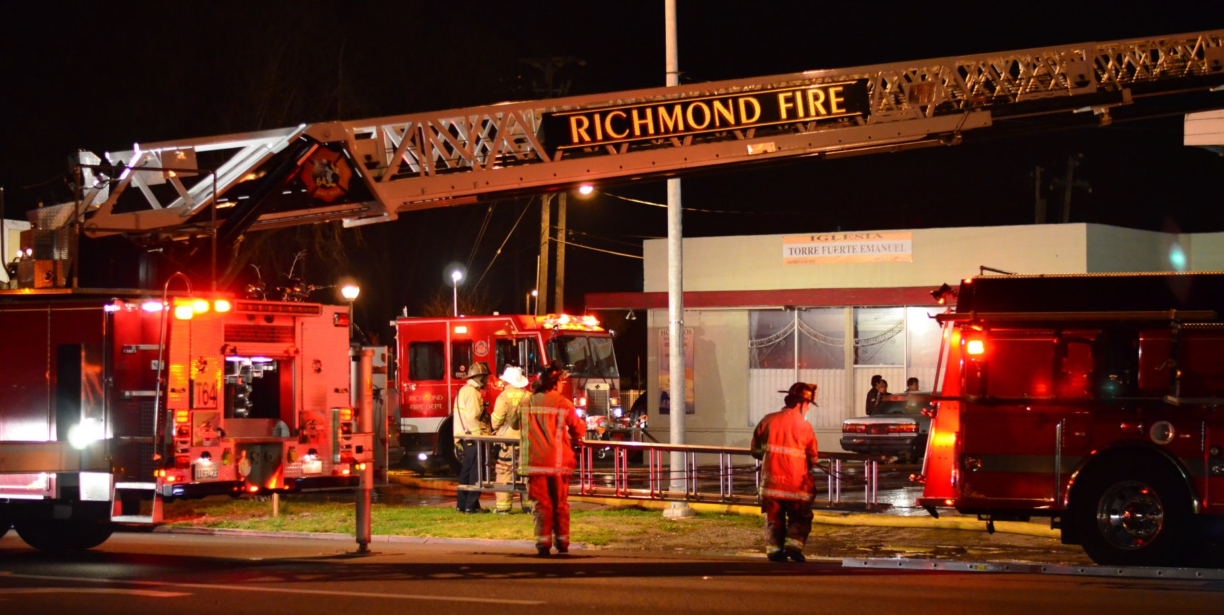
Fire Department
FY2019-20 Draft Budget Presentation
May 21, 2019

Slide 104
Mission
The Richmond Fire Department is a dedicated workforce of highly motivated and technically skilled professionals of rapid response. It is our purpose to protect life and preserve property.
We are a profession that knows no limit to what we will respond to and we prepare without constraint to meet the challenges of our chosen profession.
The citizens, businesses and visitors to the City of Richmond can expect a caring, courteous and competent response when rendered our aid.

Slide 105
FY2018-19 Accomplishments
Implemented new emergency and informational communication methods with community (Nixle, Next Door, Twitter)
Conducted the first Community Emergency Response Team training solely in Spanish.
Actively participated in several recruitment events and modernized recruitment efforts to reach a diverse audience.
Graduated three firefighter trainees from a 19-week fire academy.
Expanding the City’s emergency readiness plans and Emergency Support Functions
Conducted advanced emergency operations center training and annual drill for 100+ city staff.

Slide 106
FY2019-20 Goals
Deploy mobile data technology to streamline emergency communications between dispatch and operations, allowing for optimized on-scene management and data collection.
Take possession of, and conduct training on, new tiller apparatus.
Update occupancy inspection program and fire prevention services.
Publish Emergency Support Functions as part of City’s Emergency Operations Plan (EOP).
Continue to provide high quality emergency and non-emergency services.
Continue to partner with citizens, schools and businesses to promote fire safety, public education and civic engagement.
Supports City Council strategic priority of Full Service and Safe Community
(2D, 2E, 2F, 2G)

Slide 107
Fire Department Staff
Position | FY2018-19 Mid-Year | FY2019-20 Proposed
Fire Chief | 1.0 | 1.0
Battalion Chief | 4.0 | 4.0
Deputy Fire Chief | 1.0 | 1.0
Fire Captain | 24.0 | 24.0
Fire Engineer | 25.0 | 24.0
Fire Fighter | 29.0 | 30.0
Fire Fighter Trainee
Fire Inspector I | 2.0 | 2.0
Fire Inspector II | 3.0 | 3.0
Fire Marshal | 1.0 | 1.0
Total Sworn | 90.0 | 90.0
Administrative Aide | 2.0 | 2.0
Emergency Services Manager | 1.0 | 1.0
Executive Secretary II | 1.0 | 1.0
Project Manager I | 1.0 | 1.0
Total Non-Sworn | 5.0 | 5.0
Total Full-Time Equivalent (FTEs) | 95.0 | 95.0
* Additional Request:
-Fire Protection Engineer (Non-Sworn) 1.0 FTE

Slide 108
General Fund Budget
FY2019-20 DRAFT BUDGET
 |  | FY2018-19 Mid-Year | FY2019-20 Proposed
Revenue | Licenses, Permits, Fees | 990,000 | 1,180,418
 | Charges for Services | 1,421,787 | 985,174
 | Total Revenue | 2,411,787 | 2,165,592
Expenditures | Salaries & Wages | 16,059,896 | 16,168,662
 | Benefits | 11,061,612 | 12,165,186
 | Professional & Admin | 743,473 | 301,975
 | Other Operating | 138,128 | 123,446
 | Utilities | 29,800 | 33,660
 | Equipment & Contract Services | 81,353 | 110,350
 | Provision for Ins. Loss | 3,200 | 3,143
 | Cost Pool | 1,358,487 | 1,535,997
 | Asset Capital Outlay | 28,000 | 10,000
 | Debt Service | 441,520 | 116,367
 | Op. Transfers Out | 928,728 | 1,213,880
 | Total Expenditures | 30,874,197 | 31,782,666
Net Impact |  | (28,462,410) | (29,617,074)

Slide 109
Non-General Fund Budget
FY2019-20 DRAFT BUDGET
 |  | FY2018-19 Mid-Year | FY2019-20 Proposed
Revenue | Property Taxes | 215,586 | 215,586
 | Licenses, Permits, Fees | 53,188 | -
 | Use of Money & Property | 877 | -
 | Grants | 397,835 | 392,335
 | Total Revenue | 667,486 | 607,921
 | Professional & Admin | 522,817 | 581,663
 | Other Operating | 286,864 | 292,391
 | Equipment & Contract Services | 44,900 | 75,000
 | Cost Pool | 121,875 | 20,000
 | Total Expenditures | 976,457 | 969,054
Net Impact |  | (308,971) | (361,133)

Slide 110
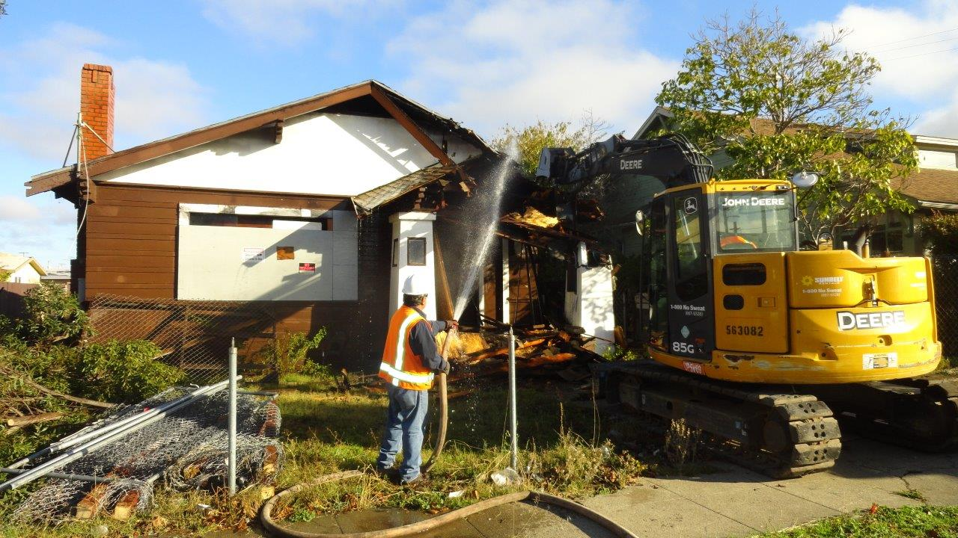
DEPARTMENT OF INFRASTRUCTURE MAINTENANCE & OPERATIONS
FY2019-20 Draft Budget Presentation
May 21, 2019

Slide 111
Mission
The Department of Infrastructure Maintenance & Operations (DIMO) in partnership with our diverse community, proudly supports and sustains the City’s environment and infrastructure through responsiveness, innovation, integrity and professionalism. DIMO strives to provide quality public service with pride and dedication to ensure a higher quality of life for the City of Richmond and our residents.

Slide 112
FY2018-19 Accomplishments
ABATEMENT
Removed 2,276 TONS of illegal dumping from city streets
and 2,040 graffiti tags from over 1,020 locations.
Conducted 13 neighborhood clean ups and assisted 204 senior citizens.
Abated 58 homeless encampments.
CODE ENFORCEMENT
Successfully implemented Receivership Program.
Demolished three uninhabitable SFD.
34 abatement warrants executed.
EQUIPMENT SERVICES
Replaced 44 vehicles for Police, Fire and seven other divisions.
Completed 1,425 work orders for repairs and maintenance.
Responded to 73 roadside calls for service.

Slide 113
FY2018-19 Accomplishments
FACILITIES MAINTENANCE
Replaced aged condensate return pumps in the Auditorium and Main Library.
Upgraded HVAC system in server room at the Communications Center.
Managed re-plastering and mural restoration at the Plunge.
PARKS
Rehabilitated tennis courts at Nicholl Park.
Opening of the Dirt World Bike Park.
New restroom at John F. Kennedy Park.

Slide 114
FY2019-20 Goals
ABATEMENT
Seek additional grant funding to assist in blight reduction efforts.
Continue working with our community and jurisdictional partners on viable homeless encampment alternatives.
Continue grant funded camera/fence installation to curtail illegal dumping and catch and prosecute illegal dumpers.
CODE ENFORCEMENT
Increase Vacant Property Registrations.
Demolish 5 red tagged/substandard properties.
Hire a part-time Vehicle Abatement Officer utilizing Vehicle
Abatement Authority Revenue

Slide 115
FY2019-20 Goals
EQUIPMENT SERVICES
Replace 51 vehicles for Police, Fire and other departments.
Shorten the amount of time that vehicles are out of service by 10%.
New roof installation and restroom upgrade for Equipment Services facility.
FACILITIES MAINTENANCE
Paint Fire Stations 62 & 63 and Booker T. Anderson Community Center.
Develop a Paint and Facility Maintenance Program
Repair water intrusion in the gym at the Recreation Center.
PARKS
New restrooms at Lucas and Southside Parks
New Futsal Court at Wendell Park.
New basketball court at John F. Kennedy and Unity Parks.

Slide 116
Staff
Position | FY2018-19 Mid-Year | FY2019-20 Proposed
Administrative Aide | 4.0 | 4.0
Associate Admin Analyst |  | 1.0
Building Trades Worker I | 1.0
Building Trades Worker II | 2.0 | 3.0
Carpenter | 2.0 | 2.0
Code Enforcement Officer I |  | 1.0
Code Enforcement Officer II | 6.0 | 5.0
Code Enforcement Superintendent | 1.0 | 1.0
Combo Equipment Mechanic | 7.0 | 7.0
Construction & Maintenance Supervisor | 1.0
Custodial Maintenance Supervisor | 1.0 | 1.0
Director, Infrastructure & Maintenance | 1.0 | 1.0
Equipment Mechanic III | 1.0 | 1.0
Equipment Mechanic IV | 2.0 | 2.0
Equipment Operator | 1.0 | 1.0
Equipment Parts Specialist | 1.0 | 2.0
Equipment Storekeeper | 1.0
Equipment Services Superintendent | 1.0 | 1.0
Equipment Supervisor | 1.0 | 1.0

Slide 117
Staff (Continued)
Position | FY2018-19 Mid-Year | FY2019-20 Proposed
Executive Secretary II | 1.0
Gardener | 3.0 | 2.0
Groundskeeper/Gardener | 14.0 | 14.0
Maintenance Leadworker | 4.0 | 6.0
Maintenance Worker I | 3.0 | 3.0
Maintenance Worker II | 3.0 | 3.0
Painter | 2.0 | 2.0
Parks & Landscaping Superintendent | 1.0 | 1.0
Parks Construction & Maintenance Worker | 9.0 | 8.0
Parks Supervisor | 3.0 | 3.0
Public Works Administrative Manager | 1.0
PW Facilities Maint. Superintendent | 1.0 | 1.0
Public Works Superintendent |  | 1.0
Stationery Engineer | 3.0 | 3.0
Stationery Engineer Supervisor | 1.0 | 1.0
Tree Lead worker | 1.0 | 1.0
Utility Worker II | 11.0 | 11.0
Total Fulltime Equivalents (FTEs) | 95 | 94

Slide 118
General Fund Budget
FY2019-20 DRAFT BUDGET
 |  | FY2018-19 Mid-Year | FY2019-20 Proposed
Revenue | Licenses, Permits, Fees | 970,000 | 930,000
 | Charges for Services | 100,000 | 160,000
 | Other Revenue | 20,000 | 10,000
 | Rental Income | 15,000 | 18,000
 | Proceeds from Sale of Property | 55,000 | 55,000
 | Total Revenue | 1,160,000 | 1,173,000
Expenditures | Salaries & Wages | 6,718,864 | 6,691,417
 | Benefits | 5,052,584 | 5,346,174
 | Professional & Admin | 241,528 | 256,730
 | Other Operating | 2,047,574 | 2,151,872
 | Utilities | 2,189,094 | 2,226,387
 | Equipment & Contract Services | 373,379 | 371,896
 | Cost Pool | 1,521,953 | 1,523,727
 | Asset Capital Outlay | 39,579 | -
 | A87 Cost Plan Reimbursements | (984,319) | (900,162)
 | Total Expenditures | 17,200,236 | 17,668,041
Net Impact |  | (16,040,236) | (16,495,041)

Slide 119
Non-General Fund Budget
FY2019-20 DRAFT BUDGET
 |  | FY2018-19 Mid-Year | FY2019-20 Proposed
Revenue | Property Taxes | 1,574,783 | 1,604,453
 | Charges for Services | 580,114 | 2,239,000
 | Other Revenue | 68,500 | -
 | Grants | 75,000
 | Loan/Bonds Proceeds | 1,230,660
 | Operating Transfer In | 608,505 | 946,850
 | Total Revenue | 4,137,562 | 4,790,303
Expenditures | Salaries & Wages | 1,037,646 | 1,069,515
 |  | 608,271 | 697,558
 | Benefits | 430,478 | 300,419
 | Professional & Admin | 129,331 | 190,645
 | Other Operating | 175,395 | 175,395
 | Utilities | 84,854 | 82,075
 | Equipment & Contract Services | 196,554 | 199,670
 | Cost Pool | 3,151,991 | 2,294,000
 | Asset/Capital Outlay | 72,742 | 326,018

Slide 120
Non-General Fund Budget (Continued)
FY2019-20 DRAFT BUDGET
 |  | FY2018-19 Mid-Year | FY2019-20 Proposed
Expenditures | Debt Service Expenditure | 72,742 | 326,018
 | Total Expenditures | 5,887,261 | 5,335,296
Net Impact |  | (1,749,699) | (544,993)

Slide 121
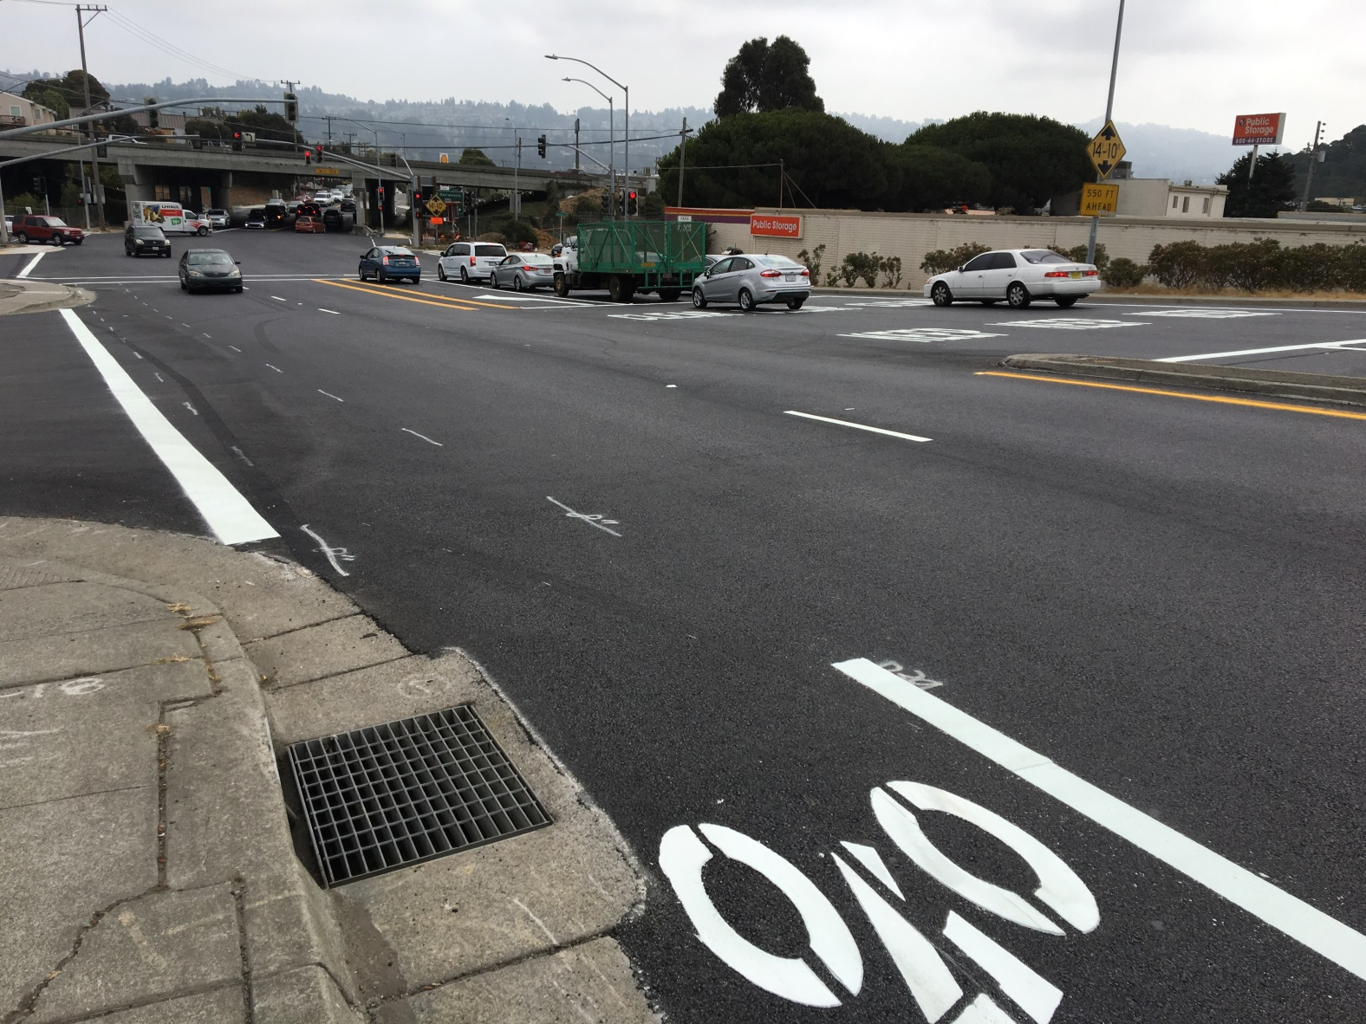
Engineering & CIP Department
FY2019-20 Draft Budget Presentation
May 21, 2019
Notes:
Central Avenue Pavement Rehabilitation

Slide 122
Engineering & CIP Department
Mission
To enhance the City’s physical environment, including infrastructure, community facilities and City-owned properties, to the greatest degree possible as efficiently as possible, in order to promote economic vitality and enhance the quality of life of the citizens in Richmond.

Slide 123
Engineering & CIP Department
FY2018-19 Accomplishments
Plunge Swimming Pool Re-plastering
Central Avenue Pavement Resurfacing
San Pablo Avenue Complete Streets Project
Harbour Way South Pavement Resurfacing
South Harbour Way Resurfacing (Richmond Ferry Terminal)
Carlson Crosstown Connection Complete Street
37th Street Bicycle & Pedestrian Improvements
Rehabilitate 60% of Richmond Parkway from I-80 to San Pablo Avenue

Slide 124
Engineering & CIP Department
FY2019-20 Goals
Deliver Americans With Disabilities Act sidewalk repair and curb ramp construction program
Complete the I-80/Central Avenue Interchange Phase II Environmental Impact Report and start construction
Start construction of the Via Verdi Landslide Repair
Construct San Francisco Bay Trail-Goodrick Avenue
Deliver the 2019-20 Paving Program
Construct the 23rd Street Traffic Signal Interconnect Project
Start the Yellow Brick Road Project construction
Replace roofs at the Recreation Child Care Center, Developing Personal Resources Center (DPRC), Richmond Museum of History, Shields-Reid Community Center, Senior Center, Fire Station 67
Complete construction of the Shields Reid ADA improvements
Rehabilitate Castro Ranch Road
Construct the short term Bicycle-Pedestrian connection (Pt. Richmond to Richmond Greenway and BART)

Slide 125
Staff
Position | FY2018-19 Mid-Year | FY2019-20 Proposed
Administrative Aide | 1.0 | 1.0
Construction Inspector I | 2.0 | 2.0
Construction & Maintenance Supervisor | 1.0 | 1.0
Development Project Manager II | 1.0 | 1.0
Electrical Supervisor | 1.0 | 1.0
Electrician | 5.0 | 5.0
Equipment Operator | 10.0 | 10.0
Executive Secretary II | 1.0 | 1.0
Maintenance Lead Worker | 3.0 | 3.0
Maintenance Worker I | 4.0 | 4.0
Maintenance Worker II | 7.0 | 6.0
Office Assistant II | 2.0 | 1.0
Public Works Administrative Manager |  | 1.0
Public Works Maintenance & Operations Director | 1.0 | 1.0
Public Works Streets Maintenance Superintendent | 1.0 | 1.0
Senior Civil Engineer | 3.0 | 3.0
Total Full-Time Equivalent (FTEs) | 43.0 | 42.0

Slide 126
General Fund Budget
FY2019-20 DRAFT BUDGET
 |  | FY2018-19 Mid-Year | FY2019-20 Proposed
Revenue | Charges for Services | 900,000 | 900,000
 | Total Revenue | 900,000 | 900,000
Expenditures | Salaries & Wages | 2,763,610 | 2,772,505
 | Benefits | 2,206,156 | 2,260,517
 | Professional & Admin | 173,335 | 175,796
 | Other Operating | 207,064 | 195,546
 | Utilities | 1,227,040 | 1,231,869
 | Equipment & Contract Services | 175,000 | 175,000
 | Cost Pool | 1,714,426 | 1,679,094
 | Debt Service | 677,474 | 537,762
 | Total Expenditures | 9,144,105 | 9,028,089
Net Impact |  | (8,244,105) | (8,128,089)

Slide 127
Non-General Fund Budget
FY2019-20 DRAFT BUDGET
 |  | FY2018-19 Mid-Year | FY2019-20 Proposed
Revenue | Licenses, Permits, Fees | 654,967 | 654,967
 | Charges for Services | 1,217,119 | 1,074,241
 | Other Revenue | 2,500 | 2,500
 | Gas Tax | 4,701,669 | 4,747,540
 | Grants | 12,582,956 | 12,162,415
 | Operating Transfer-In | 756,583 | 1,524,328
 | Total Revenue | 19,915,794 | 20,165,991
Expenditures | Salaries & Wages | 722,665 | 739,891
 | Benefits | 509,524 | 528,545
 | Professional & Admin | 671,989 | 343,050
 | Other Operating | 2,653 | 6,425
 | Utilities | 2,800 | 4,300
 | Equipment & Contract Services | 1,069,612 | 863,133
 | Cost Pool | 1,020,543 | 998,111
 | Asset/Capital Outlay | 24,225,367 | 21,112,390
 | Total Expenditures | 28,225,153 | 24,595,845
Net Impact |  | (8,309,359) | (4,429,854)

Slide 128
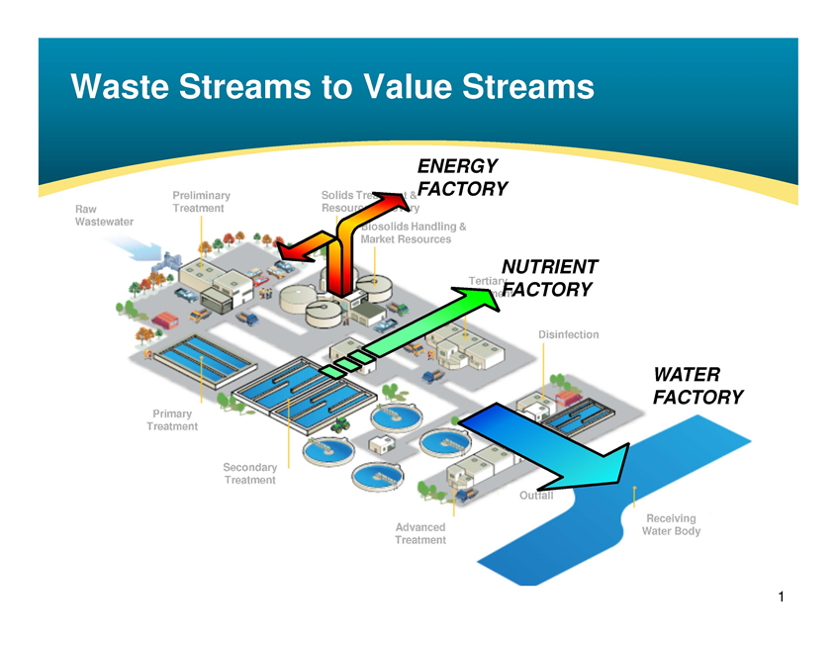
Water Resource Recovery
FY2019-20 Draft Budget Presentation
May 21, 2019

Slide 129
Mission
Protecting Richmond’s public health and environment, and transforming stormwater and wastewater into resources.

Slide 130
FY2018-19 Accomplishments
Rehabilitation of all 3 secondary clarifiers at the wastewater treatment facility
Completion of the 13th Street Sewer Wet Weather Capacity Project
Completion of the South 23rd Street Sewer Replacement Project
Successfully negotiated a new settlement agreement with the San Francisco Baykeeper
Amended Veolia’s contract to: (1) lower capital program markup from 24% to 16.5%, and (2) extend contract for additional 5 years, among other provisions

Slide 131
FY2019-20 Goals
Achieve 80% trash load reduction requirement by July 1, 2019
Obtain funds to construct deferred treatment plant and Baykeeper mandated projects
Obtain funds to construct new headworks and aeration system upgrade at the wastewater treatment plant to improve the facility's performance and reliability
Achieve goal of 27 or less sanitary sewer overflows (SSOs) in calendar year 2019

Slide 132
Staff
Position | FY2018-19 Mid-Year | FY2019-20 Proposed
Administrative Aide | 1.0 | 1.0
Administrative Services Analyst | 1.0 | 1.0
Director of Water Resource Recovery | 1.0 | 1.0
Environmental Compliance Inspector | 3.0 | 3.0
Environmental Services Manager | 1.0 | 1.0
Infrastructure Administrator | 1.0 | 1.0
Project Coordinator | 1.0 | 1.0
Project Manager I | 1.0 | 1.0
Total Full-Time Equivalent (FTEs) | 10.0 | 10.0

Slide 133
Non-General Fund Budget
FY2019-20 DRAFT BUDGET
 |  | FY2018-19 Mid-Year | FY2019-20 Proposed
Revenue | Licenses, Permits, Fees | 4,507,285 | 1,970,403
 | Fines & Forfeitures | 2,000 | 4,000
 | Charges for Services | 25,492,712 | 26,151,388
 | Rental Income | 4,380 | 4,380
 | Grant | 4,136,551 | 3,000,000
 | Total Revenue | 34,142,928 | 31,130,171
Expenditures | Salaries & Wages | 1,162,002 | 1,217,817
 | Benefits | 539,650 | 681,049
 | Professional & Admin | 9,396,326 | 10,273,003
 | Other Operating | 271,431 | 307,045
 | Utilities | 971,524 | 1,245,826
 | Equipment & Contract Services | 308,580 | 383,180
 | Cost Pool | 887,229 | 916,370
 | Asset/Capital Outlay | 22,821,833 | 7,681,000
 | Debt Service | 8,538,658 | 8,322,867
 | Total Expenditures | 44,897,233 | 31,028,157
Net Impact |  | (10,754,305) | 102,014

