Slide 1
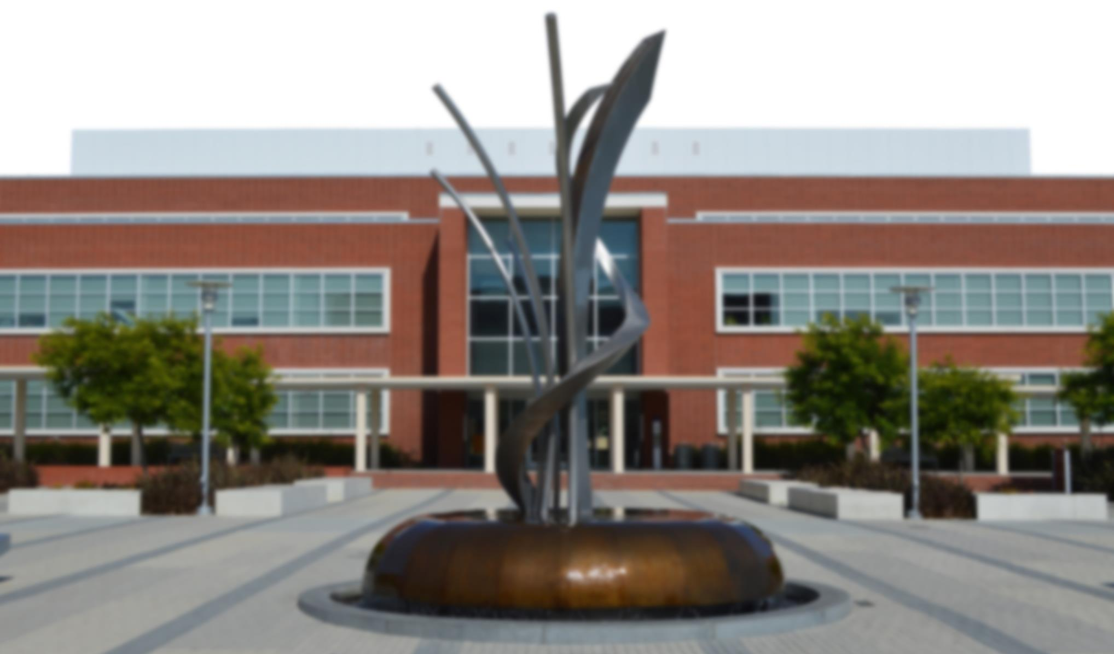
City of Richmond, California
FY2019-20 Draft Budget
May 7, 2019

Slide 2
DRAFT BUDGET & CIP INTRODUCTION
INTRODUCTION
1st Draft of FY 19-20 Annual Operating Budget & 5 Yr. 19-24 CIP
Not a substantive discussion
Overview Only
Approve process & schedule
PROCESS
February 8 – CC Strategic Priorities
March 1, Budget kick off meeting
44 key priorities included in Staff Work Plan
April 19, Departments presented budgets
Revenues | $ 172,796,469
Expenditures | $ 180,389,631
Surplus/Deficit | $ (7,593,162)

Slide 3
DRAFT BUDGET & CIP INTRODUCTION
PROCESS
Hearings: May 7, 21, 28 & June 4, 18, 25
Individual meetings with Council members TBD
May 16, Department Budget Presentation
Community Meetings: May 20 (a.m.) & June 11 (p.m.)
Priorities on online dashboard
  Tyler Technologies Inc. : $120K/yr. – 5 yrs.

Slide 4
DRAFT BUDGET & CIP INTRODUCTION
ASSUMPTIONS
US Economy will continue slowly expanding
Demand slowing – Tax cuts effects fading
Inversion of yield curve in late March – Recession?
  Long-term bond yields < short term bond yields
Near-term Recession risk not elevated.
Growth slowdown
  Labor & Capital constraints
  Tight labor markets

Slide 5
DRAFT BUDGET & CIP INTRODUCTION
ASSUMPTIONS
Conservative Projections, Increases
Property Tax: 3.1%
Sales & Use Taxes: 4.7%
Utility Users Taxes: 1%
Expenses > 12.5%
Richmond median home price 3/18-3/19 = 0,1%
  Bay Area prices < 0.6% Sales down 14% - CoreLogic
SEIU 1% > $1.1M + 1% bonus $1.1M - in budget

Slide 6
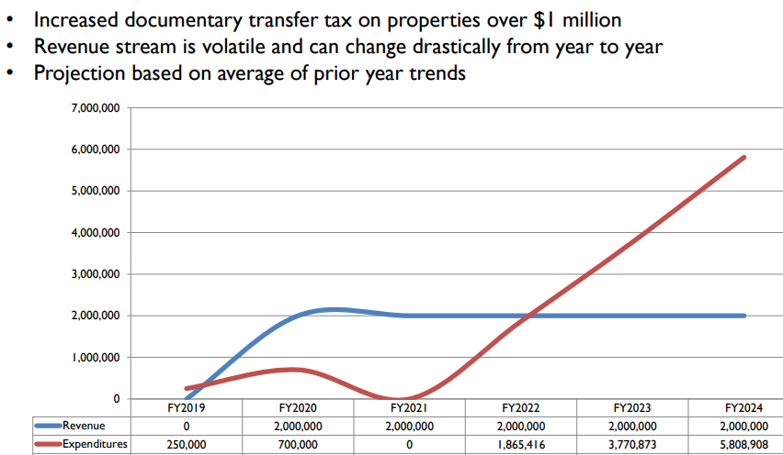
DRAFT BUDGET & CIP INTRODUCTION
ASSUMPTIONS
Transfer tax collected included in budget
  ~ $600K expected to generate $2M
  Mitigation of 1%, 2%, 3% of GF contribution starting 2022

Slide 7
DRAFT BUDGET & CIP INTRODUCTION
ASSUMPTIONS
Other Financial issues:
  RHA debt: $8.1 M as of March 2019
  Negative Balances in General Fund: $12.9M
  Retirement & OPEB obligations
    CalPERS lowered discount rate 7.5% to 7%
    Shortened period to pay unfunded liability 30 yrs. – 20 yrs.
    Long term savings – Short term pain…Higher contributions
    CalPERS Normal Cost: 13% & 21.6% of Payroll – Misc. & Safety
    Unfunded Accrued Liability FY19-20: $22M from FY17-18: $14M

Slide 8
DRAFT BUDGET & CIP INTRODUCTION
Capital Improvement Plan (CIP) budget totals $38 million
  CIP Project Highlights:
    Street Paving - $4.4 million
    I-80 Interchange - $2.4 million
    Yellow Brick Road - $7.3 million
    Stormwater Water Capture Facility - $3 million
Major Sources of Funding:
  Gas Tax
    Road Maintenance Rehabilitation Account (RMRA)/SB1
  Measure J
  Grants
  Impact Fees

Slide 9
DRAFT BUDGET & CIP INTRODUCTION
CONCLUSION
$7.5 M Budget Deficit
Potential savings:
Civic Center bond refunding
Lower risk management contributions
Two tier benefit system – Eliminating OPEB
Restructuring City Organization
  78% of GF revenues ($172M) – Personnel: ($134M)
  Retirement obligations difficult to sustain
  Additional Revenues 2-3 years away
Challenge: Bridging the gap in next 2-3 years

Slide 10
Revenues – June 2018 (audited)
0001-GENERAL FUND | ORIGINAL BUDGET | REVENUE ADJ. | REVISED ESTIMATED REVENUES | ACTUAL YTD REVENUE | REMAINING REVENUE | 100%Threshold PCT COLLECTED
30 PROPERTY TAXES | 38,782,023 | (420,758) | 38,361,265 | 38,961,021 | (599,756) | 101.6%
31 SALES & USE TAX | 42,299,235 | 577,424 | 42,876,659 | 44,474,973 | (1,598,314) | 103.7%
32 UTILITY USERS TAX | 45,916,543 | 711,300 | 46,627,843 | 46,079,755 | 548,088 | 98.8%
33 OTHER TAXES | 11,593,174 | 500,000 | 12,093,174 | 12,413,128 | (319,954) | 102.6%
34 LICENSES,PRMTS & FEES | 8,414,290 | 250,000 | 8,664,290 | 7,361,045 | 1,303,245 | 85.0%
35 FINES & FORFEITURES | 943,088 |  | 943,088 | 981,983 | (38,895) | 104.1%
37 CHARGES FOR SRVCS | 3,627,454 | 224,160 | 3,851,614 | 4,138,835 | (287,221) | 107.5%
OTHER REVENUE | 357,551 | 113,973 | 471,524 | 702,191 | (230,667) | 148.9%
39 RENTAL INCOME | 808,222 |  | 808,222 | 849,639 | (41,417) | 105.1%
GRANTS | 1,392,476 | (793,086) | 599,390 | 992,080 | (392,690) | 165.5%
90 OPER XFERS IN | 6,212,080 |  | 6,212,080 | 6,035,115 | 176,965 | 97.2%
TOTAL | 160,346,136 | 1,163,013 | 161,509,149 | 162,989,766 | (1,480,617) | 100.9%
Notes:
Sales & Use Tax – Increased sales tax collected for regular Sales Tax and both half cent measures (U & Q) stemming from increased sales at department stores, auto sales and construction materials, in addition to increase sales tax collections from online sales
Utility Users Tax – UUT related decrease related to gas and electricity collected by PG&E and Prepaid cell cards usage decreasing statewide
Other Taxes – Increase stems from significant increase in Gas Franchise from PG&E
Licenses Permits & Fees – Decrease due primarily to drop off of business license collection after efforts tied MuniServices contract spiked the previous year. Also decrease in collection from marijuana permits, fire inspection fees and abatement fees than budgeted
Charges for Services – Increased services from Police (WCCUSD, Auditorium), CM’s Office (North Richmond Mitigation Comm.), and Fire Prevention permits
Other Revenue – GF Interest allocation for CalTrust and LAIF higher than previous years
Rental Income – Combination of additional rental in Community Services and various Non-Departmental leases
Operating Transfers-In – Decreased PTORS distribution from the County based on AV being slightly lower than estimated at mid-year

Slide 11
Expenditures – June 2018 (audited)
0001-GENERAL FUND | ORIGINAL BUDGET | REVISED BUDGET | YTD EXPENDED | ENCUMBS. | AVAILABLE BUDGET | 100%Threshold PCT USED w/ ENCUMBS
40 SALARIES AND WAGES | 70,856,333 | 70,944,385 | 72,403,121 |  | (1,458,735) | 102.1%
41 PYRLL/FRINGE BENEFIT | 49,762,965 | 49,238,750 | 50,545,790 |  | (1,307,040) | 102.7%
42 PROF & ADMIN | 8,692,899 | 9,458,028 | 8,556,593 | (42,335) | 943,770 | 90.0%
43 OTHER OPERATING | 5,996,320 | 5,759,091 | 5,668,070 | (8,061) | 99,082 | 98.3%
44 UTILITIES | 3,377,559 | 3,863,130 | 3,823,912 | (10,149) | 49,367 | 98.7%
45 EQPT & CONTRACT SVCS | 1,632,813 | 1,816,240 | 1,756,313 | (11,961) | 71,888 | 96.0%
46 PROVISN FOR INS LOSS | 4,000 | 3,143 | 3,143 |  | - | 100.0%
47 COST POOL | 16,249,385 | 16,543,016 | 16,249,034 |  | 293,982 | 98.2%
48 ASSET/CAPITAL OUTLAY | 792,755 | 286,783 | 291,699 |  | (4,916) | 101.7%
49 DEBT SVC EXPENDITURE | 1,249,533 | 1,249,533 | 1,023,687 |  | 225,845 | 81.9%
4A A87 COST PLAN REIMBS | (4,433,155) | (4,484,606) | (4,577,163) |  | 92,557 | 102.1%
50 GRANT EXPENDITURES | - | 145,414 | 158,304 |  | (12,890) | 108.9%
91 OPER XFERS OUT | 6,599,286 | 7,061,311 | 7,010,216 |  | 51,094 | 99.3%
Targeted Operating Savings | (435,000) | (435,000) |  |  | (435,000) | 0.0%
TOTAL | 160,345,693 | 161,449,218 | 162,912,721 | (72,506) | (1,390,997) | 100.9%
Notes:
Salaries/Benefits – sworn overtime exceeded budget by $3.1 million; vacancy savings absorbed

Slide 12
Revenue and Expenditure Summary
 | FY2017-18 Adopted Budget | FY2017-18 Revised Budget | FY2017-18 Audited Actuals
Total Revenue | 160,346,136 | 161,509,148 | 162,989,766
Total Expenditures | 160,345,693 | 161,449,218 | 162,912,721
Net Operating Surplus/(Deficit) | 442 | 59,931 | 77,045
Notes:
Surplus of $6.1m is after paying out $3.1 million to clear non-general funds with negative cash balances: Pt Molate ($365k), Parks Fund ($1m), and Compensated Absences ($1.7m)

Slide 13
General Fund Five-Year Summary
 | FY2013-14 Audited Actuals | FY2014-15 Audited Actuals | FY2015-16 Audited Actuals | FY2016-17 Audited Actuals | FY2017-18 Audited Actuals
Total Revenue | 132,819,680 | 141,580,607 | 144,133,155 | 164,335,558 | 162,989,766
Total Expenditures | 141,911,720 | 140,354,865 | 143,417,497 | 158,253,588 | 162,912,721
Surplus/(Deficit) | (9,092,040) | 1,215,742 | 715,658 | 6,081,970 | 77,045

Slide 14
OPEB Funding Policy
Policy adopted by the City Council in 2016 to meet the objective of placing into a Trust half of any one-time revenues and one half of any year-end surplus in excess of the City’s Minimum Reserve Policy into the Trust.
City transferred $3.1 million to the Trust for the year ended June 30, 2017
Ending cash reserves are 9.5% of total expenditures, $9 million less than the City’s policy minimum of 15%
No excess cash available to transfer to the OPEB trust
Audited General Fund (GF) Year-end Cash Reserves | 15,413,405
Total Year-end Expenditures | 162,912,721
15% of total GF expenditures | 24,436,908
Amount below 15% minimum | 9,023,503
Notes:
Revised balance = 8.9% of total expenditures for FY2017-18

Slide 15
Actuals vs. Cash Reserves
 | FY2013-14 | FY2014-15 | FY2015-16 | FY2016-17 | FY2017-18
Cash Reserves | 3,661,567 | 7,283,648 | 5,900,610 | 17,574,205 | 15,413,405
Actual Expenditures | 141,911,720 | 140,354,865 | 143,417,497 | 158,253,588 | 162,912,721
Cash Reserve % of Actuals | 2.6% | 5.2% | 4.1% | 11.1% | 9.5%

Slide 16
FY2019-20 draft budget

Slide 17
General Fund Revenue
 | FY2018-19 Mid-Year Budget | FY2019-20 Draft Budget | % change
Property Taxes | 42,628,543 | 43,964,458 | 3.1%
Sales & Use Tax | 46,377,434 | 48,539,771 | 4.7%
Utility Users Tax | 46,213,222 | 46,670,419 | 1.0%
Other Taxes | 12,300,935 | 12,426,953 | 1.0%
Licenses, Permits & Fees | 7,385,618 | 6,580,667 | -10.9%
Fines & Forfeitures | 922,238 | 897,604 | -2.7%
Charges for Services | 3,833,833 | 3,226,735 | -15.8%
Rental Income | 890,610 | 914,650 | 2.7%
Grants | 764,502 | 679,337 | -11.1%
Other Revenue | 1,058,497 | 627,075 | -40.8%
Transfers In | 8,011,234 | 8,268,801 | 3.2%
Total Revenue | 170,386,666 | 172,796,469 | 1.4%
Notes:
Property Taxes - Based on combination of projected AV growth of 4% and an increase in SA Pass-through revenue stemming from State Bill 107
Sales & Use Tax - Based on projections provided by Sales Tax Consultant. Also includes a 15% increase in marijuana tax
Utility Users Tax - Decrease stems from deterioration of both cable and telecommunications (no more land lines)
Licenses, Permits, & Fees - Decrease based on actuals BL Tax received in FY2018-19 was inflated because it included many back year catch-ups through the services of MuniServices
Charges for Services - Primarily decrease to Police Department services
Grants – most grants moved to Outside Funded Grants fund
Other Revenue – This category includes miscellaneous payments, settlements, rents. Fines, etc. No major decreases except to adjust to match more closely to historical actuals
Transfer In - Increase to PTORS based on combination of projected AV growth of 4% and an increase in SA Pass-through revenue stemming from State Bill 107

Slide 18
General Fund Expenditures
 | FY2018-19 Mid-Year Budget | FY2019-20 Draft Budget | % change
Salaries | 73,155,270 | 75,586,033 | 3.3%
Benefits | 52,084,782 | 58,625,762 | 12.6%
Professional & Admin Services | 9,477,210 | 9,426,307 | -0.5%
Other Operating | 7,636,294 | 7,874,493 | 3.1%
Utilities | 4,058,067 | 4,287,776 | 5.7%
Cost Pool | 15,173,723 | 16,062,592 | 5.9%
Debt Service Expenditures | 1,811,725 | 890,289 | -50.9%
A87 Cost Plan Reimbursement | (4,388,871) | (4,914,071) | 12.0%
Transfers Out | 11,236,050 | 12,550,450 | 11.7%
Total Expenditures | 170,244,250 | 180,389,631 | 6.0%
Notes:
Benefits – Significant increases in PERS and workers comp
Cost Pool – increase in proposed vehicle replacement
Debt Service – Fire Department debt service moved to transfers out to paid from Equipment Services fund; CalTrans pass-thru loan to Richmond Neighborhood Housing Services paid off
A87 – updated Cost Allocation Plan
Transfers Out – increase in subsidies to non-general funds, including increase to E&T for Summer Youth Program; and Fire Department debt service reclassified as transfer out to be paid from Equipment Services fund

Slide 19
General Fund Budget Summary
 | FY2019-20 Draft Budget
Total Revenue | 172,796,469
Total Expenditures | 180,389,631
Shortfall as of 5/7/2019 | (7,593,162)
Items under review as potential cost savings/additional revenue:
Property tax revenue
Sales tax revenue
Financing options for vehicle/equipment replacement
Insurance reserve allocations
Subsidies to non-general funds
Across-the-board expenditure reductions

Slide 20
Personnel Summary
 | Adopted FY2014-15 | Adopted FY2015-16 | Adopted FY2016-17 | Adopted FY2017-18 | Adopted FY2018-19 | Draft FY2019-20
Non-Sworn | 467.2 | 463.2 | 453.2 | 453.2 | 465.2 | 458.2
Sworn | 290.0 | 275.5 | 272.0 | 268.5 | 268.0 | 268.0
Total FTEs | 757.2 | 738.7 | 725.2 | 721.7 | 733.2 | 726.2
Notes:
Total FTE 806.2 in FY2013-14

Slide 21
CalPERS Historical Actuals
 | FY2014-15 Actuals | FY2015-16 Actuals | FY2016-17 Actuals | FY2017-18 Actuals | FY2018-19 Adopted Budget | FY2019-20 Draft Budget
General Fund | 14,999,363 | 16,275,736 | 18,454,284 | 21,164,010 | 24,979,255 | 30,351,831
Non-General Funds | 2,869,962 | 3,065,454 | 3,149,766 | 3,295,840 | 3,987,704 | 4,439,836
Total | 17,869,325 | 19,341,190 | 21,604,050 | 24,459,850 | 28,966,959 | 34,791,667
$ change | 2,114,831 | 1,471,865 | 2,262,860 | 2,855,800 | 4,507,109 | 5,824,708
% change | 11.9% | 8.2% | 11.7% | 13.2% | 18.4% | 20.1%

Slide 22
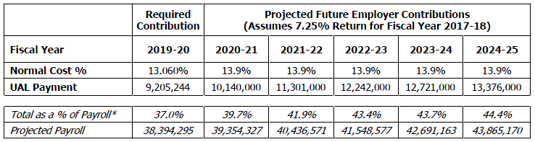
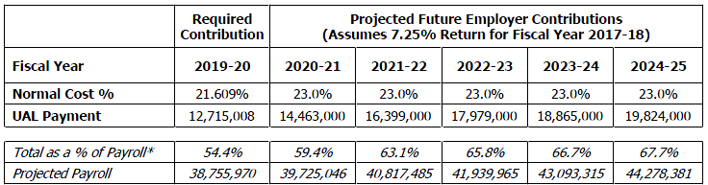
CalPERS Five-Year Rate Projections
Miscellaneous Employees
Sworn Employees
Notes:
CalPERS actuary reports

Slide 23
Forecast Model vs. Draft Budget
Forecast model presented at mid-year estimated a balanced budget with a surplus
Variance between forecast model and draft budget mostly due to:
  Other Taxes, primarily Documentary Transfer Tax
  1% cost of living adjustment
  Department requests for additional appropriations above baseline
  Benefits costs
  Transfers out to non-general funds
Notes:
Documentary transfer tax optimistic projection in forecast model - $1.2 million
1% cost of living adjustment - $1.1 million
Department requests for additional appropriations above baseline – $2.3 million
Benefits - $3.2 million
CalPERS - $2.5 million
Transfers out to non-general funds - $1 million

Slide 24
Forecast Model Updates
City working with PFM Group Consulting on the following to:
  Document the City’s current fiscal condition and update forecast model
  Evaluate the City Council’s goals alongside the budget
  Review organizational structure
  Recommend actions for fiscal sustainability
Updated financial forecast to be presented to the City Council in June
  Forecast will include various scenarios, including a recession scenario

Slide 25
Schedule
Council Meeting Date | Activity
May 7th | Receive an overview of the first drafts of operating and capital budgets and establish the process and schedule for City Council review and final approval.
May 16th (special meeting ) 9:00am – 12:30pm | Department to present their missions, accomplishments, goals, personnel levels, and proposed budget to the City Council.
May 20th 1:30pm – 3:00pm | Community Budget Meeting in Council Chambers
May 21st | Continue City Council review and discussion of draft operating and capital budgets.
May 28th | Continue City Council review and discussion of draft operating and capital budgets.
June 4th | Continue City Council review and discussion of draft operating and capital budgets. Initiate the process to provide staff direction concerning additions and deletions from the budget.
June 11th 6:00pm – 7:30pm | Community Budget Meeting in Council Chambers
June 18th | Conclude the process to provide staff direction concerning additions and deletions from the budget.
June 25th | Adopt the Fiscal Year 2019-20 Annual Operating Budget and Fiscal Years 2019-24 Five-Year Capital Improvement Budget.

