Slide 1

INFORMATION SESSION
Environmental Community Investment Agreement (ECIA)
FY 2024-2025
Welcome! We will start at 11:35 a.m. Please drop your name and organization in the chat.

Slide 2
Outline
Introduction & Program Overview
Guideline Review
Application Review
Next Steps
Questions
Notes:
Please hold your questions i

Slide 3

INTRODUCTION & OVERVIEW

Slide 4
ECIA Background
Represents an investment of $90 million over 10 years
Community programs, Greenhouse Gas Reductions & solar farm
$6 million - Competitive grant program
Notes:
FY 24-25
Entering our 9th grant cycle

Slide 5
Focus
The ECIA states that the grant program could “...fund community programs and non-profits focused on communities, youth, and youth sports programs...”
Access to organizations of varying capacity and financial need
Focus on organizations with smaller budgets
Sustainability
  organizations should NOT be reliant on ECIA grant funding

Slide 6

FY 2024-25
GUIDELINE REVIEW
Notes:
The Plunge, oldest swimming pool in the Bay Area

Slide 7
Eligibility Requirements (Page 4)
Operate as not-for-profit entity with 501(c)(3) tax status
Did not receive an ECIA grant award of more than $10,000 in previous grant cycle
Grant funded program serves Richmond and/or North Richmond residents (80% threshold)
Current (filed) 990/990N or Audited Financials
Fiscal Sponsor may be used
1
2
3

Slide 8
Grant Awards (Page 4 & 5)
Grant Awards
Minimum - $10,000
Maximum - $50,000
Grant Cycle: July 1, 2024 - June 30, 2025
Funds are available following execution of grant service agreements
Organizations may submit only one (1) application per grant per cycle
Can apply for ECIA (Category 1+2) and CSD Mini Grant (Category 4)
Notes:
Ad hoc ECIA committee approved the changes to increase the grant amounts

Slide 9
 | Grant Award Options | Eligibility | Financials | Award Decision Made By | Award Range | Total Award Amount
1 | Competitive Grant Awards (Relevant for this Application) | Non-profit organizations reporting gross receipts of less than $50,000 annually | 990N Form | City Council (Recommendations made by ECIA Review Panel) | $10,000 - $50,000 | $500,000 See Special Note Below
2 | Competitive Grant Awards (Relevant for this Application) | Non-profit organizations reporting gross receipts of more than $50,000 annually | 990 Form | City Council (Recommendations made by ECIA Review Panel)
3 | City Council Approved Awards | Organizations that applied for the ECIA Grant (categories 1 and 2) but were not recommended for funding | Either | City Council | $10,000 | $ 56,000
4 | Community Services Mini-Grant Awards | Non-profit organizations with 501(c)(3) tax status with programming connected to the Community Services Department | Either | Community Services Department | Up to $10,000 | $ 50,000
 | TOTAL |  |  |  |  | $606,000
Grant Categories (Page 4 & 5)
SPECIAL NOTE: A maximum of $100,000 in grant awards is available to organizations with annual budgets over $750,000 (per last completed 990s or audited financials).

Slide 10
Eligible Uses (Page 5)
Grant will fund programs/projects supporting:
Youth programs (up to 21yrs)
Youth sports programs
Community-focused programs
Examples include but are not limited to:
Health and Wellness
Students and Parents
Service Learning
Gardening and Urban Greening

Slide 11
Ineligible Uses (Page 5 & 6)
Repayment of existing debt, pre-existing tax liens, obligations, endowment
Payment of bonuses
Legal, loan or bank fees
Subsidization of existing contracts
Advancement of certain sectarian, politically partisan, or religious projects
Intended for commercial gain
Occurs before or after the grant award period
To support annual fund drives or fundraisers or other events not open to the general public
Furniture and cell phones
Notes:
Based on other city grant programs and best practices, the city working group
recommends that the ECIA Competitive Grant funds may not be used for the following
projects or programs:

Slide 12
Fiscal Sponsorship (Page 6)
Allows organization w/o 501(c)(3) tax status to apply for the ECIA grant
Organizations are responsible for finding a fiscal sponsor
Fiscal sponsor will serve as the applicant
Signed agreement between sponsored org and fiscal sponsor
Fiscal sponsor will enter into grant service agreement
Notes:
Note Regarding Fiscal Sponsors:
Receiving a RFCY Grant does not prohibit an organization from serving as a fiscal sponsor for an ECIA Grant recipient.
The ECIA Fiscal Sponsorship acts/serves as a pass-through only.

Slide 13
Collaborating Organizations (Page 7)
Collaboration is strongly encouraged across all organizations
Benefits include: Information sharing, joint programming, leverage funding, efficiency, reduced redundancy, etc.
Collaboration with governmental entities/agencies
Written agreement authorizing collaborative relationship with government entity only
Name of agency, contact, description of collaboration

Slide 14
Required Documents (Page 7 & 8)
Completed application
Budget
Organizational budget
Program budget
Proof of 501(c)(3) status
Financial statements (990, 990N, audited financials)
List of Board of Directors and affiliations
Letter authorizing collaboration (if needed)
Signed agreement with fiscal sponsor (if needed)

Slide 15
New Online Submission Details (Page 8)
Submit completed grant application (include budgets and résumés and/or descriptions of work experience with the application) and a set of all additional required documents
The responses to the application questions shall be limited to eight (8) pages.
This page limit is not inclusive of budgets, résumés, descriptions of work experience, or documents requested as part of the application

Slide 16
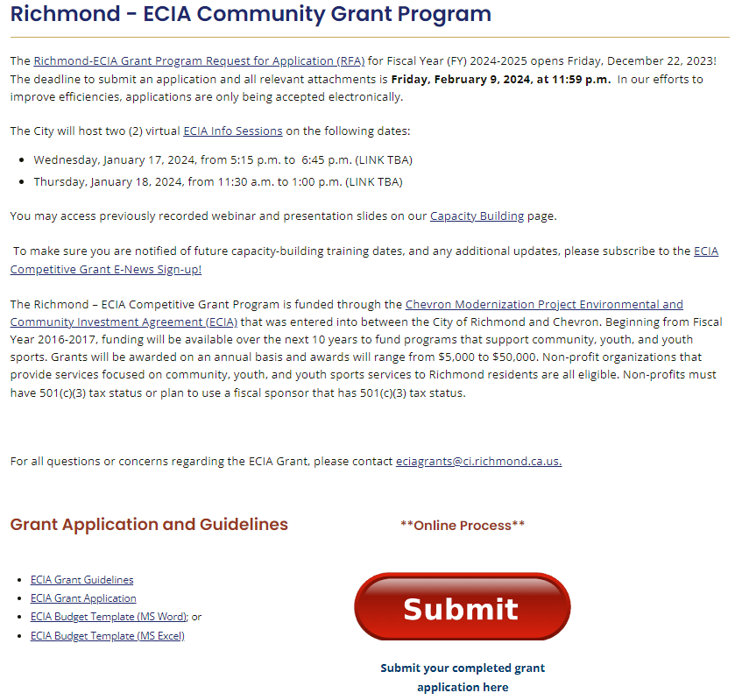
Online Submission Details (Page 8)

Slide 17
Payment Provisions (Page 8)
Grant payments:
Awarded on reimbursement basis
Bi-annual basis
Advance Payments
Initial advance of 50% of total award
Additional 35% by request
Remaining 15% released with final report
Notes:
Reimbursement grant
Should not cover your entire program and ideally should be able to float at the beginning

Slide 18
Review Criteria (Page 8)
Total Points | 110 points
Program Description and Concept | 40 points | Section 2
Impact and Goals | 40 points | Section 3
Financial Viability | 20 points | Section 4
Richmond-based Organizations | 10 points

Slide 19
Proposal Writing Process
What do you need the money for?
How to put it all together?
PLANNING
RESEARCH
WRITING
FOLLOW UP
Who will you approach?
What to do once the decision has been made?
Notes:
It’s important to know that proposal writing is part of a process that includes planning, research, writing and follow up. Building relationships with donors and potential donors is also a very important aspect of all types of fundraising.
The thing to remember here is that you can devote a lot of time—and possibly money as well—to produce a well written proposal, but if you’ve skipped one of the other steps, your proposal probably won’t be as successful as it could be.
Planning is about what do you need the money for
Research will help you determine who will you approach: Before you start writing, you need to know as much about the funder as possible. Thorough research helps you to know who you’re approaching and why.
Writing is how will you put your proposal together
Follow up is what you will do once the decision has been made
Planning is an important first step in the proposal writing process. Grantseeking is very competitive and you need to be very prepared when approaching funders.
In getting started, you need to make sure you give yourself enough time to go through each step of this process so that you can end up with a competitive proposal. Once you submit the proposal to the foundation, they will have their own process for reviewing the many requests they receive
Next, you’ll need to decide what kind of support you need—funding for general operations, funding for a specific project or program, or something else such as equipment or a building renovation. It is often easier to secure funding for a specific project or program than for general operations.

Slide 20

What we want to know is…
What specific need are you addressing?
  Make sure it fits the size and scale of your solution
What is your specific plan of action?
What are you trying to achieve?
  Outcomes must be measurable
How will you know if you’re successful?
How will the project sustain in the long run?

Slide 21

CSD Mini-Grants (Category 4)

Slide 22
 | Grant Award Options | Eligibility | Financials | Award Decision Made By | Award Range | Total Award Amount
1 | Competitive Grant Awards (Relevant for this Application) | Non-profit organizations reporting gross receipts of less than $50,000 annually | 990N Form | City Council (Recommendations made by ECIA Review Panel) | $10,000 - $50,000 | $500,000 See Special Note Below
2 | Competitive Grant Awards (Relevant for this Application) | Non-profit organizations reporting gross receipts of more than $50,000 annually | 990 Form | City Council (Recommendations made by ECIA Review Panel)
3 | City Council Approved Awards | Organizations that applied for the ECIA Grant (categories 1 and 2) but were not recommended for funding | Either | City Council | $10,000 | $ 56,000
4 | Community Services Mini-Grant Awards | Non-profit organizations with 501(c)(3) tax status with programming connected to the Community Services Department | Either | Community Services Department | Up to $10,000 | $ 50,000
 | TOTAL |  |  |  |  | $606,000
SPECIAL NOTE: A maximum of $100,000 in grant awards is available to organizations with annual budgets over $750,000 (per last completed 990s or audited financials).
Grant Categories (Page 4)

Slide 23
Eligible Uses (Page 5 & 6)
Grant will fund programs/projects supporting:
Youth programs (up to 21yrs)
Youth sports programs
Community-focused programs
Examples include but are not limited to:
Health and Wellness
Students and Parents
Service Learning
Gardening and Urban Greening
CSD Facility Fees

Slide 24

Community Services Department (CSD) Mini Grants – Things to Note
In 2024, aligned more closely with overall ECIA format
Eligibility, application, timeline, documents, and other requirements and policies required all similar
Difference vs. Category 1 and 2:
  Requires use of CSD facilities (e.g. Rec Complex, Auditorium, community centers, pools, etc.)
Grant amount increased to $10,000
  Can apply for $5,000 or $10,000

Slide 25
Review Criteria (Page 9)
Total Points | 103 points
Program Description and Concept | 40 points | Section 2
Impact and Goals | 40 points | Section 3
Financial Viability | 20 points | Section 4
Richmond-based Organizations | 3 points
Notes:
Smaller pool bc of smaller grant

Slide 26

FY 2024 - 25
APPLICATION

Slide 27
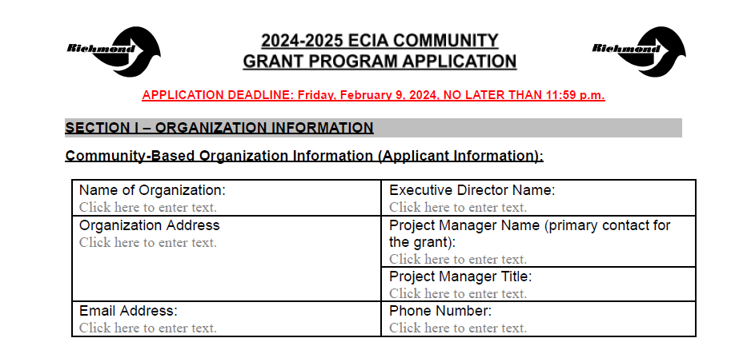
Grant Application - Section 1

Slide 28
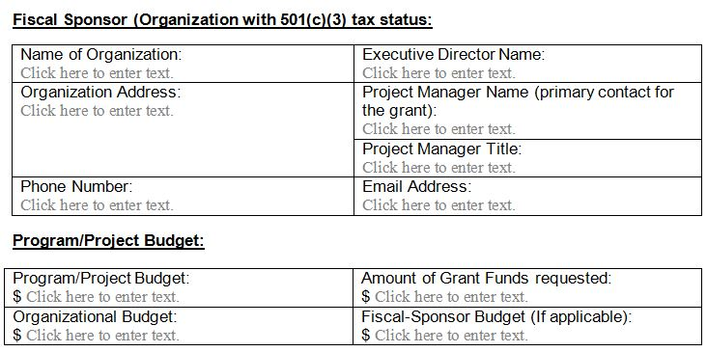
Grant Application - Section 1

Slide 29

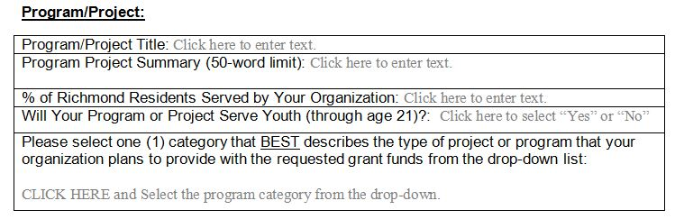
Grant Application - Section 1

Slide 30
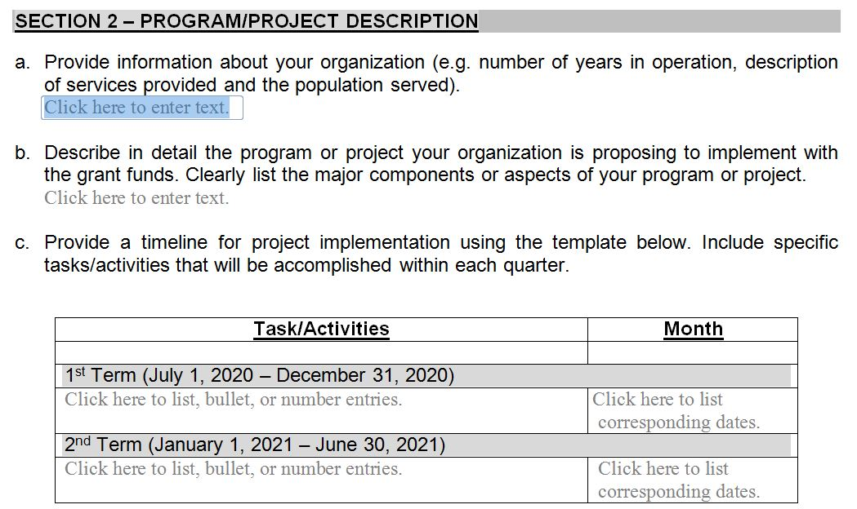
Grant Application - Section 2 (40 Points)

Slide 31
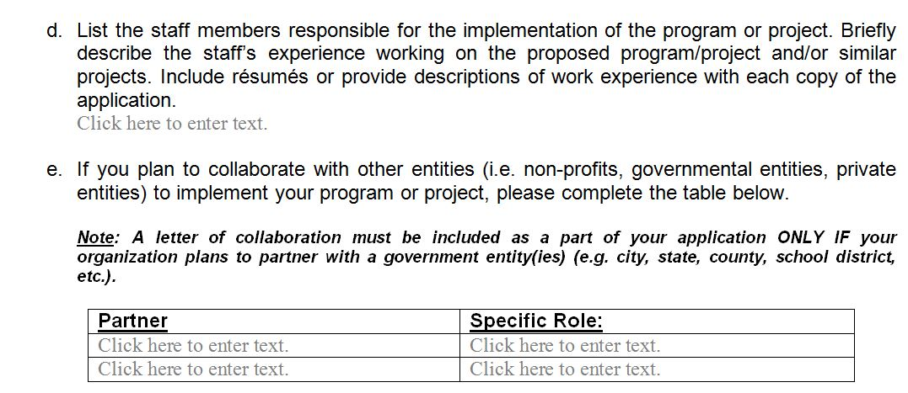
Grant Application - Section 2

Slide 32
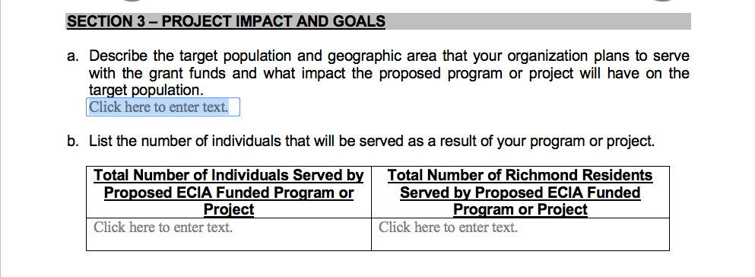
Grant Application - Section 3 (40 Points)

Slide 33
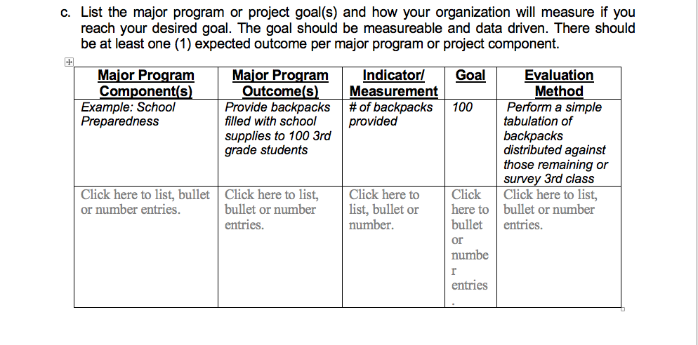
Grant Application - Section 3

Slide 34
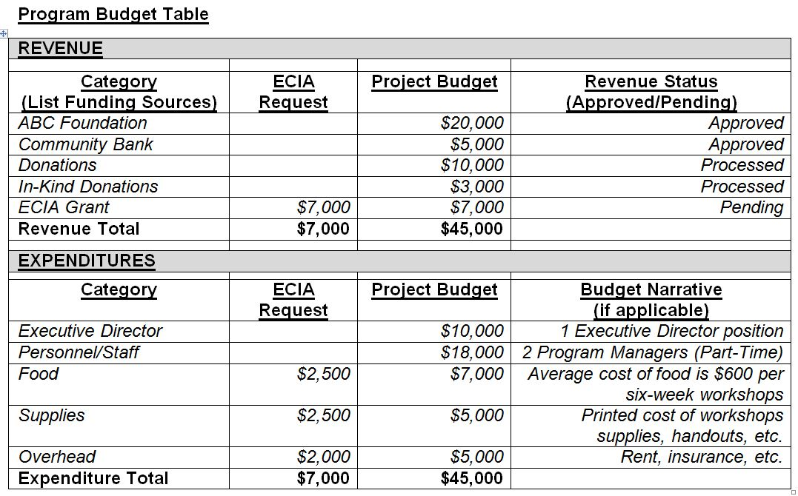
Grant Application - Section 4 (20 Points)

Slide 35
Review Process (Page 9)
Applications are received by 11:59 p.m. on Friday, February 9, 2024 (no exceptions)
City staff review for responsiveness
All complete and eligible applications are forwarded to the review panel for scoring
Review Panel’s recommendations are forwarded to City Council for final approval
Awardees will enter into contracts with the City

Slide 36
Timeline (Page 11)
TASK | DATE
Application Release Date | December 22, 2023
FY 2024-25 ECIA Information Session | January 17 & 18, 2024
Applications Due (No Exceptions) | February 9, 2024, by 11:59 p.m.
Application Review and Scoring | March - April 2024
City Council Review and Approval | April 2024
Grant Award Notification | May 2024
Grant Award Period | July 1, 2024 - June 30, 2025

Slide 37

Grantee Requirements (Page 11)
Enter into a City contract (grant agreement)
W-9 and Supplemental Vendor Application
Obtain a City of Richmond Business License
Meet City’s insurance requirements
Host City staff and/or members of the Review Panel for one or more program evaluations
Reference City as a grantor on applicable material
Submit bi-annual report/invoices

Slide 38
For More Information, Contact Us
Email: eciagrants@ci.richmond.ca.us
Web: http://www.ci.richmond.ca.us/eciagrants
Email Alerts (COR E-News): http://www.ci.richmond.ca.us/list.aspx

Slide 39

QUESTIONS?
Peres Elementary School

