Slide 1

Richmond Rising
Collaborative Stakeholder Committee (CSC)
July 10, 2024

Slide 2
Roll Call
Project lead for City of Richmond
Project lead for GRID Alternatives
Project lead for Groundwork Richmond
Project lead for Rich City Rides
Project lead for Trust for Public Land
Project lead for UC Berkeley
Project lead for Urban Tilth

Slide 3
Meeting Information
Every first Wednesday of the month 6:00 – 8:00 pm.
In-person Attendance: Nevin Community Center 598 Nevin Ave, Richmond, CA 94801
Virtual Attendance: https://ci-richmond-ca-us.zoom.us/webinar/register/wn_gx8xwknptcutbnefzdbv1w
Phone Attendance: (669) 900-6833, or (669) 444-9171 Webinar ID: 976 6319 9451
All Committee members and members of the public must abide by the Community Agreements

Slide 4
Land Acknowledgement
While Richmond Rising seeks to strengthen the economy, improve public health and the environment – particularly in the Iron Triangle, Santa Fe and Coronado Neighborhoods, we do so with the awareness that we occupy unceded Huichin and Karkin Ohlone territory.
We acknowledge that land theft of indigenous homelands, and the dismantling of indigenous sovereignty, was done to advance colonization.
We acknowledge that capitalism and white supremacy are branches of colonization that have persisted throughout hundreds of years of oppression, are alive today, and contribute to keeping Black, Indigenous, and all other People of Color from thriving.
We further acknowledge that this country’s political economy and social institutions were built on the forced labor of African people on stolen land through violent, systematic abduction from their homelands and enslavement over hundreds of years.

Slide 5
Land Acknowledgement
We further acknowledge the exploitation of immigrant and refugee communities as modern forms of cheap and disposable labor are regularly carried out on stolen land.
Thus, we acknowledge that we have been impacted and harmed by these histories and experiences imposed on our ancestors and communities. We further uplift the shared struggle among Black, Indigenous, and All People of Color.
We also acknowledge that indigenous people continue to live here, steward the land, and resist settler colonialism.
We conclude that our Land acknowledgement is an active and evolving statement and process. It requires us to recognize historical injustices and invites us in to be active participants in our collective healing.

Slide 6
Richmond Rising
The City of Richmond and 6 local organizations (together known as ‘Richmond Rising’) received $35 million to bring health, economic, and environmental benefits to the Iron Triangle, Santa Fe, and Coronado neighborhoods.
Richmond Rising is supported by the California Strategic Growth Council’s Transformative Climate Communities Program.

Slide 7
Collaborative Stakeholder Committee
Provides guidance on project implementation and holds us accountable in reaching our goals
Can make recommendations, provide input, and assist Project Leads in implementing project activities
Does not have final decision-making authority
Project Leads must consider recommendations from the Committee and members of the public

Slide 8
Public Comment Not on the Agenda
This is the space for members of the public to provide public comment on items that are not included in the agenda.

Slide 9
Review and Approve Previous Meeting Minutes
Members to review and approve previous meeting minutes

Slide 10
Project Status Reports
Each partner will share up-to-date financials and grant expenditures to date for each project and this will be shared with the Committee and the public.

Slide 11

Grantee
Work completed since last meeting:
CSC Meeting: Scheduled, coordinated, and currently facilitating CSC meeting #8, including translation, refreshments, and childcare.
Invoices and Reports: Submitted bimonthly invoice and progress reports #5. Invoice 4 was approved by SGC. Reimbursement checks #1, #2, and #3 were received. Check# 4 is in process of being received.
Total expenditures reported to date: $135,451.06
Remaining budget: $558,224.60
Planned work in the next ~two weeks:
CSC Meeting: Circulating CSC meeting #5 minute.
Invoice and Reports: Start integrating Invoice 6.
Leverage Reports: Share forms to report leverage for City and partners.
Payments: Processing and paying invoices from partners.

Slide 12
Neighborhood Complete Streets
Work completed since last meeting:
Met with CSW consultants to review costs of the project.
Met with Richmond Main Street Initiative to talk about community engagement for the project.
Total expenditures reported to date: $ 6,315.12
Remaining budget: $ 5,174,858.03
Planned work in the next ~two weeks:
Prepare engagement messaging and communications.
Start community engagement.
Prepare for Town Hall meeting.

Slide 13

Richmond Wellness Trail
Work completed since last meeting:
Site survey performed by sub-consultant to produce base maps
Total expenditures reported to date: $ 22,247.44
Remaining budget: $ 4,793,906.16
Planned work in the next ~two weeks:
Consultant will begin design work
Continued engagement planning
Continued coordination planning with stakeholders

Slide 14

eBike Lending Library
Work completed since last meeting:
Drafted Operations and Maintenance Plan.
Scheduled Design Review Board (DRB) meeting to start permitting process.
Started working on bidding documents.
Total expenditures reported to date: $ 63,692.36
Remaining budget: $ 2,397,395.63
Planned work in the next ~two weeks:
Community outreach at local neighborhood councils.
Prepare documents for DRB Meeting on August 7th.

Slide 15

Resilient Homes
Work completed since last meeting:
To date: 7 projects installed
12 in pipeline to be scheduled
6 Bi-weekly canvassing efforts
MCE attendance at Juneteenth festival
4 Completed Home Energy Efficiency completions in addition to those included in works indicated above
15% more clients added to overall project pipeline
Total expenditures reported to date: $ 150,415.11
Remaining budget: $ 6,816,280.80
Planned work in the next ~two weeks:
Richmond Workshop in partnership with City of Richmond on July 29,2024

Slide 16

Basins of Relations
Work completed since last meeting:
Hired new Community Engagement Manager, Cheryl Lopez, to guide outreach efforts for Water Conservation Projects in the Iron Triangle.
Continuing to install drip irrigation and greywater recycling systems in the project area: 9 total projects have been completed in the project area to date.
Total expenditures reported to date: $ 126,049.77
Remaining budget: $ 1,554,654.01
Planned work in the next ~two weeks:
Continued site visits for homeowners interested in greywater systems, drip irrigation systems.
Door-to-door outreach to connect with interested homeowners.

Slide 17

Bosque del Barrio
Work completed since last meeting:
Continue to canvass in Iron Triangle, Coronado, Santa Fe neighborhoods
Planted 6 new trees, with a total of 25 trees planted
Total expenditures reported to date: $ 53,965.11
Remaining budget: $993,441.50
Planned work in the next ~two weeks:
Plant 20-25 trees in the next month at designated residential sites determined from canvassing
Coordinate Arbor Day tree planting event in Oct.

Slide 18
ADA Accessible Garden
Work completed since last meeting:
Design has continued.
Utility service and connection details are being determined.
The approach to the Public Art has been discussed and will be presented to the Arts and Culture Commission (date TBD.)
Hosted design unveiling celebration at Unity Park on June 14th
Total expenditures reported to date: $ 32,577.81
Remaining budget: $ 922,466.19
Planned work in the next ~two weeks:
Submit to plans to City for permitting.
Present final plans to DRB for approval on August 7th.
Finalize Report for unveiling celebration
Begin drafting up O&M for the ADA Garden and our letter of commitment

Slide 19
Orchard for ALL!
Work completed since last meeting:
Conducted Interviews for Gleaners Apprentice Training Program
Second Quarterly Newsletter was published
Finalized onboarding for 4 apprentices to participate in the 6-week training program
Canvassing in the project area
Follow ups with community members who received trees from Annual Fruit Tree Giveaway
Total expenditures reported to date: $ 48,341.49
Remaining budget: $ 1,119,872.14
Planned work in the next ~two weeks:
Conduct the 6-week training program
Continue to glean in the project area
Continue to canvass in the project area to bring awareness to OFA!
Begin the end of year report

Slide 20
Veggie Rx
Work completed since last meeting:
Graduated 1st cohort of Train the Trainers!
Distributed 280 VeggieRx produce bags
Conducted 5 English and 5 Spanish HEAT classes
Began interviews for Urban Tilth Community Health Promoters
Implemented new cost methodology for LifeLong Medical Care to relieve administrative burden
Total expenditures reported to date: $ 155,324.77
Remaining budget: $ 3,015,008.62
Planned work in the next ~two weeks:
Hire 1-2 Community Health Promoters
Begin work on Task 4 readiness requirements
Draft annual summaries

Slide 21
E-Bike Share
Work completed since last meeting:
Received Project Area encroachment permits
Installed two bike hubs
Submitted key deliverables to Strategic Growth Council
Total expenditures reported to date: $ 0
Remaining budget: $ 998,979.21
Planned work in the next ~two weeks:
Continued engagement with local community
Attend community meetings
Distribute vouchers for community area residents

Slide 22
Community Engagement Plan
Work completed since last meeting:
Hired and onboarded new TCC Youth Fellows Project Manager
Total expenditures reported to date: $ 55,006.41
Remaining budget: $ 2,511,026.32
Planned work in the next ~two weeks:
Begin developing Youth Fellows program with newly hired TCC Youth Fellows Project Manager
Check-in between City of Richmond and Rich City Rides/ TCC Youth Fellows Project Manager

Slide 23
Displacement Avoidance Plan
Work completed since last meeting:
CLT:
Began drafting RFP for affordable housing developers
Identified first Priority Site
ADU Toolkit:
City currently reviewing permit set
Buy Local campaign
Building out contract with bluedot to support the Buy Local campaign
Total expenditures reported to date: $ 82,062.44
Remaining budget: $ 599,573.18
Planned work in the next ~two weeks:
CLT Policy Implementation check-in with City of Richmond and Partnership for the Bay Fellow
Notes:
The levying of taxes for DRPBID is applicable to many parcels in the downtown area. The money goes to improving the Downtown area and is also the budget for Richmond Main Street Initiative.

Slide 24
Workforce Development and Economic Opportunity Plan (WDEOP)
Work completed since last meeting:
City of Richmond:
Contracting and Onboarding with Glenn Price Group (see also CSC presentation)
GRID:
Onboarding additional staff
Total expenditures reported to date: $ 6,560.66
Remaining budget: $ 1,427,247.08
Planned work in the next ~two weeks:
GPG to begin coordinating interviews
GRID and City of Richmond (Employment & Training)coordination meeting

Slide 25

Indicator Tracking Plan
Work completed since last meeting:
Finalized Indicator Tracking Plan Baseline Report
Developed first draft of Veggie Rx Case Study
Began drafting outline for the ADA Garden Case Study
Total expenditures reported to date: $ 441,825.29
Remaining budget: $ 628,174.71
Planned work in the next ~two weeks:
Complete Veggie Rx case study
Field visit to Resilient Homes Projects
Continue indicator data collection

Slide 26
Report on Public Comments & Questions
Report out on any community questions or comments received, including responses

Slide 27
Committee Business Items for Discussion
Place-Based Workforce Development Strategy and Implementation Plan Presentation
Leverage Reporting and SGC Annual Reporting Discussion
Community Member Nomination
Discuss Community Engagement Updates (moved from previous CSC meeting)

Slide 28
Place-Based Workforce Development Strategy and Implementation Plan (WDSIP) Development
City of Richmond
July 10, 2024

Slide 29
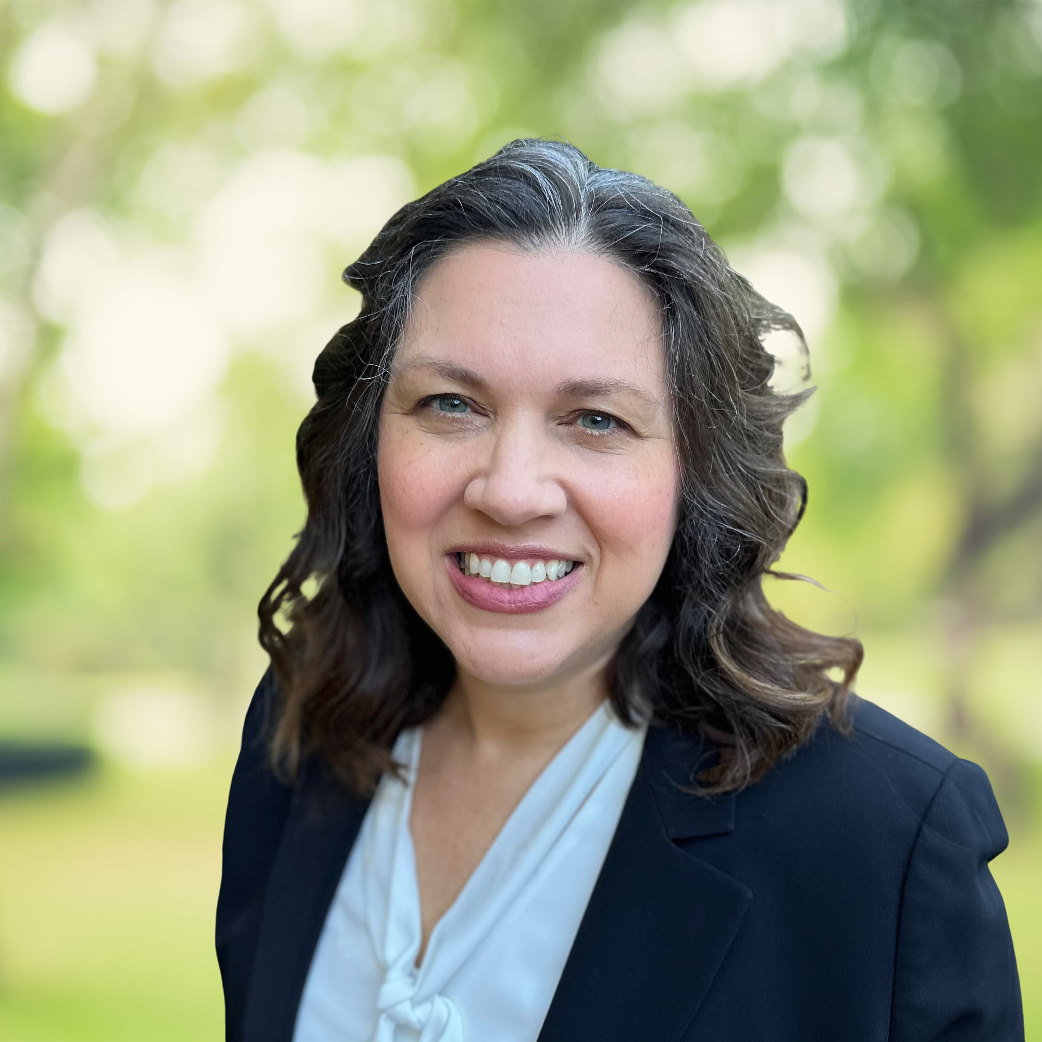
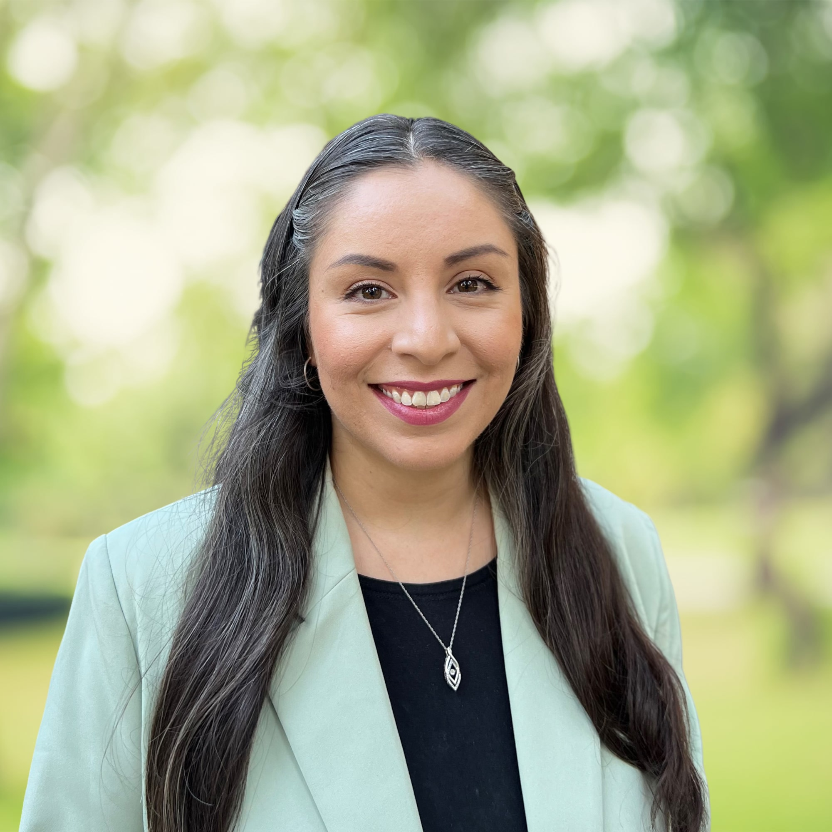
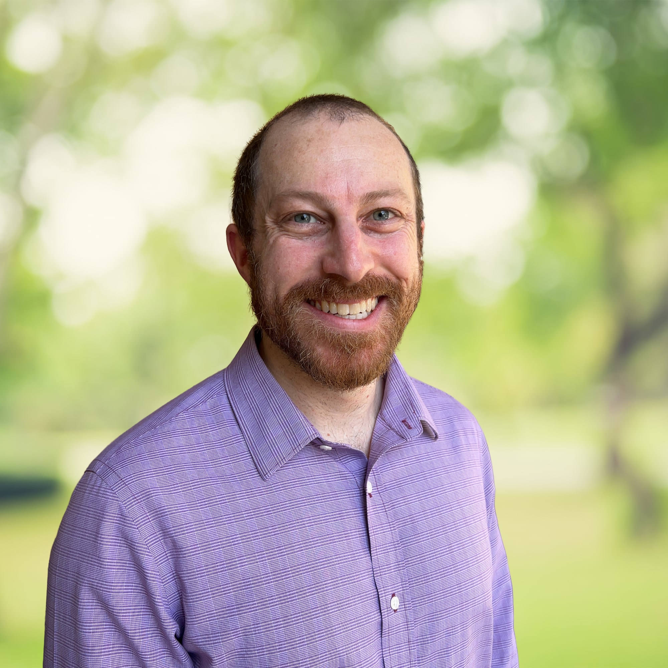

GPG Project Team
Jennifer O’Donnell
Rosa Guzman
Aaron Price
GPG is a results-oriented consulting firm with extensive experience providing planning, facilitation, research, policy analysis, and fund development support to public agencies, nonprofit organizations, and philanthropic foundations.
www.glenpricegroup.com
Notes:
For more than 10 years, GPG has worked with the City of Richmond Employment and Training (E&T) Department to secure state and federal funding to support a range of workforce development projects and initiatives. This includes grant awards from the YouthBuild, Workforce Accelerator, Dislocated Worker, Brownfields Job Training, and other grant programs. In addition, GPG has supported the development of the Richmond Workforce Development Board (WDB) Local Plan. GPG has also assisted with the Contra Costa County WDB local plan and East Bay Regional Planning Unit’s regional plan.
More broadly, GPG brings extensive experience with community assessment and planning projects. This includes the development of community assessments for Head Start organizations and Local Child Care Planning Councils in various regions of California. In addition, GPG has developed Discovery Reports, containing data and analysis about a program or organization’s context, needs, and opportunities, as part of strategic planning processes for numerous public agencies and nonprofit organizations.
GPG is familiar with key state and federal data sources, including the U.S. Census Bureau, U.S. Department of Labor Bureau of Labor Statistics, California Employment Development Department, and more.

Slide 30
Overview of WDSIP Plan Development
Project Goal
Develop a Place-Based Workforce Development Strategy and Implementation Plan for the Transformative Climate Communities (TCC) grant focused on the Iron Triangle, Santa Fe, and Coronado neighborhoods.

Slide 31
Planning Project Overview
Discovery Work (July to Oct)
Design (Oct to Nov)
Delivery (Dec to April)
Collect relevant local, state and national workforce data
Conduct informational interviews
Draft summary of research findings and emerging recommendations
Develop overall strategy and annual plan
Produce final report of research findings and emerging recommendations, overall strategy, and priority activities for next 12 months
Check on implementation progress to date and plan modifications needed
Project Management and Facilitation
Notes:
To understand the context, needs, and opportunities, GPG will conduct: desk research, informational interviews, and meetings with the CSC
Resulting in:
a set of findings and recommendations
an overall workforce development strategy
identification of priority activities for the first year of implementation

Slide 32
Overview of WDSIP Plan Development
Help Needed Today
Data Sources
Current job and workforce development opportunities or initiatives in the project area
Key people to interview about local workforce development barriers and opportunities
*Please list contact information if known

Slide 33
Overview of WDSIP Plan Development
GPG Next Steps
Desk Research
Informational Interviews

Slide 34
Overview of WDSIP Plan Development
Contact Information
Jennifer O’Donnell, Senior Associate
jennifer@glenpricegroup.com

Slide 35
2. Leverage Reporting and SGC Annual Reporting Discussion
City of Richmond
July 10, 2024

Slide 36
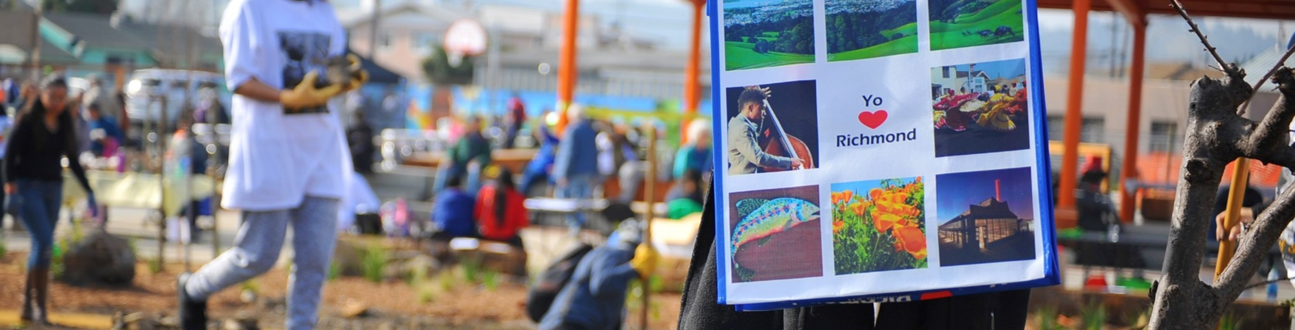
Agenda
Content
Annual Report Overview
Progress Report
Leverage Report
Equipment Report
Questions?

Slide 37
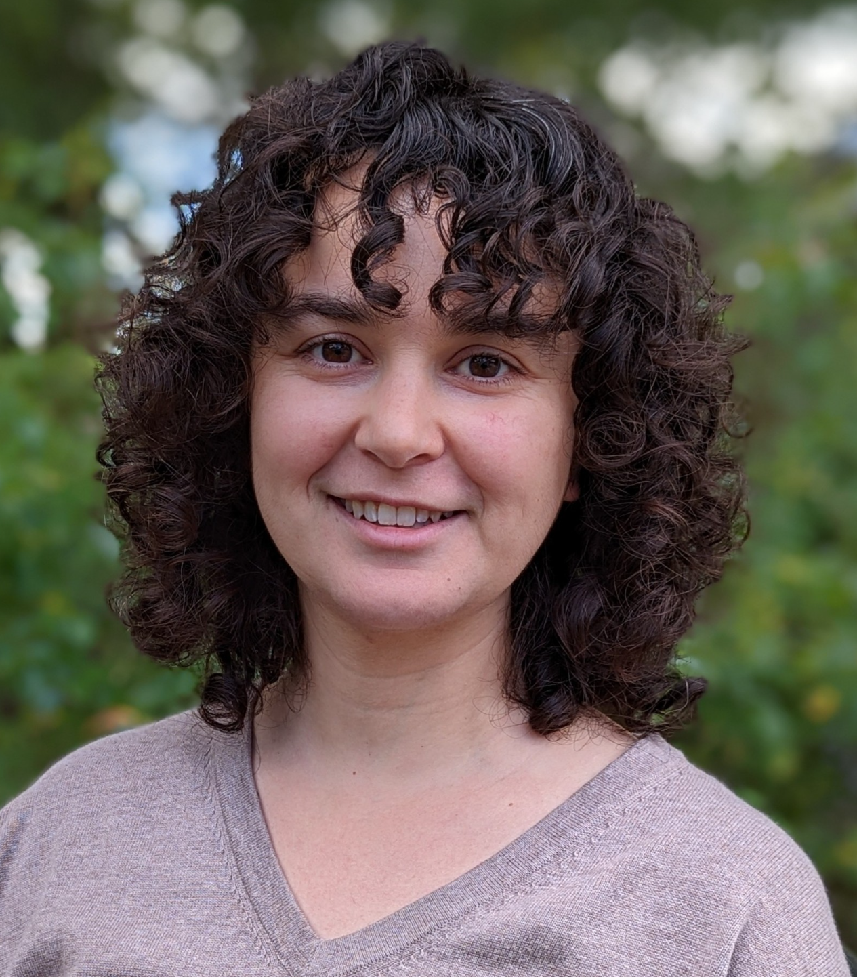

Facilitation Team
PlaceWorks is a 100% employee-owned planning, design, and environmental consulting firm.
We take a holistic approach, bringing together people from diverse practice areas to offer integrated and comprehensive expertise under one roof.
We believe that collaboration—with our clients, communities, stakeholders, and colleagues—is essential to our success and requires meaningful outreach, engagement, and communication.
We have been supporting the City of Richmond on the application, post-award consultation process, and first year of implementation of the TCC grant.
Rachel Jacobson
Associate
Amanda Tsang
Intern

Slide 38
Annual Report Overview
Each August, grantees are required to compile and submit annual reports for the preceding year, August 1 to July 31
I. Progress Report
Answer narrative questions
Success Stories and Lessons Learned
Challenges and Areas of Improvement
Report new leverage sources committed
II. Leverage Funding Report
Report expenditures on leveraged funding sources
Key information
New leverage source names
Amount spent
Dates
Supporting documentation
III. Equipment Inventory Report
Items that cost more than $5,000 each and have been purchased with TCC funds
To date, no Richmond Rising budgets have equipment purchases

Slide 39
I. Progress Report
Narrative Questions – Brainstorm Session
Notes:
https://corcaus.sharepoint.com/:w:/r/sites/TCCTeamsTest/_layouts/15/Doc.aspx?sourcedoc=%7B0E925417-0F78-4B1D-87DA-DC5FB235BCE2%7D&file=SGC23112_Annual%20Progress%20Report_Year%201.docx&action=default&mobileredirect=true

Slide 40
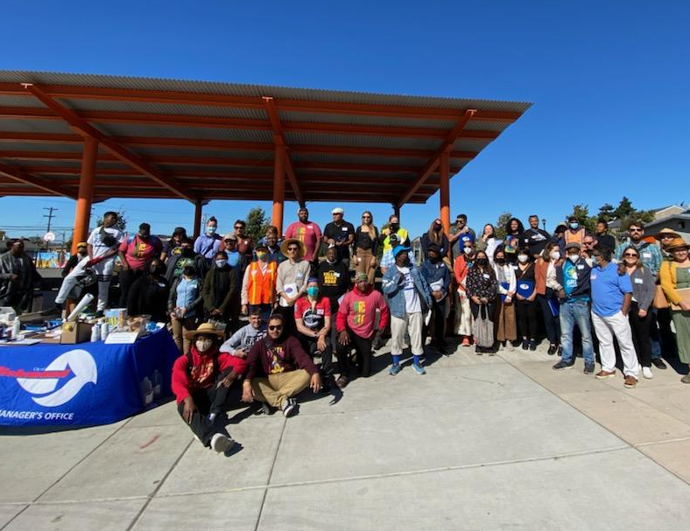
Q1:
What major grant milestones have we completed in the last year?

Slide 41
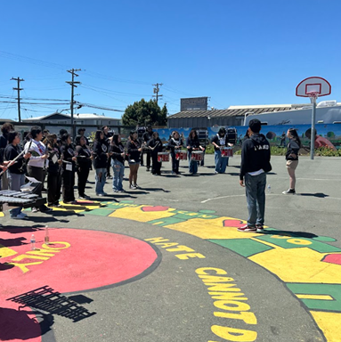
Q2:
What other success stories can we share from the Project Area?
Links to related media?

Slide 42
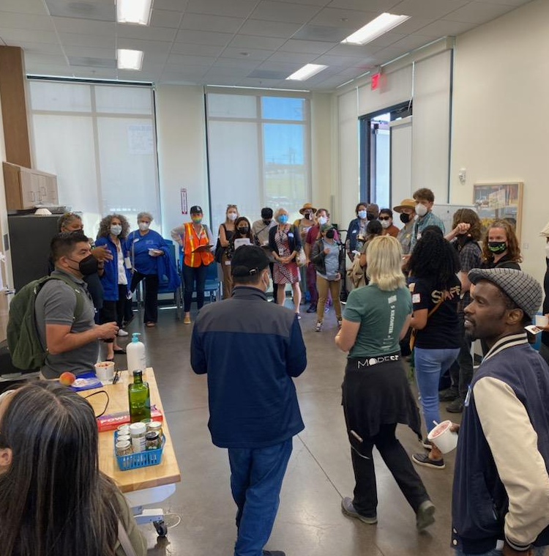
Q3:
What challenges have we experienced while implementing the grant?

Slide 43
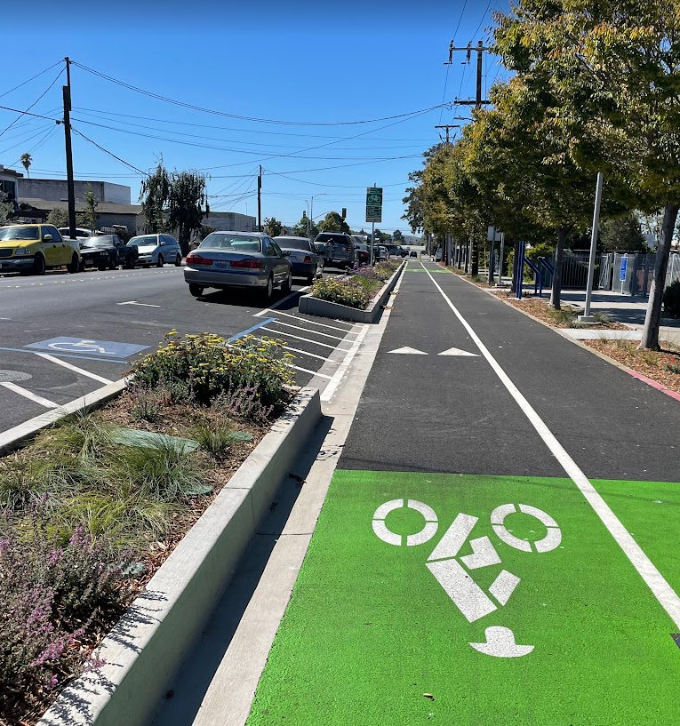
Q4
What lessons have we learned in this past year?
Share to help current grantees, future applicants, or the State, in continued implementation of the projects, and program, respectively.

Slide 44
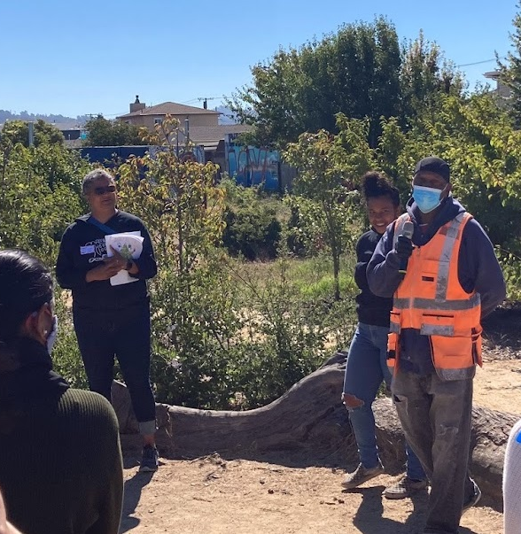
Q5:
Have we had any issues when working with the technical assistance providers or program evaluation consultants?

Slide 45
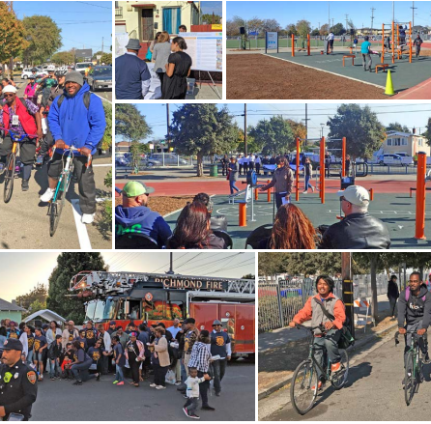
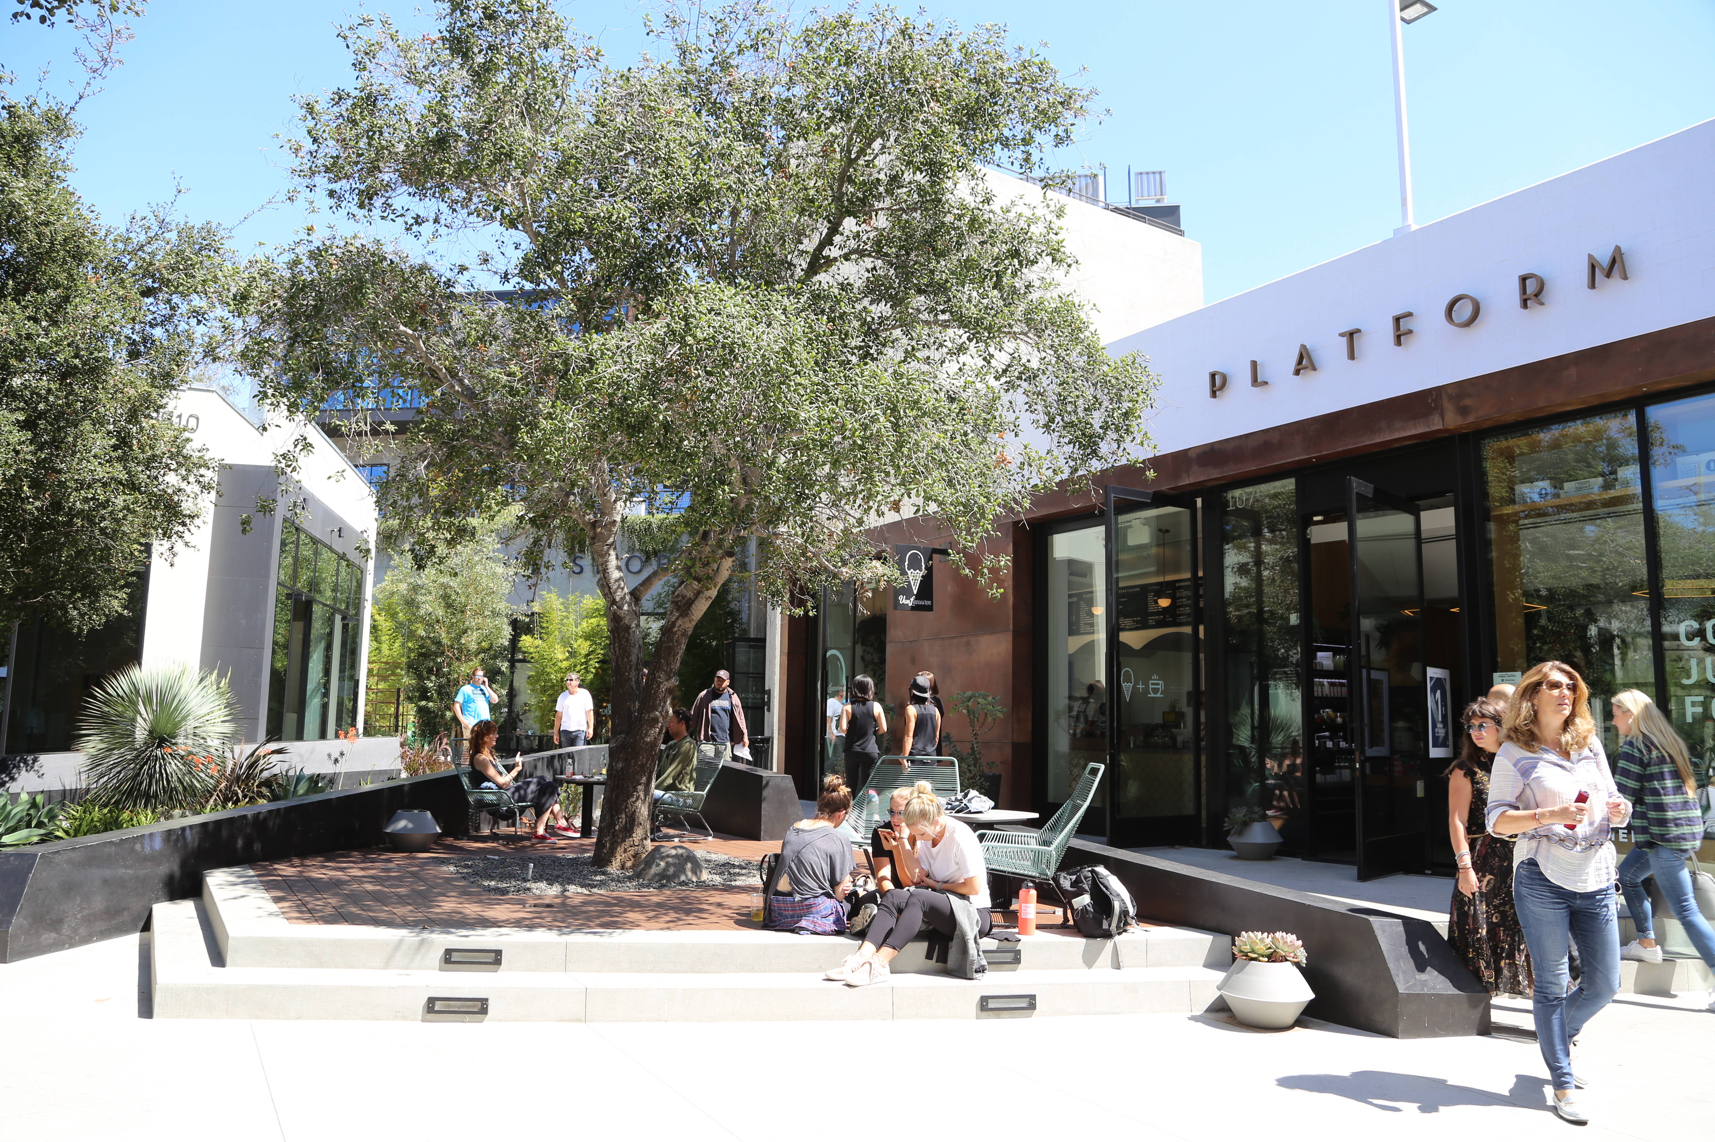
Q6:
Do we have any concerns related to administering the grant or working with State?

Slide 46
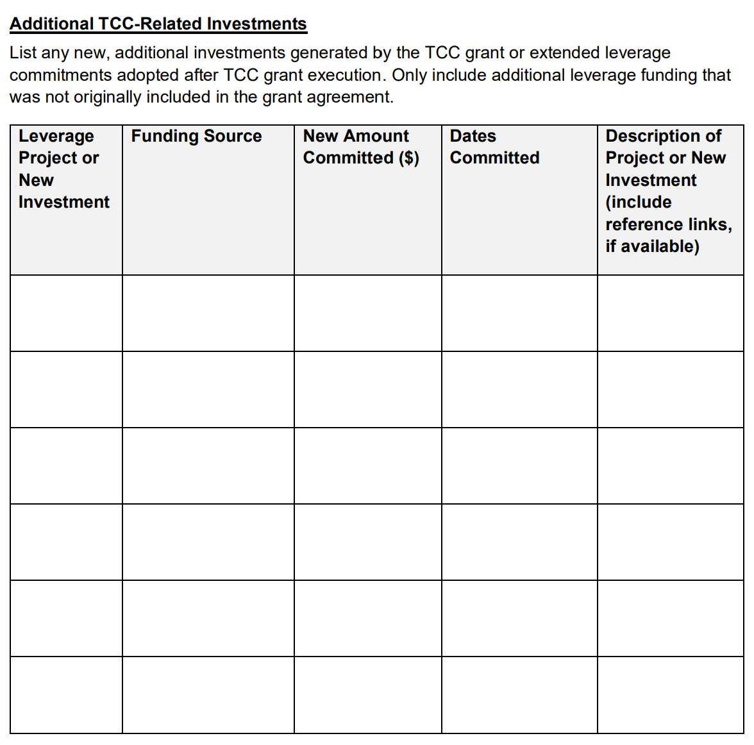
Reporting New Leverage Sources
How to Report
Add information to table
OR
Email to TCC Team (Beatriz, Matias, Rachel)
What to Include
Project # under “New Investment”
Funding Source
New Amount Committed ($)
Dates Committed
Description of Project or New Investment

Slide 47
II. Leverage Funding Report
Due: Aug 15, 2024
Notes:
https://corcaus.sharepoint.com/:w:/r/sites/TCCTeamsTest/_layouts/15/Doc.aspx?sourcedoc=%7B0E925417-0F78-4B1D-87DA-DC5FB235BCE2%7D&file=SGC23112_Annual%20Progress%20Report_Year%201.docx&action=default&mobileredirect=true

Slide 48
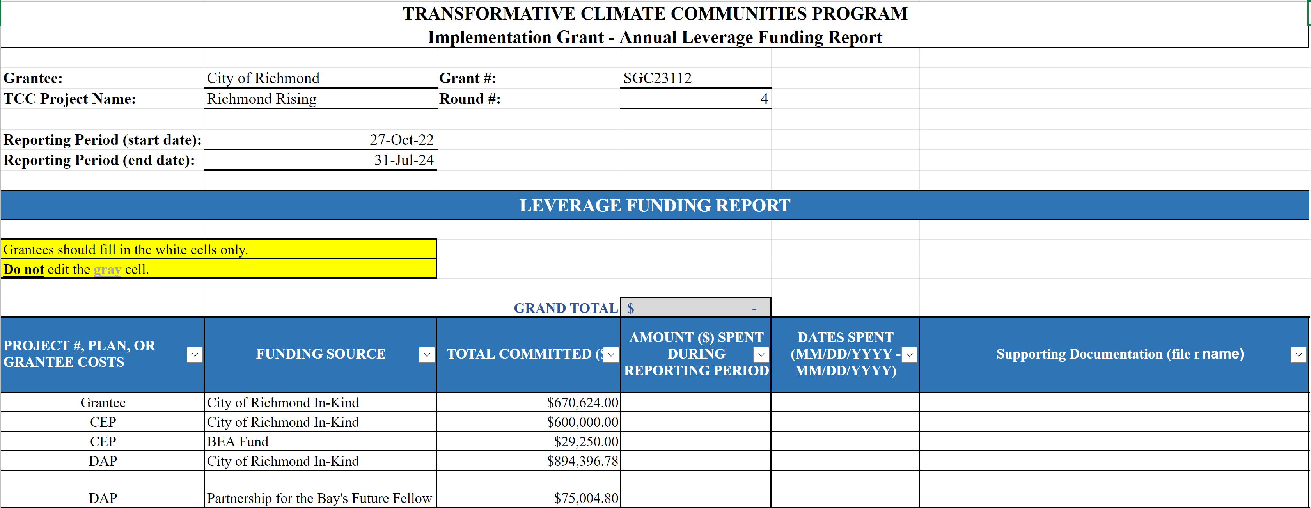
What is the Leverage Funding Report?
Report expenditures on leveraged funding sources
Pre-populated with leverage sources identified at the time of grant execution

Slide 49
Action Items – Due Aug 15, 2024
New Leverage Sources
Insert a row so that the new leverage is grouped with your project’s other leverage sources
Supporting Documentation
Upload to folder
Document must be provided for each leverage source
Acceptable documents:
Signed letter or memo
Example/template provided as Word doc and PDF
Other grant agreements or reports or invoices
Financial documents (like a QuickBooks report)
Include in document:
Dates work was completed
Leverage funding source
What leverage funding was spent on
Confirmation that leverage funding was spent (e.g., signed letter from ED; QuickBooks report)
Add Amount Spent
Spending Period: October 27, 2022 - July 31, 2024
Can count from November 2022
Enter $0.00 if no funds have been expended yet for the leverage source
Add Dates Spent
Full OR Partial Reporting Period
If project spending in progress, list end date as July 31, 2024 (end of reporting period)

Slide 50
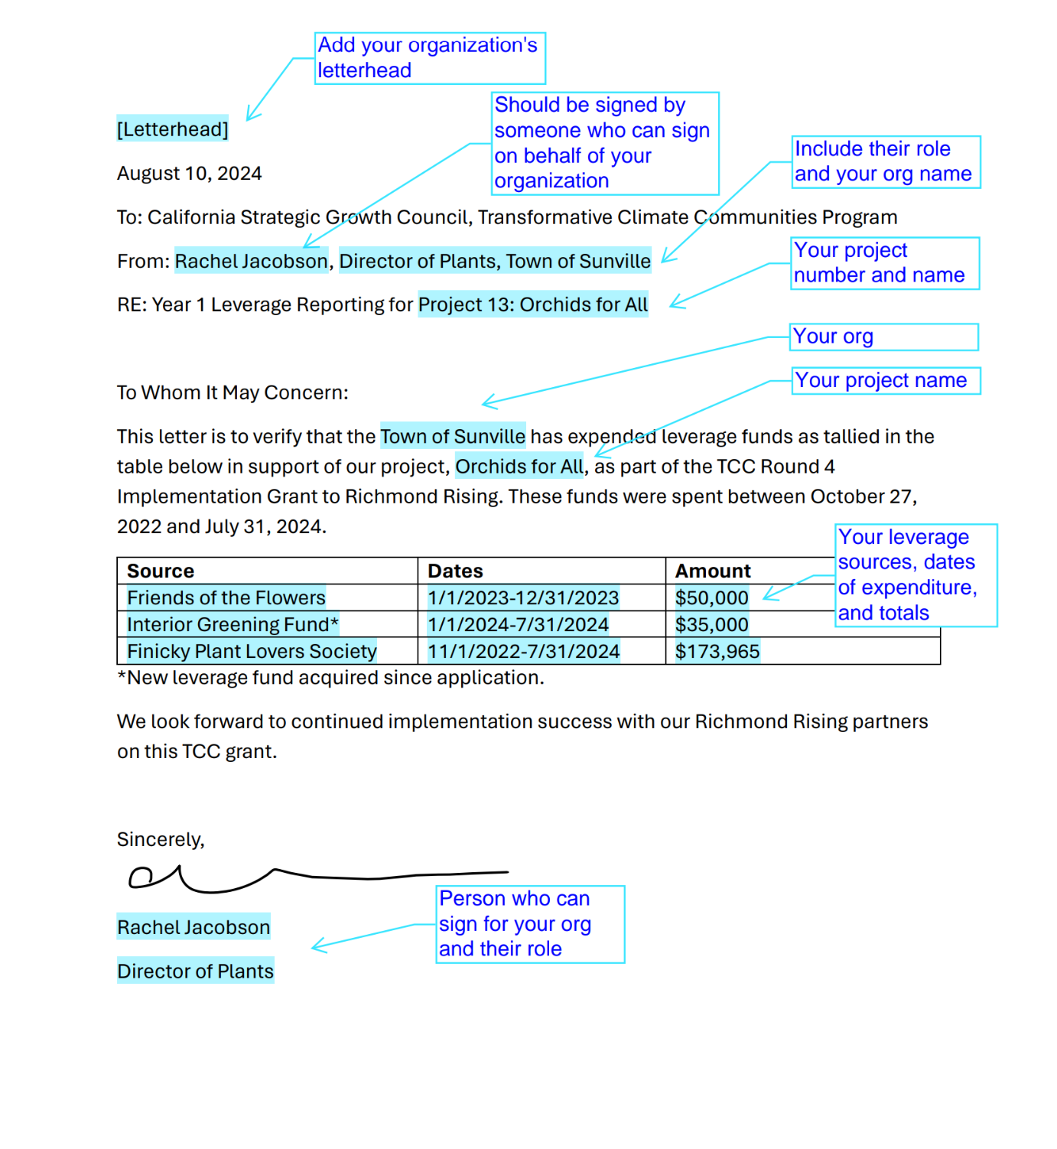
Supporting Documentation Examples
Sample Leverage Letter

Slide 51
III. Equipment Inventory Report
Due: Aug 15, 2024
Notes:
https://corcaus.sharepoint.com/:w:/r/sites/TCCTeamsTest/_layouts/15/Doc.aspx?sourcedoc=%7B0E925417-0F78-4B1D-87DA-DC5FB235BCE2%7D&file=SGC23112_Annual%20Progress%20Report_Year%201.docx&action=default&mobileredirect=true

Slide 52
Equipment Purchases?
Items that:
cost more than $5,000 each
have been purchased
with TCC funds

Slide 53
Next Steps…
I. Progress Report
PlaceWorks will prepare a summary of our discussion about the questions and circulate it to project leads for review.
II. Leverage Report
PlaceWorks will send out the instructions in this presentation by the end of the week to project leads.
All leverage reporting information and supporting documents are due August 15.
III. Equipment Report
No action needed unless you have purchased an item that cost $5,000 or more with authorized TCC funds.

Slide 54

Questions?
Notes:
All the information from these slides can also be found in the pdf/docx sent to you all.

Slide 55


Thank You!

Slide 56
Project | Leverage Source | Amount
Grantee | City of Richmond In-Kind | $670,624.00
CEP | City of Richmond In-Kind | $600,000.00
CEP | BEA Fund | $29,250.00
DAP | City of Richmond In-Kind | $894,396.78
DAP | Partnership for the Bay's Future Fellow | $75,004.80
WDEOP | Reimagine Public Safety Fund | $243,000.00
WDEOP | WIOA | $243,000.00
WDEOP | YouthBUILD | $243,000.00
WDEOP | EPA | $243,000.00
Supporting Documentation
Signed letter or memo
Other grant agreements
Financial documents
Enough to show you spent the dollars on a specific project in specific timeframe.
City Projects

Slide 57
Project | Leverage Source | Amount
1 | City In-Kind | $62,791.00
1 | CNRA Urban Greening Grant | $2,573,312.00
1 | Caltrans Clean CA Grant | $5,241,634.00
3 | City of Richmond In-Kind | $44,057.49
3 | BEA Fund | $109,465.00
3 | Windward Foundation | $287,395.00
3 | Chorus Grant | $196,750.00
3 | Shared Mobility In-Kind | $150,000.00
10 | Charleston Mobility In-Kind | $15,184.00
10 | City of Richmond In-Kind | $35,163.18
10 | ECIA Funds | $77,390.80
Supporting Documentation
Signed letter or memo
Other grant agreements
Financial documents
Enough to show you spent the dollars on a specific project in specific timeframe.
City Projects

Slide 58
Project | Leverage Source | Amount
CEP | City of Richmond In-Kind | $600,000.00
CEP | BEA Fund | $29,250.00
3 | City of Richmond In-Kind | $44,057.49
3 | BEA Fund | $109,465.00
3 | Windward Foundation | $287,395.00
3 | Chorus Grant | $196,750.00
3 | Shared Mobility In-Kind | $150,000.00
4 | DAC-SASH Funds | $1,739,347.08
4 | ECIA Funds | $1,559,407.33
4 | CPUC Funds | $1,696,750.00
5 | Mighty Arrow Family Foundation | $20,000.00
Supporting Documentation
Signed letter or memo
Other grant agreements
Financial documents
Enough to show you spent the dollars on a specific project in specific timeframe.
Partner Projects

Slide 59
Project | Leverage Source | Amount
6 | CalFire 3.2 | $122,766.50
6 | CalFire Workforce Dev | $12,250.00
6 | CNRA Urban Greening Grant | $1,153,962.00
6 | ECIA Funds | $931,319.00
7 | Hellman Foundation Greenway Grant | $24,492.00
7 | Individual Donor | $36,000.00
7 | Contra Costa County CDBG | $80,000.00
8 | Hellman Foundation Greenway Grant | $27,360.00
9 | Sunlight Giving | $150,000.00
9 | Kaiser Permanente’s Northern California Community Benefit Programs | $25,000.00
10 | Charleston Mobility In-Kind | $15,184.00
10 | City of Richmond In-Kind | $35,163.18
10 | ECIA Funds | $77,390.80
Supporting Documentation
Signed letter or memo
Other grant agreements
Financial documents
Enough to show you spent the dollars on a specific project in specific timeframe.
Partner Projects

Slide 60
Community Seat Nomination
Review community seat applications and consider nomination of community members to CSC

Slide 61
Community Engagement Updates
Continue discussion from May CSC regarding individual and collective engagement practices

Slide 62
Agenda Requests for Next Meeting

Slide 63
General Announcements
CSC Members, members of the public, and other partners or organizations are encouraged to share information or announcements related to upcoming events, projects, or programs in the Project Area

Slide 64
Meeting Adjourned
Thank You!
Questions? Comments?
Please reach out at tcc@ci.richmond.ca.us

