Slide 1

Richmond Rising
Collaborative Stakeholder Committee (CSC)
November 13, 2024

Slide 2
Roll Call
Project lead for City of Richmond
Project lead for GRID Alternatives
Project lead for Groundwork Richmond
Project lead for Rich City Rides
Project lead for Trust for Public Land
Project lead for UC Berkeley
Project lead for Urban Tilth
CSC Community Member: Tomasa Espinoza
CSC Community Member: Juana Hernandez
CSC Community Member: Montserrat Gonzalez
CSC Community Member: Judith Rocha
CSC Community Member: Curtis Rice

Slide 3
Meeting Information
Every first Wednesday of the month 6:00 – 8:00 pm.
In-person Attendance: Nevin Community Center 598 Nevin Ave, Richmond, CA 94801
Virtual Attendance: https://ci-richmond-ca-us.zoom.us/webinar/register/wn_gx8xwknptcutbnefzdbv1w
Phone Attendance: (669) 900-6833, or (669) 444-9171 Webinar ID: 976 6319 9451
All Committee members and members of the public must abide by the Community Agreements

Slide 4
Land Acknowledgement
While Richmond Rising seeks to strengthen the economy, improve public health and the environment – particularly in the Iron Triangle, Santa Fe and Coronado Neighborhoods, we do so with the awareness that we occupy unceded Huichin and Karkin Ohlone territory.
We acknowledge that land theft of indigenous homelands, and the dismantling of indigenous sovereignty, was done to advance colonization.
We acknowledge that capitalism and white supremacy are branches of colonization that have persisted throughout hundreds of years of oppression, are alive today, and contribute to keeping Black, Indigenous, and all other People of Color from thriving.
We further acknowledge that this country’s political economy and social institutions were built on the forced labor of African people on stolen land through violent, systematic abduction from their homelands and enslavement over hundreds of years.

Slide 5
Land Acknowledgement
We further acknowledge the exploitation of immigrant and refugee communities as modern forms of cheap and disposable labor are regularly carried out on stolen land.
Thus, we acknowledge that we have been impacted and harmed by these histories and experiences imposed on our ancestors and communities. We further uplift the shared struggle among Black, Indigenous, and All People of Color.
We also acknowledge that indigenous people continue to live here, steward the land, and resist settler colonialism.
We conclude that our Land acknowledgement is an active and evolving statement and process. It requires us to recognize historical injustices and invites us in to be active participants in our collective healing.

Slide 6
Richmond Rising
The City of Richmond and 6 local organizations (together known as ‘Richmond Rising’) received $35 million to bring health, economic, and environmental benefits to the Iron Triangle, Santa Fe, and Coronado neighborhoods.
Richmond Rising is supported by the California Strategic Growth Council’s Transformative Climate Communities Program.

Slide 7
Collaborative Stakeholder Committee
Provides guidance on project implementation and holds us accountable in reaching our goals
Can make recommendations, provide input, and assist Project Leads in implementing project activities
Does not have final decision-making authority
Project Leads must consider recommendations from the Committee and members of the public

Slide 8
Public Comment Not on the Agenda
This is the space for members of the public to provide public comment on items that are not included in the agenda.

Slide 9
Review and Approve Previous Meeting Minutes
Members to review and approve previous meeting minutes

Slide 10
Project Status Reports
Each partner will share up-to-date financials and grant expenditures to date for each project and this will be shared with the Committee and the public.

Slide 11

Grantee
Work completed since last meeting:
CSC Meeting: Scheduled, coordinated, and currently facilitating CSC meeting #10, including translation, refreshments, and childcare.
Invoices and Reports:
Received reimbursement check for Invoice #6. Submitted Invoice 7 for months of August and September 2024
Calendar for Invoice #8 will be sent once the City know the Holidays schedule.
Year 1 Annual Progress Report. Completed and submitted to SGC (Revised Leverage Report pending updated data).
Submitted amendments and modifications request for Grant Agreement.
Total expenditures reported to date: $214,646.21
Remaining budget: $479,029.45
Planned work in the next ~two weeks:
Get reviews and approval from SGC for Progress Report and Invoice #7.
Get reviews and approval from SGC for Annual Report.

Slide 12
Neighborhood Complete Streets
Work completed since last meeting:
Held biweekly coordination meetings between consultant team (CSW) and city staff.
Attended Richmond Wellness trail Project Site Walk to discuss collaboration.
Collaborated with Pogo Park and other community stakeholders to create Draft Living Preview Design
Finalized materials for Neighborhood Complete Streets town hall at Nevin Community Center.
Total expenditures reported to date: $ 9,752.89
Remaining budget: $ 5,171,420.26
Planned work in the next ~two weeks:
Host Neighborhood Complete Streets town hall at Nevin Community Center on November 16th, from 12:00 to 2:00pm.
Analyze information provided by residents to incorporate it in the project.
Continue working on project design.

Slide 13

Richmond Wellness Trail
Work completed since last meeting:
Community Engagement Event: Community Health Walk
Cost estimation submitted by PlaceWorks for TPL review
Coordination meetings with project team and external stakeholders
Planning and coordination of project.
Planning and coordination of community engagement.
Total expenditures reported to date: $42,512.01
Remaining budget: $ 4,773,641.59
Planned work in the next ~two weeks:
Continued Design Work and Community Engagement Planning.
Permitting coordination work

Slide 14

eBike Lending Library
Work completed since last meeting:
Applied for building permit.
Coordination with City to explore additional funding and programmatic opportunities to ensure deliverables are completed on time
Total expenditures reported to date: $ 116,775.68
Remaining budget: $ 2,344,276.31
Planned work in the next ~two weeks:
Pay for building permit fees.

Slide 15

Resilient Homes
Work completed since last meeting:
Weekly Resilient Homes team project management meetings
Conducted Resilient Homes Program year end review for 2025 program planning
Total expenditures reported to date: $ 334,046.56
Remaining budget: $ 6,632,649.35
Planned work in the next ~two weeks:
Resilient Homes mailer scheduled for 1st week of December

Slide 16

Basins of Relations
Work completed since last meeting:
Our Water Conservation team installed 5 additional drip irrigation / water efficiency improvements for Iron Triangle homeowners since early October, with total annual water savings estimated at 38,400 gallons/year.
Hired two additional community members into permanent roles with Watershed Restoration and Water Conservation Teams.
Total expenditures reported to date: $ 174,570.02
Remaining budget: $ 1,506,133.76
Planned work in the next ~two weeks:
Additional installations of drip irrigation systems for homeowners. We also hope to find more homeowners interested in laundry-to-landscape greywater installations, though it can be challenging to find residents with the needed set-up (position of laundry machine next to exterior wall, e.g.) to make this work.
Planning our first water catchment pilot project to develop best practices and staff capacity.

Slide 17

Bosque del Barrio
Work completed since last meeting:
82 trees total trees planted
Hosted Arbor Day on Oct 19th- 45 volunteers, 10+ community partners
Hired new Urban Forestry Field Foreman
Total expenditures reported to date: $ 102,596.45
Remaining budget: $ 985,416.30
Planned work in the next ~two weeks:
MLK Day- Jan 1 9th- Volunteer event
Maintenance on the Greenway
Hiring Grant Administrator

Slide 18
ADA Accessible Garden
Work completed since last meeting:
Permit is ready and just needs to be sent to the City of Richmond
2-year planting plan for the ADA Garden based on anticipated user's feedback
Total expenditures reported to date: $ 46,611.62
Remaining budget: $ 908,432.38
Planned work in the next ~two weeks:
Permit Review
Start conversation with a construction company to provide cost estimates for the project

Slide 19
Orchard for ALL!
Work completed since last meeting:
Created checklist for fruit tree care
New flyer to better intake fruit tree care
Created harvesting document
Participated in Arborday
Registered 4 more people from the project area for tree care
Total expenditures reported to date: $ 84,984.14
Remaining budget: $ 1,083,229.49
Planned work in the next ~two weeks:
Prepare Fruit Tree Giveaway order for 2025
Update intake documents for 2025
Canvass Santa Fe and intake/home inspection to new recipients

Slide 20
Veggie Rx
Work completed since last meeting:
Added 15 new members to our bag delivery from event sign ups
Began Climate Health Promoters training (Cohort 2)
Hosted 3 Climate Friendly Diet (CFD) events:
Arbor Day Veggie Giveaway – 10/19/24
Climate Friendly Diet Workshop at Shields Nursing Center – 10/23/24
RPD Cops & Goblins Veggie Giveaway – 10/26/24
Total expenditures reported to date: $ 397,306.52
Remaining budget: $2,841,565.48
Planned work in the next ~two weeks:
Plan our final Climate Friendly Diet Workshop for the year
Fill the remaining spots on our weekly deliveries from event sign ups
Climate Health Promoters Graduation – November 16th

Slide 21
E-Bike Share
Work completed since last meeting:
Continued coordinated outreach and distribution of vouchers to increase community awareness and knowledge.
Total expenditures reported to date: $ 456,669.79
Remaining budget: $ 542,309.42
Planned work in the next ~two weeks:
Complete invoicing and payment process for current period.
Meeting with TODAY and the City of Richmond staff for monthly check in.

Slide 22
Community Engagement Plan
Work completed since last meeting:
Finished first draft modules and other training materials for Youth Fellows
Finished onboarding documents for Youth Fellows (job description, participation agreement, waivers, offer letter, and contract)
First review of all documents was done by City staff and Technical Assistant (Placeworks)
Began development of a process for a Richmond Rising Newsletter, to inform residents of projects, updates, and highlights.
Attended Santa Fe, Iron Triangle and Coronado Neighborhood Councils.
Provided information to a reporter for an article about Richmond Rising for the San Francisco Business Times
Total expenditures reported to date: $ 116,600.14
Remaining budget: $ 2,449,432.59
Planned work in the next ~two weeks:
Finish the review of comments and edits.
Submit documents to City Attorney's office to get their review.

Slide 23
Displacement Avoidance Plan
Work completed since last meeting:
Community Development Department submitted application for a Partnership for the Bay’s Future Housing Fellow to support on this project and a Fellow was assigned for City of Richmond.
Incorporated DRB feedback into architectural design styles, including design guidance on three additional architectural styles.
Coordinated with structural engineer for submittal of 50% permit set for City review.
Scored and interviewed candidates for the Event and Marketing Consultant for Buy Local Campaign
Drafted and released RFP/Q for a software/service provider to administer the rewards and buy local platform, to comply with City procurement policies and directives.
Total expenditures reported to date: $ 119,464.36
Remaining budget: $ 562,171.26
Planned work in the next ~two weeks:
Work within the scope of the Bay Area Future Housing Fellow program.
The City will continue to review the ADU Toolkit permitting suite.
Notes:
The levying of taxes for DRPBID is applicable to many parcels in the downtown area. The money goes to improving the Downtown area and is also the budget for Richmond Main Street Initiative.

Slide 24
Workforce Development and Economic Opportunity Plan (WDEOP)
Work completed since last meeting:
Workforce Development Planning Session (this morning)
GRID Alternatives:
Solar Instructor preparation, including receiving CPR Instructor certification, learning IBT200 curriculum and labs
Preparation of training space for solar training program including purchasing necessary classroom tools, supplies, and materials for lab space
Total expenditures reported to date: $ 33,563.02
Remaining budget: $ 1,400,244.72
Planned work in the next ~two weeks:
Include feedback from Workforce Planning Session into report.
GRID Alternatives: Coordinated with an affiliate office for trainer shadowing

Slide 25

Indicator Tracking Plan
Work completed since last meeting:
Began drafting Year 1 Evaluation Report
Gathered data and metrics from deliverables and progress reports
Updated Logic models
Generated tree canopy map and project specific maps to show progress made during year 1
Updated case studies
Total expenditures reported to date: $ 0
Remaining budget: $ 1,070,000
Planned work in the next ~two weeks:
Share data collection tool with project partners to ensure gathered data is accurate and fill any data gaps

Slide 26
Report on Public Comments & Questions
Report out on any community questions or comments received, including responses

Slide 27
Committee Business Items for Discussion
Universally Accessible Garden Design Presentation
Youth Fellows Coordination with Projects and Training
Richmond Wellness Trail Site Walk Summary
Rescheduling January 2025 Meeting

Slide 28
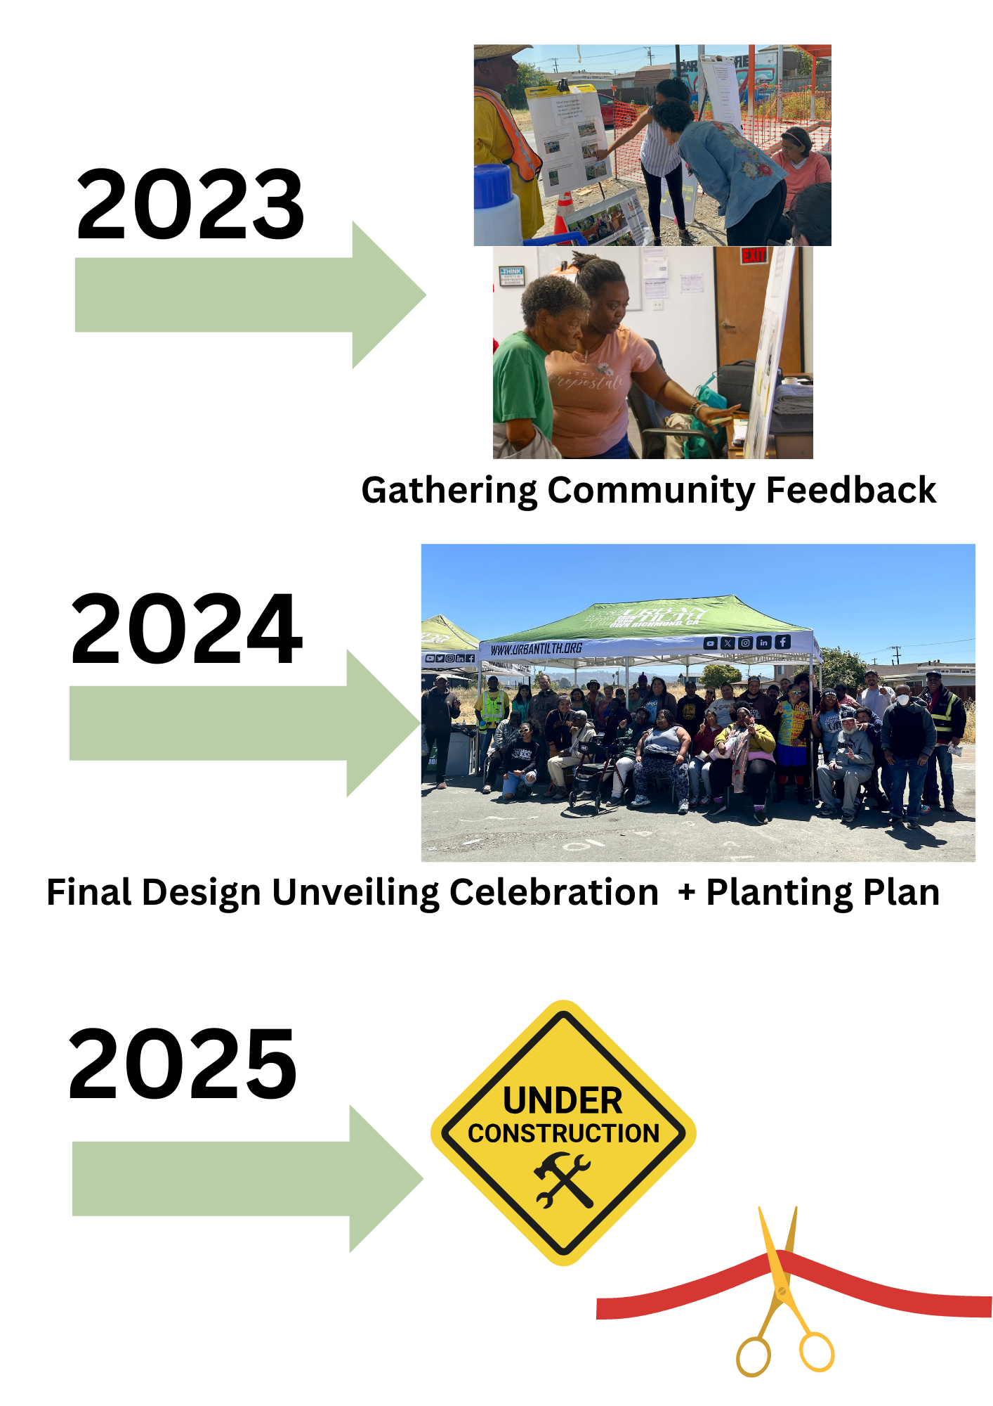
Universally Accessible Garden Design Presentation

Slide 29
Richmond Rising
Youth Fellow Program
Collaborative Stakeholder Committee (CSC) Meeting
November 13th, 2024

Slide 30
Youth Fellow Program
The Youth Fellow Program falls under the Community Engagement Plan (CEP)
The Richmond Rising Youth Fellow Program is an annual paid fellowship program for youth in Richmond.
The youth program will be overseen by Rich City Rides and the City’s TCC Coordinator.
What does the program aim to accomplish?
Provide mentorship and training by Richmond Rising and community partners.
Involve Richmond youth in helping lead engagement for Richmond Rising projects to ensure TCC implementation reflects the communities needs.
Provide the youth fellows with the necessary skills and tools to be able to enter the workforce in the future.
Promote climate equity!

Slide 31


Program Training & Orientation
There will be 4 modules and 3 trainings
Module 1- Climate Equity
The module aims to provide information on what climate equity is and how climate change affects communities and people differently.
Module 2- Richmond Rising Project & Plans
The module aims to present information about Richmond Rising and the projects that are part of Richmond Rising.
Module 3- Community Engagement
The module aims to highlight the importance of the youth interacting with community members through community projects and events.
Module 4- Organizing
The module aims to showcase community organizing and activism.
Notes:
These bullet points will be used as talking points. I will go into more detail during the presentation.

Slide 32
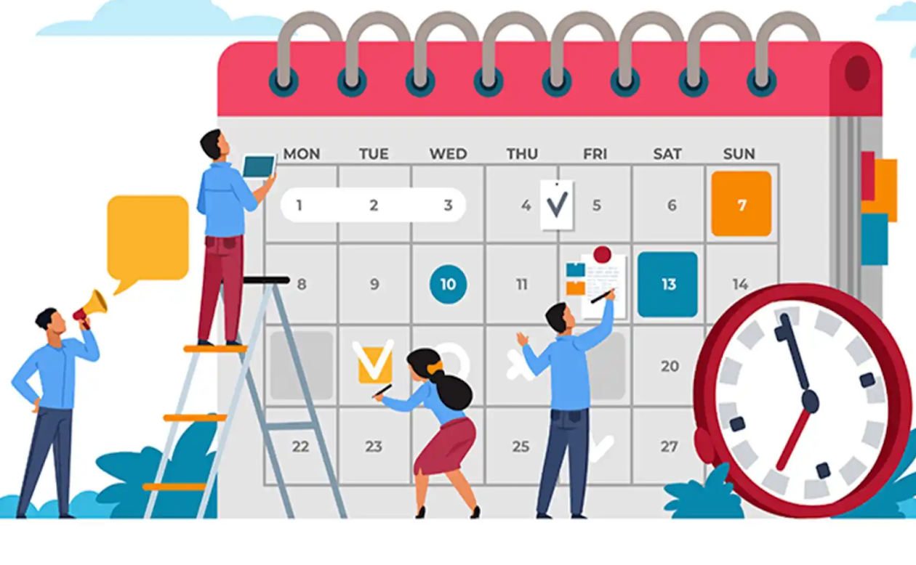

Program Training & Orientation
There will be 4 modules and 3 trainings (Contin…)
Training 1-
Topics covered: types of dress codes in the workplace, time management skills, public speaking skills, adaptability, empathy, leadership skills, communication skills, organizational skills, and soft skills vs hard skills.
Training 2-
Topics covered: clocking in & out procedures, review youth fellow journal expectations, calendar usage, and one-on-one resident mock interviews.
Training 3-
Topics covered: practice an elevator pitch, review and practice hosting for a tabling event, and review and practice set-up for hosting a bike ride.
Notes:
These bullet points will be used as talking points. I will go into more detail during the presentation.

Slide 33
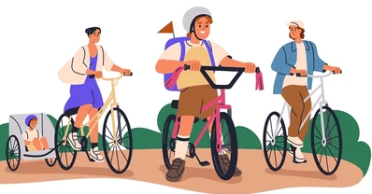

Youth Fellow Program Responsibilities
Youth Fellows Responsibilities will include but are not limited to:
Attending all program trainings & orientation
Attending at least 5 project or community meetings
Hosting up to 4 community bike rides
Conduct a minimum of 2 one-on-one resident interviews
Host up to 5 informational tables at community events
Richmond Rising Project Support
Communication and outreach
Attend the Collaborative Stakeholder Committee meetings
The Richmond Rising Youth Fellows will have 2 voting seats
Richmond Rising
Notes:
These bullet points will be used as talking points. I will go into more detail during the presentation.

Slide 34
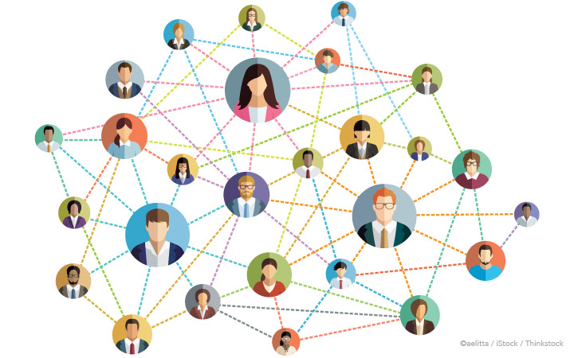

What We Offer
Paid Internship
Networking Opportunities
Flexible Schedules
Work Experience
Training and mentorship to enhance professional skills
Unlimited AC Transit monthly bus pass

Slide 35
Eligibility
Ages: 16 to 24
Work, live, or study in the Iron Triangle, Santa Fe, or Coronado Neighborhoods
Enthusiasm and willingness to learn!
Don’t think you meet all the requirements? We encourage you to apply anyways, or reach out with any questions.

Slide 36
Questions for Richmond Rising Partners
Does your organization envision collaborating with Richmond Rising Youth Fellows in 2025?
What type of activities could your organization offer them?
Could those activities be done in 10 hours per month?
What type of learning would the activities offer them?

Slide 37

Want To Stay Updated?
Scan the QR Code & sign-up for more information
Or
Contact our Richmond Rising Youth Fellows Manager
Gabriela Zacarias
Email: gzacariaslopez@richcityrides.org

Slide 38
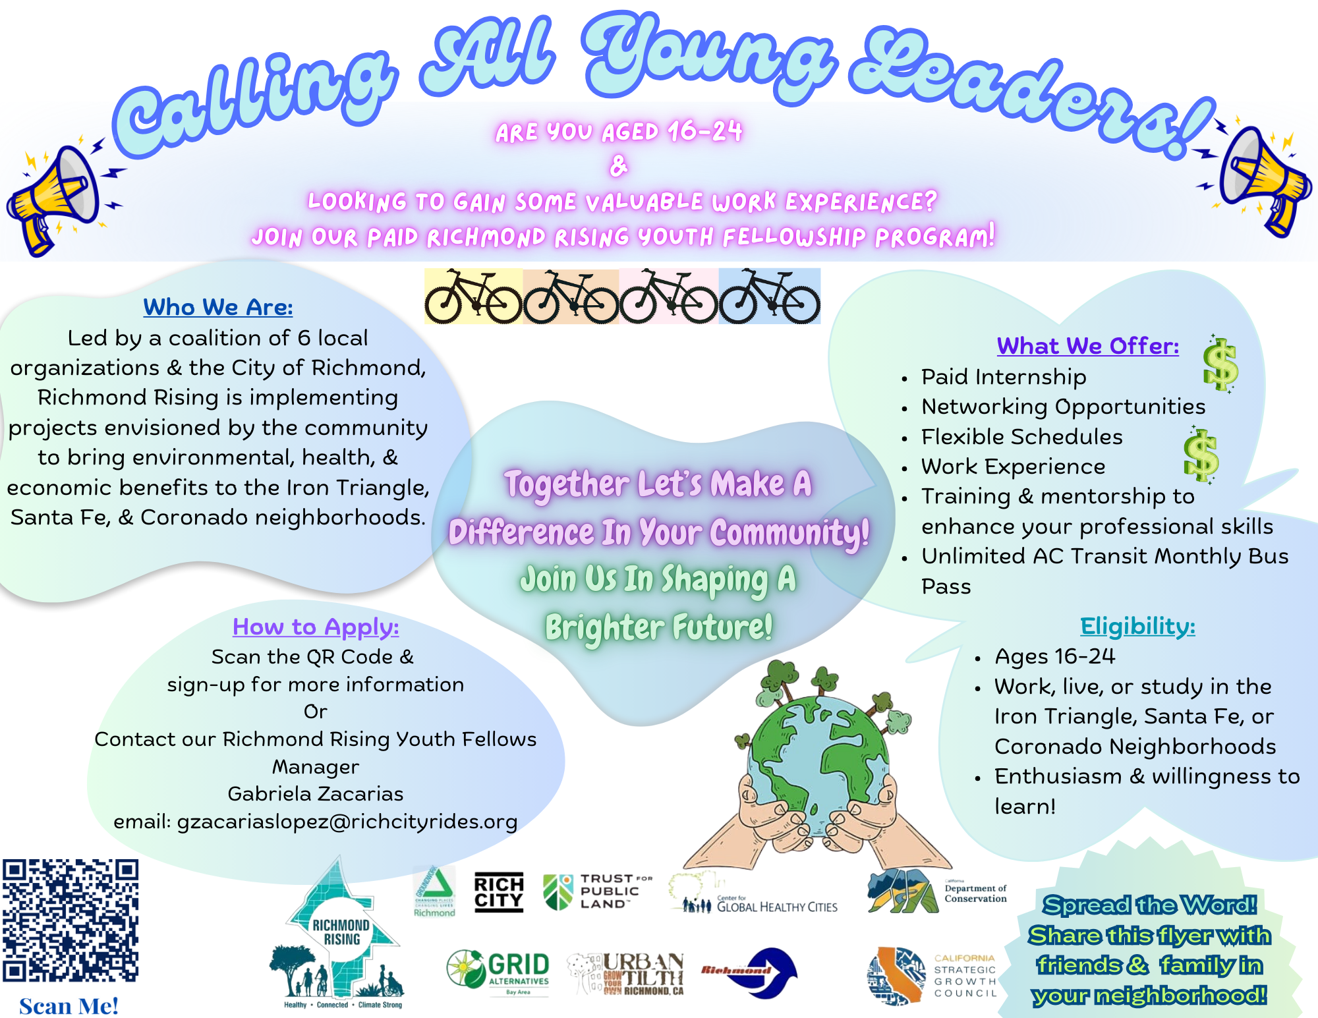

Slide 39
Together Let’s Make A Difference In Your Community! Join us in Shaping a Brighter Future!

Slide 40
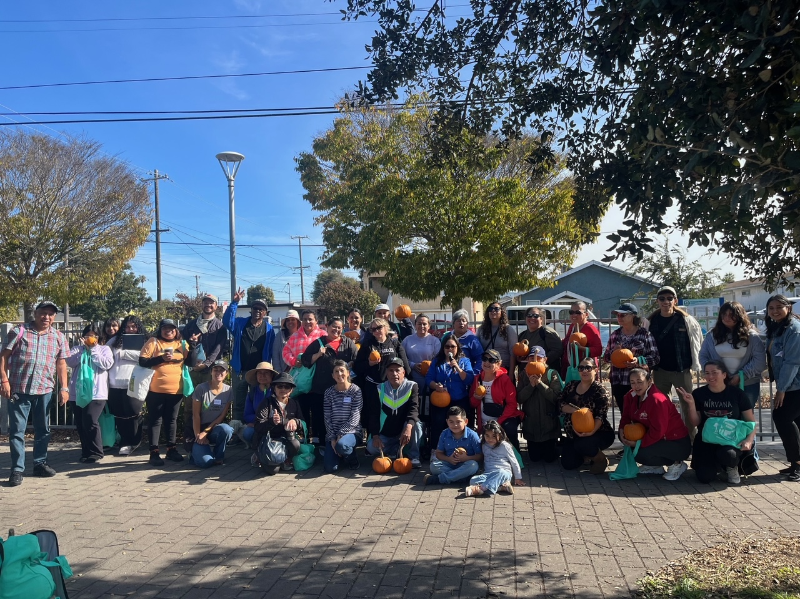
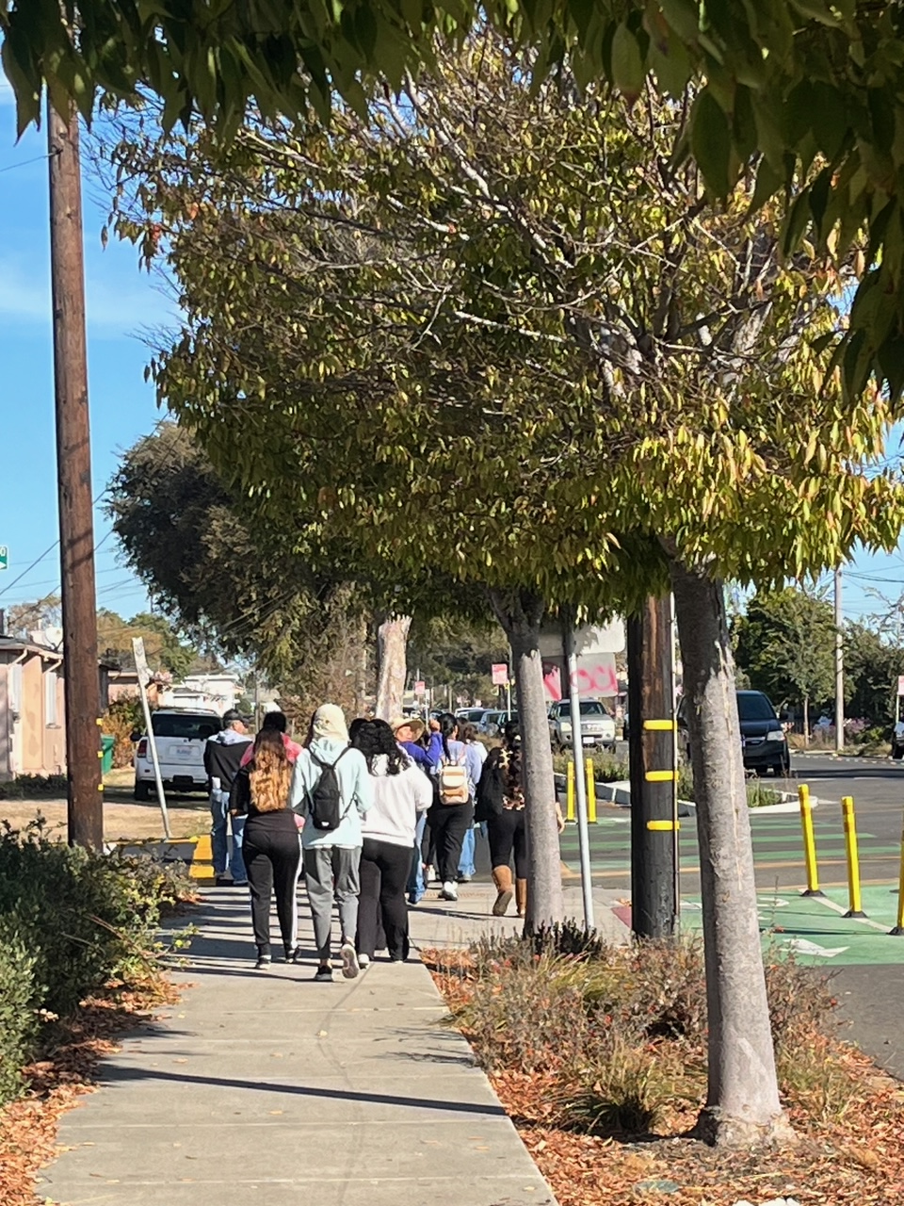
RWT Site Walk Summary

Slide 41
Rescheduling January 2025 Meeting
The Richmond Rising team is proposing to reschedule the CSC meeting from January 1st (Holiday) to January 15th, 2025.

Slide 42
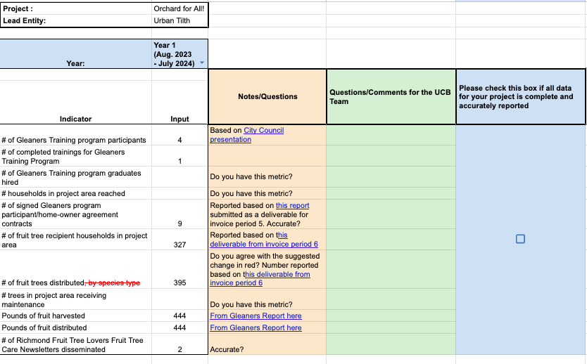
Year 1 Data Collection
Are the numbers we reported accurate?
Do you agree with any proposed changes (in red)?
Do you have any questions/comments/concerns, etc.
Please let us know if your data is complete so we can paste it into the report!

Slide 43
Agenda Requests for Next Meeting

Slide 44
General Announcements
Neighborhood Complete Streets Townhall – November 16th, 2024

Slide 45
Meeting Adjourned
Thank You!
Questions? Comments?
Please reach out at tcc@ci.richmond.ca.us

