Slide 1

Richmond Rising
Collaborative Stakeholder Committee (CSC)
February 5, 2025

Slide 2
Roll Call
Project lead for City of Richmond
Project lead for GRID Alternatives
Project lead for Groundwork Richmond
Project lead for Rich City Rides
Project lead for Trust for Public Land
Project lead for UC Berkeley
Project lead for Urban Tilth
Community member Espinoza
Community member Hernandez
Community member Gonzalez
Community member Rocha
Community member Rice
Community member Becker

Slide 3
Meeting Information
Every first Wednesday of the month 6:00 – 8:00 pm.
In-person Attendance: Nevin Community Center
598 Nevin Ave, Richmond, CA 94801
Virtual Attendance: https://ci-richmond-ca-us.zoom.us/webinar/register/wn_gx8xwknptcutbnefzdbv1w
Phone Attendance: (669) 900-6833, or (669) 444-9171
Webinar ID: 976 6319 9451
All Committee members and members of the public must abide by the Community Agreements

Slide 4
Land Acknowledgement
While Richmond Rising seeks to strengthen the economy, improve public health and the environment – particularly in the Iron Triangle, Santa Fe and Coronado Neighborhoods, we do so with the awareness that we occupy unceded Huichin and Karkin Ohlone territory.
We acknowledge that land theft of indigenous homelands, and the dismantling of indigenous sovereignty, was done to advance colonization.
We acknowledge that capitalism and white supremacy are branches of colonization that have persisted throughout hundreds of years of oppression, are alive today, and contribute to keeping Black, Indigenous, and all other People of Color from thriving.
We further acknowledge that this country’s political economy and social institutions were built on the forced labor of African people on stolen land through violent, systematic abduction from their homelands and enslavement over hundreds of years.

Slide 5
Land Acknowledgement
We further acknowledge the exploitation of immigrant and refugee communities as modern forms of cheap and disposable labor are regularly carried out on stolen land.
Thus, we acknowledge that we have been impacted and harmed by these histories and experiences imposed on our ancestors and communities. We further uplift the shared struggle among Black, Indigenous, and All People of Color.
We also acknowledge that indigenous people continue to live here, steward the land, and resist settler colonialism.
We conclude that our Land acknowledgement is an active and evolving statement and process. It requires us to recognize historical injustices and invites us in to be active participants in our collective healing.

Slide 6
Richmond Rising
The City of Richmond and 6 local organizations (together known as ‘Richmond Rising’) received $35 million to bring health, economic, and environmental benefits to the Iron Triangle, Santa Fe, and Coronado neighborhoods.
Richmond Rising is supported by the California Strategic Growth Council’s Transformative Climate Communities Program.

Slide 7
Collaborative Stakeholder Committee
Provides guidance on project implementation and holds us accountable in reaching our goals
Can make recommendations, provide input, and assist Project Leads in implementing project activities
Does not have final decision-making authority
Project Leads must consider recommendations from the Committee and members of the public

Slide 8
Public Comment Not on the Agenda
This is the space for members of the public to provide public comment on items that are not included in the agenda.

Slide 9
Review and Approve Previous Meeting Minutes
Members to review and approve previous meeting minutes

Slide 10
Project Status Reports
Each partner will share up-to-date financials and grant expenditures to date for each project and this will be shared with the Committee and the public.

Slide 11

Grantee
Work completed since last meeting:
  CSC Meeting: Scheduled, coordinated, and currently facilitating CSC meeting #11, including translation, refreshments, and childcare.
  Invoices and Reports:
      Invoice 7 for months of August and September 2024 was received.
      Invoice 8 was submitted
      Invoice 9 is under way.
    Working on Amendments and Modifications.
    Met regularly with all project partners and SGC and DOC grant managers.
Total expenditures reported to date: $243,346.81
Remaining budget: $450,328.85
Planned work in the next ~two weeks:
  Review and provide feedback to Partners on Invoice 9
  Submit invoice to SGC by February 28th.

Slide 12
Neighborhood Complete Streets
Work completed since last meeting:
  Engagement with Pogo Park on Neighborhood Complete Streets design
  Continued coordination with partners
Total expenditures reported to date: $ 23,725.61
Remaining budget: $ 5,157,447.54
Planned work in the next ~two weeks:
  Follow up meeting with Pogo Park on Neighborhood Complete Streets design
  Meeting to discuss Federal funding issues and next steps.

Slide 13

Richmond Wellness Trail
Work completed since last meeting:
  Community Engagement Planning: Coordination with the Climate Health Promoters
  AC Transit Coordination: Meeting to discuss scope where improvements overlap and intersect
  Grant Award: The Reconnecting Communities Pilot (RCP) Program from the US Dept. of Transportation (DOT) has awarded $9.5+M to complete streets projects in Richmond
Total expenditures reported to date: $ 94,208.01
Remaining budget: $ 4,721,945.59
Planned work in the next ~two weeks:
  Continued design, community engagement, and project coordination

Slide 14

eBike Lending Library
Work completed since last meeting:
  Currently working on Branding for the e-Bike Lending Library
  Participated in the 18th Annual MLK Day event on Monday, January 20, 2025
  Presented to the ECIA Committee, introducing the E-Bike Lending Library project for consideration of potential funding.
Total expenditures reported to date: $ 134,422.88
Remaining budget: $ 2,326,629.11
Planned work in the next ~two weeks:
  Meet with the ECIA Committee on February 10th to formally request financial support through ECIA funds.
  Outreach at Kennedy High's Black History Joy Event Friday February 28th
  as well as Books & Breakfast on Sat Feb 22

Slide 15

Resilient Homes
Work completed since last meeting:
  Attended and Participated in Urban Tilth's MLK Event on Jan 20, 2025
  Attended Lifelong Medical CHP meeting
  Participated in WCCUSD school fair meeting on Jan 25, 2025
  Subcontractor (MCE) began production of impact video for Resilient Homes' work
  Hired two new Community Engagement Coordinators
Total expenditures reported to date: $ 378,368.16
Remaining budget: $ 6,588,327.75
Planned work in the next ~two weeks:
  Attending Urban Tilth Senior Gardening Day by February
  24th fo program outreach purposes and Planning TCC
  Summer event

Slide 16

Basins of Relations
Work completed since last meeting:
  Ongoing design and development of Water Catchment pilot projects, to inform future homeowner installations
  Installing first combination drip + greywater system for 3rd St homeowner
  Propagation of native, drought-tolerant plants in our native plant nursery for future homeowner installations.
  Completed 29 homeowner installations in total in 2024, well ahead of our goal of 20 systems.
Total expenditures reported to date: $ 205,612.36
Remaining budget: $ 1,475,091.42
Planned work in the next ~two weeks:
  1 laundry-to-landscape installation scheduled
  1 drip irrigation installation scheduled

Slide 17

Bosque del Barrio
Work completed since last meeting:
  Planted 7 new trees on MLK Day on the Greenway
  100+ volunteers
  Planted 4 new residential trees
  Canvassed for new Adopt-A-tree spots
Total expenditures reported to date: $ 132,086.95
Remaining budget: $ 955,925.80
Planned work in the next ~two weeks:
  Continue to canvass for tree adoptions
  Coordinating next volunteer opportunity- President's Day/Cesar
  Chavez Day

Slide 18
ADA Accessible Garden
Work completed since last meeting:
Paid the plan review fees to the City of Richmond
  Talked with contractors about the upcoming project
  Worked on finalizing the project specifications
  Talked with the County regarding the CDBG funding component
Total expenditures reported to date: $ 64,678.23
Remaining budget: $ 890,365.77
Planned work in the next ~two weeks:
  Plan review comment back in the next couple of weeks
  Incorporate the comments into the plans to resubmit
  Getting an updated construction cost estimate after resubmittal

Slide 19
Orchard for ALL!
Work completed since last meeting:
  Organized curriculum and collected all materials for the apprenticeship
  Launched separate forms for both gleaning and tree care to better intake
  Helped update our website with all corresponding services Orchard For All! offers
  Opened application to the public for apprenticeship (closing this Friday, Feb. 7th)
Total expenditures reported to date: $ 106,353.89
Remaining budget: $ 1,061,859.74
Planned work in the next ~two weeks:
  Conduct and Complete interviews for apprenticeship
  Pick up 400 fruit trees and all other materials for the Fruit tree giveaway event
  Continue doing tree care to tree care recipients for winter pruning.
  Finish updates on the website with the communications team for OFA! Landing page

Slide 20
Veggie Rx
Work completed since last meeting:
  Veggie Rx team participated in group cooking class to learn new skills for 2025 cooking demos
  Scheduled workshop for January with the Coronado Neighborhood Council
  Hosted 10 HEAT Classes (English and Spanish)
  Hosted a New Year dinner for Climate Health Promoters (January 22nd)
Total expenditures reported to date: $ 485,998.69
Remaining budget: $ 2,752,873.31
Planned work in the next ~two weeks:
  Schedule CFD Workshop with FIERCE Advocates for March
  Update CFD Curriculum for different audiences

Slide 21
E-Bike Share
Work completed since last meeting:
  Continued maintenance and operations of existing bike hubs
  Develop and release survey for additional location in District 5 (outside of Project Area)
  Ride Today and City met to discuss most recent data
Total expenditures reported to date: $ 466,088.31
Remaining budget: $ 532,890.90
Planned work in the next ~two weeks:
  Collect and share data on vouchers with SGC for reimbursement

Slide 22
Community Engagement Plan
Work completed since last meeting:
  Youth Fellow Program:
    Outreach and tabling opportunities for recruitment at MLK Day of Celebration event, tabling the Education Fair, John F. Kennedy High School and El Cerrito High School.
    Weekly posts on Instagram and Facebook sharing the Youth Fellow Program Outreach Flyer.
    Posted the Youth Fellow Outreach Flyer on the Richmond Rising Website.
    Received a total of 10 applicants for the Youth Fellows Program
Total expenditures reported to date: $ 161,866.52
Remaining budget: $ 2,404,166.21
Planned work in the next ~two weeks:
Youth Fellow Program:
  Continue recruitment: reaching out to local schools to share more about the
  Youth Fellow program.
  Review applications and send offer letters to youth fellow applicants.
  Applications close February 10th.

Slide 23
Displacement Avoidance Plan
Work completed since last meeting:
  Housing Fellow began their work with Partnership for the Bay's Future
Total expenditures reported to date: $ 133,414.66
Remaining budget: $ 548,220.96
Planned work in the next ~two weeks:
  Onboarding Housing Fellow to begin work on the Community Land Trust policy
Notes:
The levying of taxes for DRPBID is applicable to many parcels in the downtown area. The money goes to improving the Downtown area and is also the budget for Richmond Main Street Initiative.

Slide 24
Workforce Development and Economic Opportunity Plan (WDEOP)
Work completed since last meeting:
  GRID Alternatives started official recruitment for first solar training cohort including:
    Distributed recruitment flyers to City of Richmond and TCC partners
    Attended/tabled at Urban Tilth's MLK day event at Unity Park and WCCUSD Education Fair
    Recruitment announcement in our regional monthly newsletter
  Finalized Spanish translation of Workforce Development Strategy
Total expenditures reported to date: $ 101,482.90
Remaining budget: $ 1,332,324.84
Planned work in the next ~two weeks:
  GRID Alternatives continue to recruit for solar training cohort

Slide 25

Indicator Tracking Plan
Work completed since last meeting:
  Finalized Year1 Report Draft and submitted to the City for feedback;
  Finalized case studies (Veggie Rx and ADA Garden), included in the report.
  Ran CARB models to quantify Green House Gas emission reductions in year 1
Total expenditures reported to date: $ 0
Remaining budget: $ 1,070,000
Planned work in the next ~two weeks:
  Submit CARB templates to the City
  Receive and Implement feedback on year 1 report

Slide 26
Report on Public Comments & Questions
Report out on any community questions or comments received, including responses

Slide 27
Committee Business Items for Discussion
Fruit Tree Giveaway Promotion
NCS Status Update
Place-Based Workforce Development Strategy Presentation
Climate Health Promoters Planning

Slide 28
Fruit Tree Giveaway Program
Orchard For ALL! Fruit Tree Giveaway will take place on March 8th, 2025 from 10 am – 1pm at Unity Park Plaza 1605 Ohio Ave, Richmond, CA 94804
FREE Fruit Tree Giveaway for Iron Triangle, Santa Fe, & Coronado Residents
Different fruit tree varieties will be distributed like oranges, limes, lemons, apples peaches and much more!
Please bring a cart if you want more than 2 trees.
All recipients of the giveaway must book an on-site follow-up consultation with our OFA! Team

Slide 29
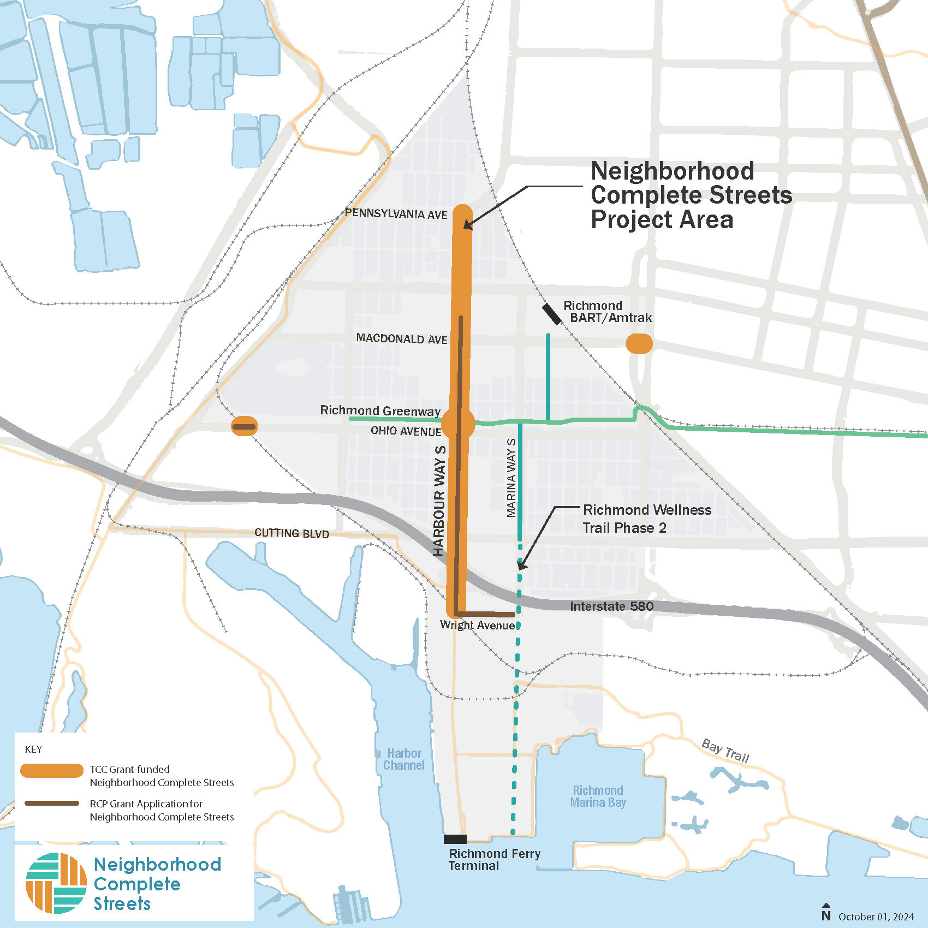
Neighborhood Complete Streets Update
  The Neighborhood Complete Streets project focuses on improving walking and biking access for residents of the Iron Triangle, Santa Fe, and Coronado neighborhoods.
  The project will support connections between neighborhoods, downtown Richmond, the Richmond Greenway, and the Richmond Ferry terminal.

Slide 30
Neighborhood Complete Streets
  This project will improve conditions for walking, biking, and taking the bus on:
  Harbour Way South
  Ohio Avenue
  Macdonald Avenue
  Additional grant funding may become available:
  Harbour Way – Enhanced design
  Wright Avenue – Continuous sidewalks
Additional Funding Awarded!

Slide 31
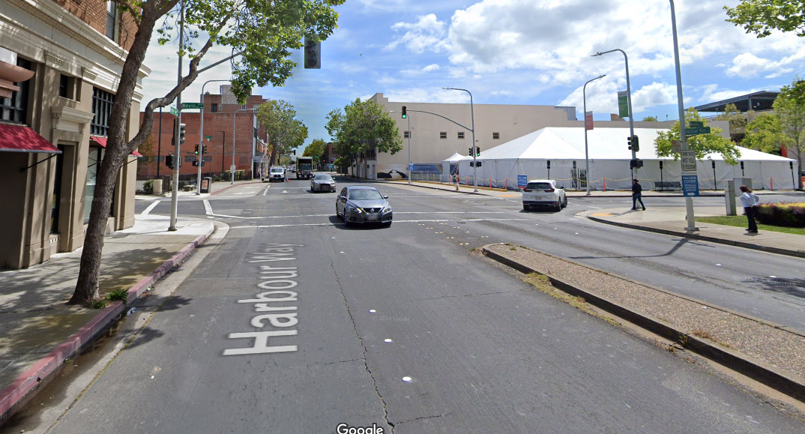
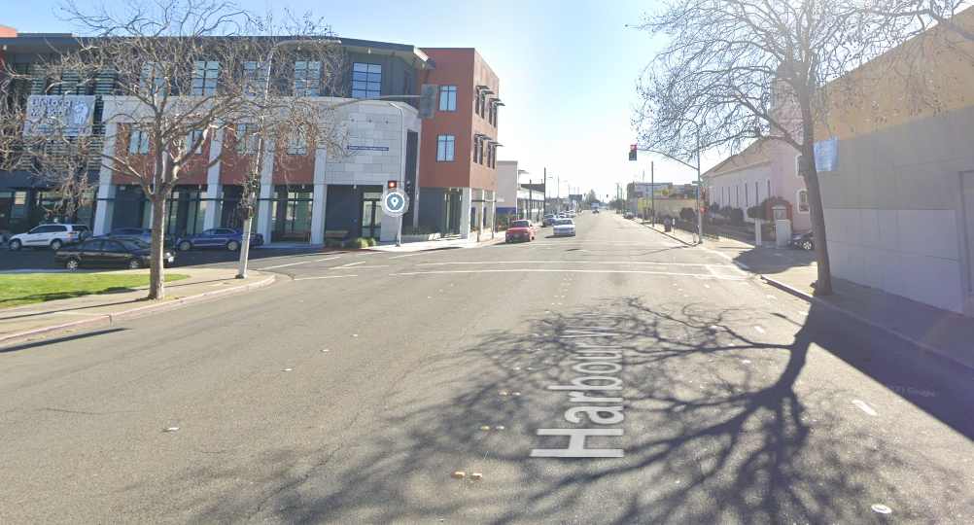
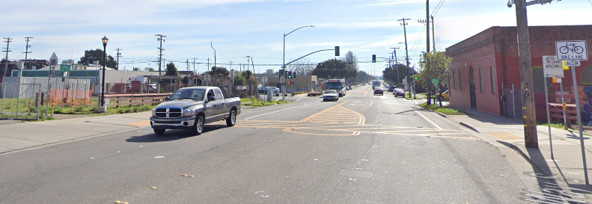
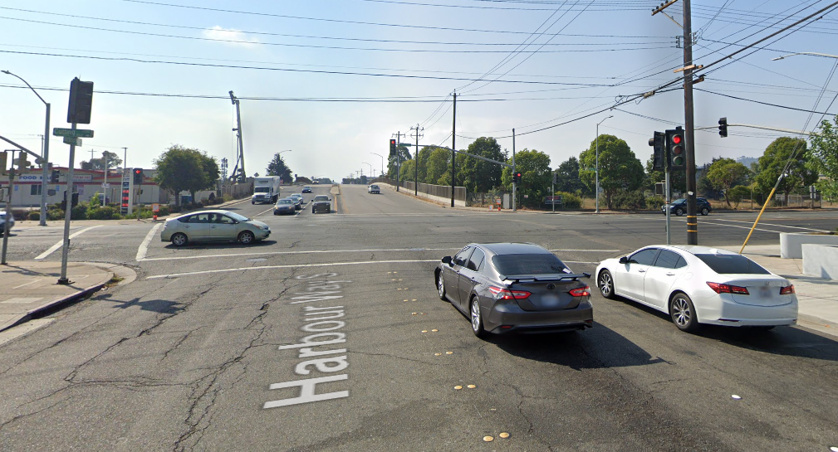
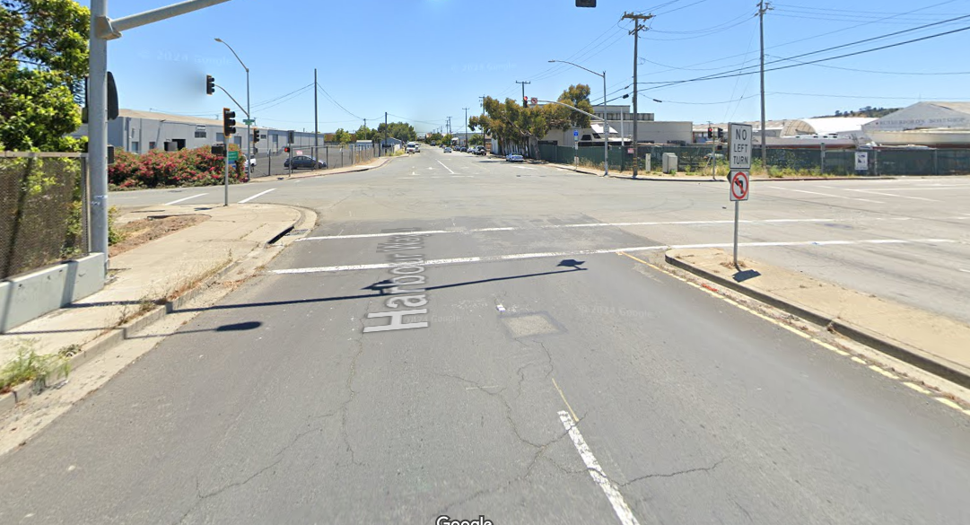
Neighborhood Complete Streets
  Harbour Way (Pennsylvania to Wright)
  Traffic signals
  Bus stops
  Roadway surface
  Bike lanes (Nevin to Wright)
  Pedestrian crossings
  Sidewalk amenities
  Street trees

Slide 32
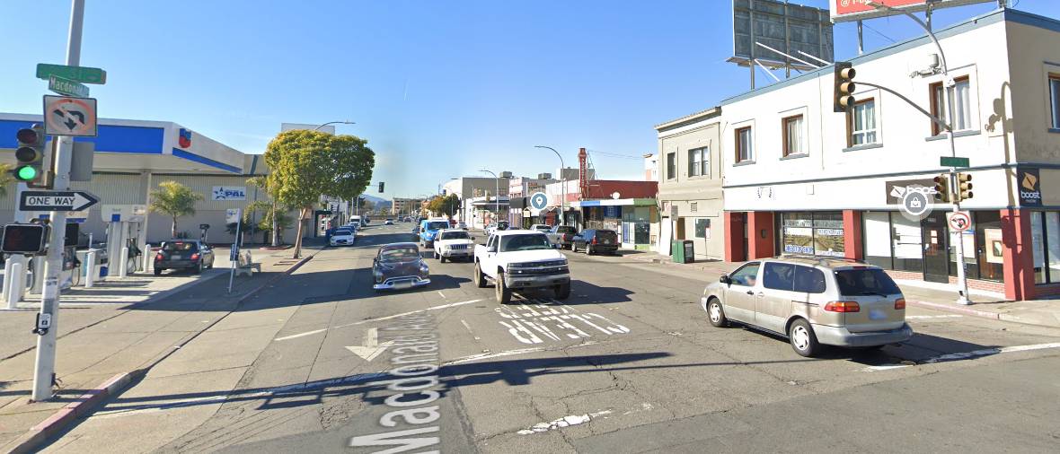
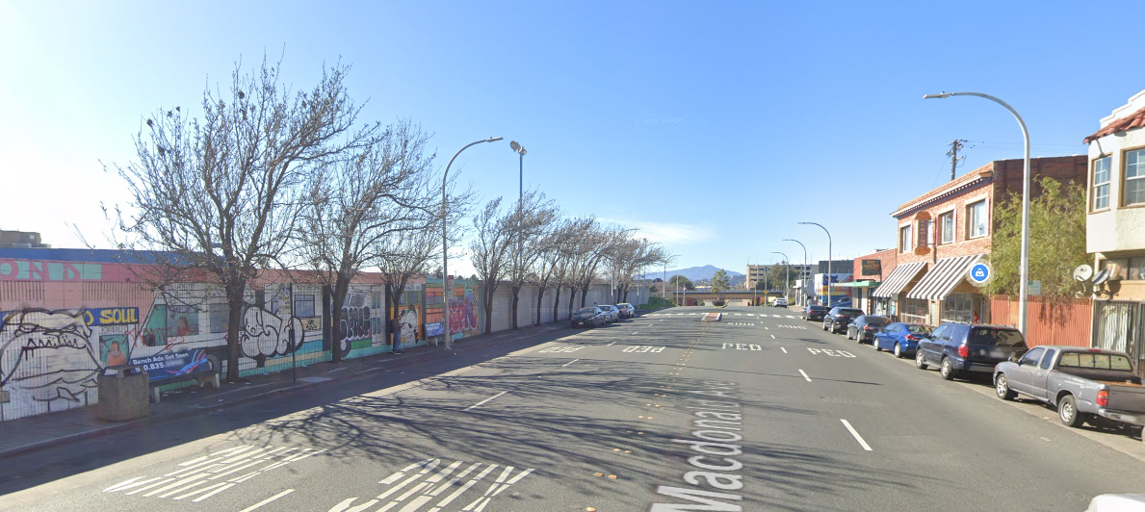
Neighborhood Complete Streets
  Macdonald Ave Bus Stops (21st to 23rd)
  Shelters
  Lighting
  Accessibility upgrades

Slide 33
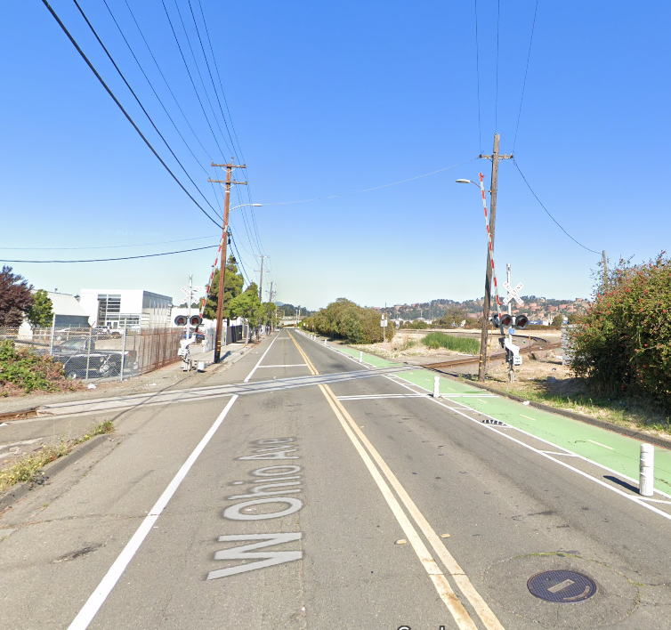
Neighborhood Complete Streets
  Ohio Avenue @ BNSF Crossing
  New paving behind the existing railroad gates
  Installation of new grade-crossing panels, warning lights, bicycle gates, and signage that complies with Federal Railway Administration standards.

Slide 34
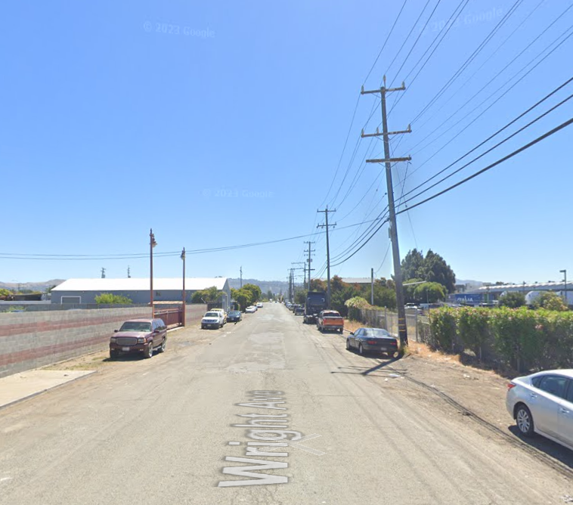
Neighborhood Complete Streets
  Wright Avenue
  Continuous sidewalk (both sides)
  Marina Way
  Signal upgrade at Cutting Blvd
  Signal upgrade at Wright Ave.
  Pedestrian lighting

Slide 35
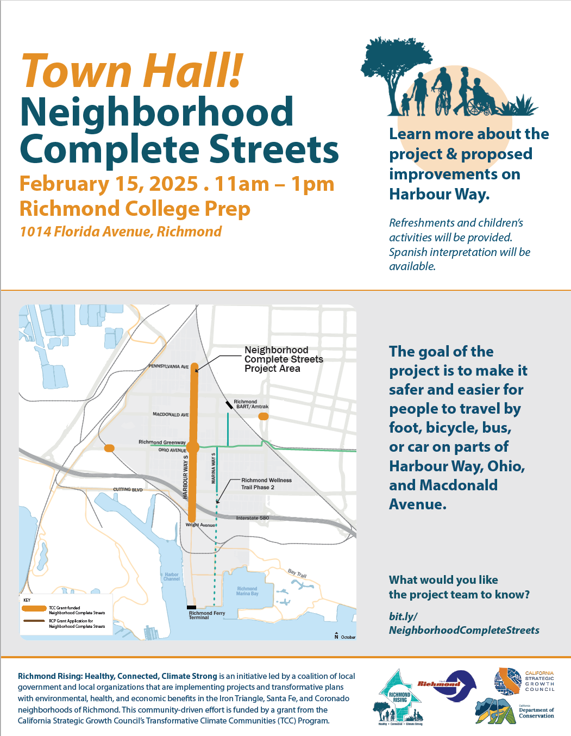
Town Hall #1 Feedback
  Top Comments
  Cars drive too fast, especially between Macdonald and Cutting Blvd.
  Pedestrian crossings feel very unsafe near the Greenway and the schools (Ohio, Florida, Maine, & Virginia)
  Signals downtown are confusing (Barrett, Nevin, Macdonald)
  Bike lanes in other locations in the city feel unsafe.
  Plant more trees!
See design team’s proposed response and give your feedback

Slide 36
Neighborhood Complete Streets
You are invited
Project Kick off
Inicio del proyecto
Permitting and Construction
Permisos y Construcción
Preliminary Design
Diseño Preliminar
50% Design
Diseño básico
Final Design
Diseño Final
#1
#2
#3
#4
November 13-16, 2024
February 15, 2025
11:00am – 1:00pm
Richmond College Prep
1014 Florida Ave
May 2025
July 2025

Slide 37
Place-Based Workforce Development Strategy Presentation
Workforce Development and Economic Opportunity Plan, Task 1.
Objective: Develop a Place-Based Workforce Development Strategy and Implementation Plan for the Transformative Climate Communities (TCC) grant focused on the Iron Triangle, Santa Fe, and Coronado neighborhoods.
Document: Richmond Rising Place-Based Workforce Development: Findings Report
  https://richmondrisingca.org/resources/ (English/Spanish)

Slide 38
Place-Based Workforce Development Strategy Presentation
Planning Project Overview:
Discovery Work (July to Oct)
Produce final report of research findings and emerging recommendations, overall strategy, and priority activities for next 12 months.
Check on implementation progress to date and plan modifications needed.
Design (Oct to Nov)
Collect relevant local, state and national workforce data.
Conduct informational interviews.
Delivery (Dec to April)
Draft summary of research findings and emerging recommendations.
Develop overall strategy and annual plan.

Slide 39
Place-Based Workforce Development Strategy Presentation - RECOMMENDATIONS
Pathways Model
Implement a structured approach for career progression that considers young people (16 years and older).
Create direct pathways from training to employers and job placement.
  Consider starting with Richmond Rising projects and Green-Blue New Deal jobs projects.
  Explore partnerships and funding for additional training and workforce development projects related to healthcare, social assistance, leisure, and hospitality that could be integrated with Richmond Rising.
  Engage with employers to understand their job openings, application processes, and attributes of a successful applicant and employee.
Provide career exploration pathways and opportunities for young people, including high school programs.
Provide step-by-step guidance for skill development by identifying the hard and soft skills needed for jobs in the area.
Offer mentorship programs to support career growth by engaging program alumni / recent graduates.

Slide 40
Place-Based Workforce Development Strategy Presentation - RECOMMENDATIONS
2. Central Hub
Establish a centralized resource center in the project area where residents can stop by for workforce development opportunities and develop an online presence where residents can access similar information and resources.
Create a one-stop platform (physical and online) for residents to access basic employment skills, the Internet and computers, and information on projects, job training, and career opportunities in the project area.
Implement co-branding strategies with community-trusted entities, such as the City of Richmond, and host ‘open house’ events or attend local events to become more visible to the community.
Improve website navigation and information accessibility on both the Richmond Rising and City of Richmond websites. Ensure that both have the same information or link to the same webpage with relevant information.
Enhance collaboration among existing workforce development initiatives.
Introduce job coaches to provide personalized support:
  Assist with goal-setting and career planning.
  Identify skill gaps and coordinate training.
  Offer support for overcoming barriers (e.g., computer literacy).

Slide 41
Place-Based Workforce Development Strategy Presentation - RECOMMENDATIONS
3. Strengthen Partnerships
Foster connections between workforce development programs and local employers and / or unions:
Develop partnerships to help bridge the gap between training programs and employment needs by directly contacting area employers.
Educate local employers about available training programs and their outcomes.
  Encourage employers to waive certain degree or certification requirements for those who complete training programs.
Seek to understand local employer green-blue job needs better and align training programs with needs.
Foster connections between workforce development programs and social services to address barriers to participation and / or future employment.
Share information on available resources in the project area or online to address barriers.
Connect job coaches with social service case managers or coordinators.
Establish a clear referral system to quickly connect individuals with resources to address barriers.

Slide 42
Place-Based Workforce Development Strategy Presentation - RECOMMENDATIONS
4. Support Small Businesses and Business Development
Enhance the local business ecosystem.
Revitalize Chamber of Commerce membership, focusing on small businesses.
Encourage local businesses to support workforce development in their communities.
Develop programs to assist businesses in hiring and retaining local talent, including formerly incarcerated individuals.
Offer trainings on how to start a business and business advertising.
Develop a process for supporting undocumented residents with starting their own

Slide 43
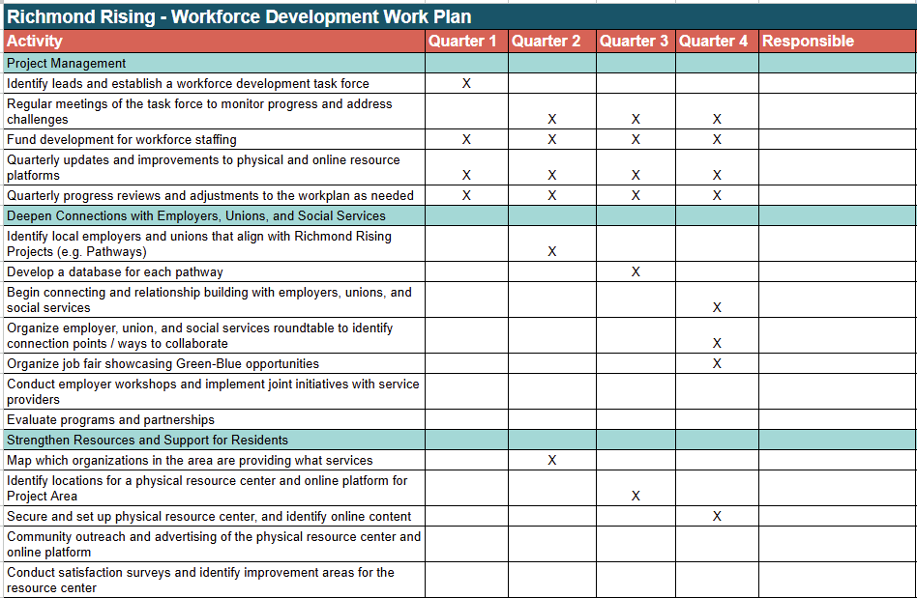
Place-Based Workforce Development Strategy Presentation

Slide 44
Climate Health Promoters Planning

Slide 45
Agenda Requests for Next Meeting

Slide 46
General Announcements
CSC Members, members of the public, and other partners or organizations are encouraged to share information or announcements related to upcoming events, projects, or programs in the Project Area

Slide 47
Meeting Adjourned
Thank You!
Questions? Comments?
Please reach out at
tcc@ci.richmond.ca.us

